Slide 1
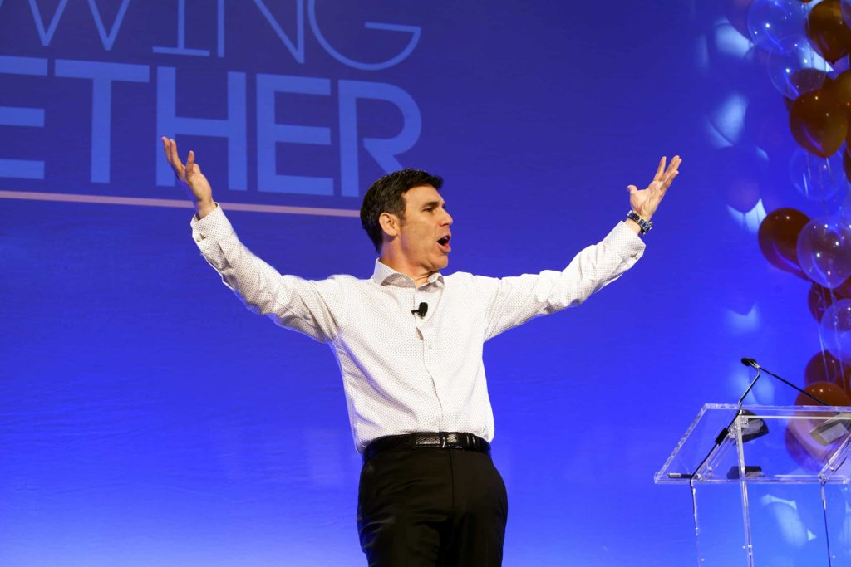
Opening Keynote: Garrison Wynn

Slide 3
Engaged clients, employees, contractors and coworkers are:
40x more likely to recommend you
15.5x more likely to stay with you
9x more likely to enjoy working with you
43% safer and more focused on the job
86% more likely to be loyal
4.5x more likely to recommend their organization’s products and services.
Making people feel valuable and focusing much more on strengths than weaknesses allows everything else you do to get better results.

Slide 4
WEBSITE GARRISONWYNN.COM
FACEBOOK /GarrisonWynn LINKEDIN /in/GarrisonWynn
TWITTER @Garrisonwynn
INSTAGRAM /keynotespeakergarrisonwynn
NOTES
Download today’s notes from https://www.motivational-speaker-success.com/notes/
OR Text GARRISONWYNN (one word ) to 90210 Text SAFETY NOTES to 90210 for the safety version.
YouTube.com/ GarrisonWynn
Increase engagement and improve performance: https://www.motivational-speaker-success.com/evolve/
Search “Garrison Wynn” on Amazon.com for Garrison’s books

