Slide 1
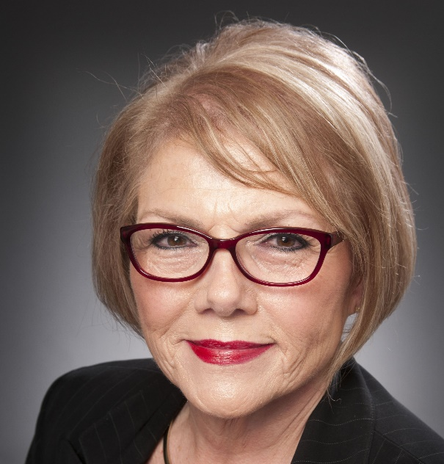
Business & Industry Leadership Team BILT
Dr. Ann Beheler
Principal Investigator
National Convergence Technology Center

Slide 2
National Convergence Technology Center
National Science Foundation Center of Excellence in Convergence Technology (CTC) is based at Collin College, Frisco, TX (2012-2022)
The CTC works with a wide range of business leaders from across the nation to determine the Knowledge, Skills, and Abilities that they want “workforce ready” graduates to posses for the future
BILT information is disseminated nationally to colleges and universities, including 80 who share curriculum and guidance with one another through a “mesh” network

Slide 3
MAJOR GOAL FOR ALL HIGHER EDUCATION PROGRAMS and EMPLOYERS
STUDENTS complete certificates and degrees and are well-qualified for ready employment or transfer
EMPLOYERS are highly engaged and want to hire students
Implementing the Business & Industry Leadership Team (BILT) Model helps to meet both goals, and it’s proven effective.

Slide 4
ESSENTIAL ELEMENTS OF BILT MODEL
Businesses must co-lead programs (not whole departments or divisions), typically via quarterly meetings
Prioritize Knowledge, Skills and Abilities (KSAs) they want graduates to have 12-36 months into the future (annually)
Predict Labor Market Demand
Predict trends (at the other 3 quarterly meetings)
Faculty must
Cross reference KSAs to existing curriculum
Update curriculum to address KSAs needed by businesses
Provide businesses with feedback regarding implementation

Slide 5
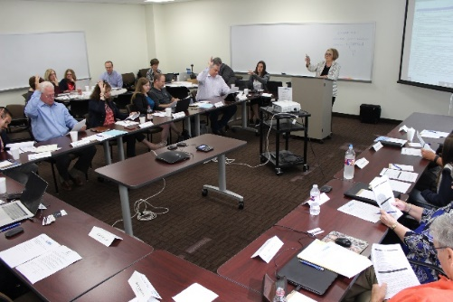
ESSENTIAL ELEMENT CO-LEADERSHIP
Employers report they are more likely to hire graduates from programs for which they have curricular leadership responsibility
Employers report they will assume this role (and more) if
Their time is respected
There is a method for ensuring that their input is consistently and seriously considered by the faculty members
They consistently receive feedback on their recommendations

Slide 8
Resources
BILT resources from the National Convergence Technology Center on “Business tab” of http://connectedtech.org
60-minute “BILT Basics” webinar bit.ly/BILTbasic
10-minute “Job Skills Validation Vote” webinar bit.ly/jobskillsvote
“An Inside Look at the BILT” brochure bit.ly/BILTinside
20-minute “Using Google Tools” webinar bit.ly/KSAGooglevideo
abeheler@collin.edu
abeheler@gmail.com

