Slide 1
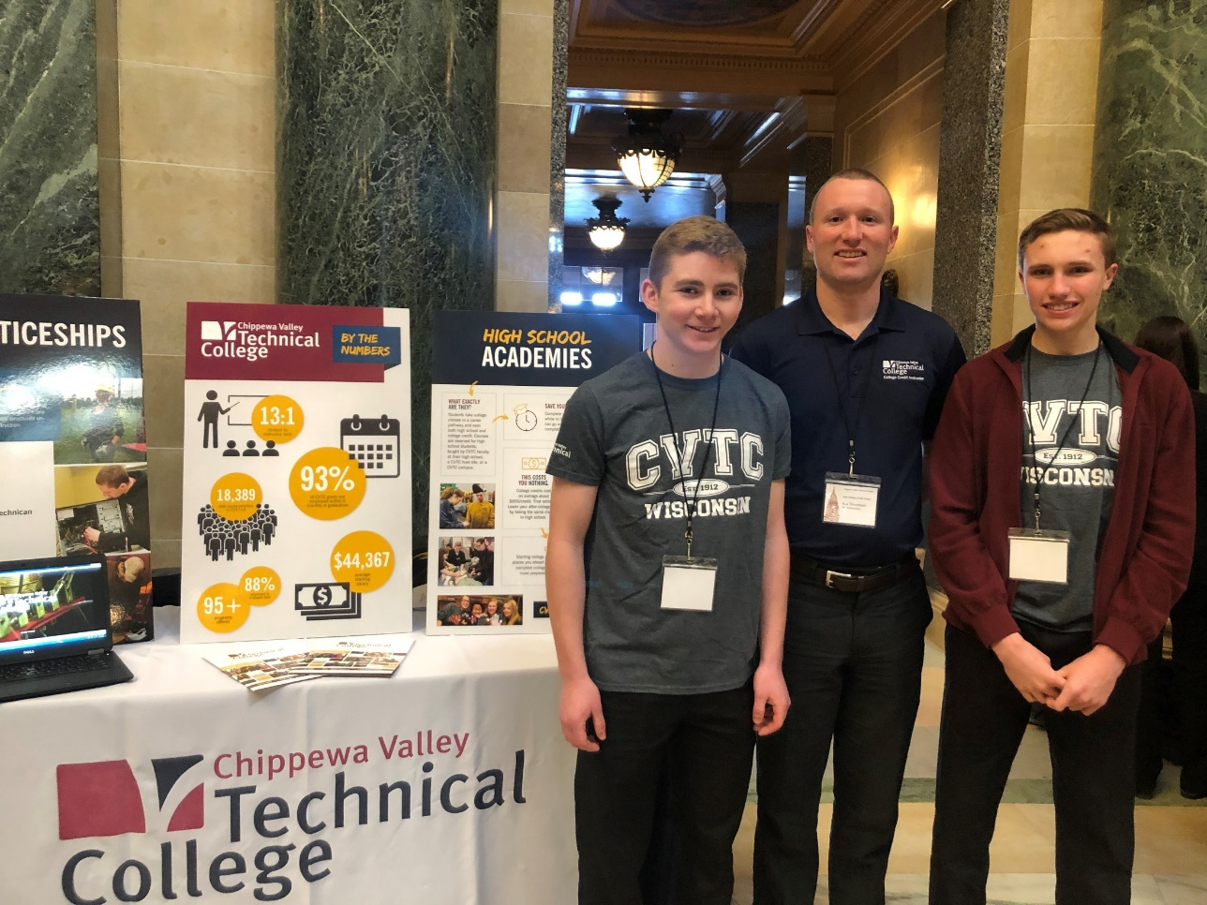
High School Academies
An Innovative Approach to Earning College Credit in High School
………………………………………………………………………………………………………………………….

Slide 2
An Innovative Approach to Earning College Credit in High school
………………………………………………………………………………………………………………………….
Chippewa Valley Technical College
Kristel Tavare
Director of PK-12 Initiatives
Keith Stearns
High School Academy Specialist
Laura Volbrecht
Fall Creek School Counselor
Notes:
All

Slide 3
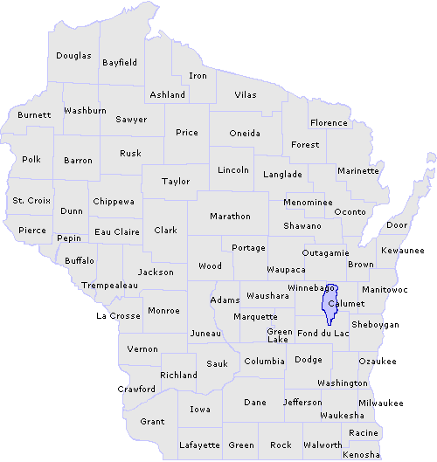
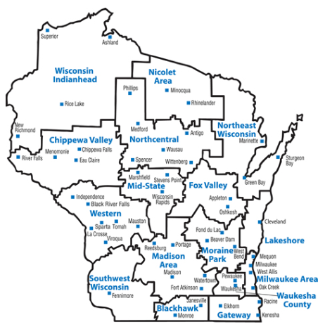
Chippewa Valley
……………………………………………………………………………………………………………………….
Where in the world is the Chippewa Valley?
Population we serve
Notes:
Keith Stearns

Slide 4
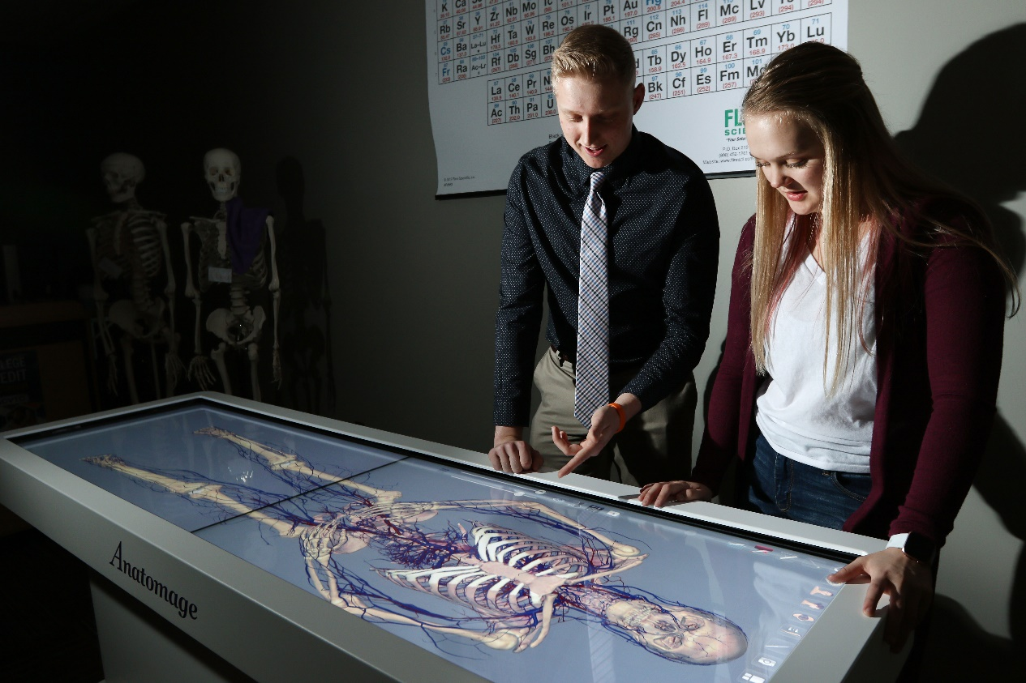
DUAL CREDIT
OPPORTUNTIES
……………………………………………………………………………………………………………………….
High School Academies
Start College Now
Transcripted Credit
Notes:
Laura

Slide 5
HIGH SCHOOL PARTNERSHIP
OPPORTUNITIES
……………………………………………………………………………………………………………………….
Transcripted Credit
High school teacher meets the higher learning commission requirements
High school teacher works with CVTC faculty to create 100% course match
High school teacher in the high school offers CVTC courses
Start College Now
CVTC courses taught at CVTC or online by CVTC instructor
Students apply for courses by March 1 or October 1 of each year
If a seat is available the students register for the class
Notes:
Word to the wise- Kristel

Slide 6
HIGH SCHOOL PARTNERSHIP
OPPORTUNITIES
……………………………………………………………………………………………………………………….
High School Academies
A series of courses taught by a CVTC instructor for a group of high school students
Often lead to an industry credential
Section is set up exclusively for high school students.
Notes:
Word to the wise- Kristel

Slide 7
Growth in High School Academies over 5 years
High School Academies
 | Total Student Count | Student Count (Earning A to C) | Credits Attempted | Successful Credits (C or Better) | Money Saved | High Schools with Academies
2015-16 | 16 | 15 | 123 | 117 | $15,023 | 2
2016-17 | 207 | 191 | 965 | 867 | $113,013 | 20
2017-18 | 399 | 357 | 1,928 | 1,739 | $229,896 | 33
2018-19 | 398 | 347 | 2,236 | 2,004 | $268,937 | 41
2019-20 | 604 | 570 | 3,462 | 3,260 | $445,030 | 54
26% of HSA Seniors enrolled at CVTC in 2020!
Notes:
Kristel

Slide 8
High School Academy Program 2018-2019
Kb
NUMBER OF ACADEMIES
398
CREDITS EARNED
54
SUCCESSFUL STUDENTS
3260

Slide 9
High School Academies
https://www.cvtc.edu/admissions/college-credit-opportunities-in-high-school/hs-academies

Slide 10
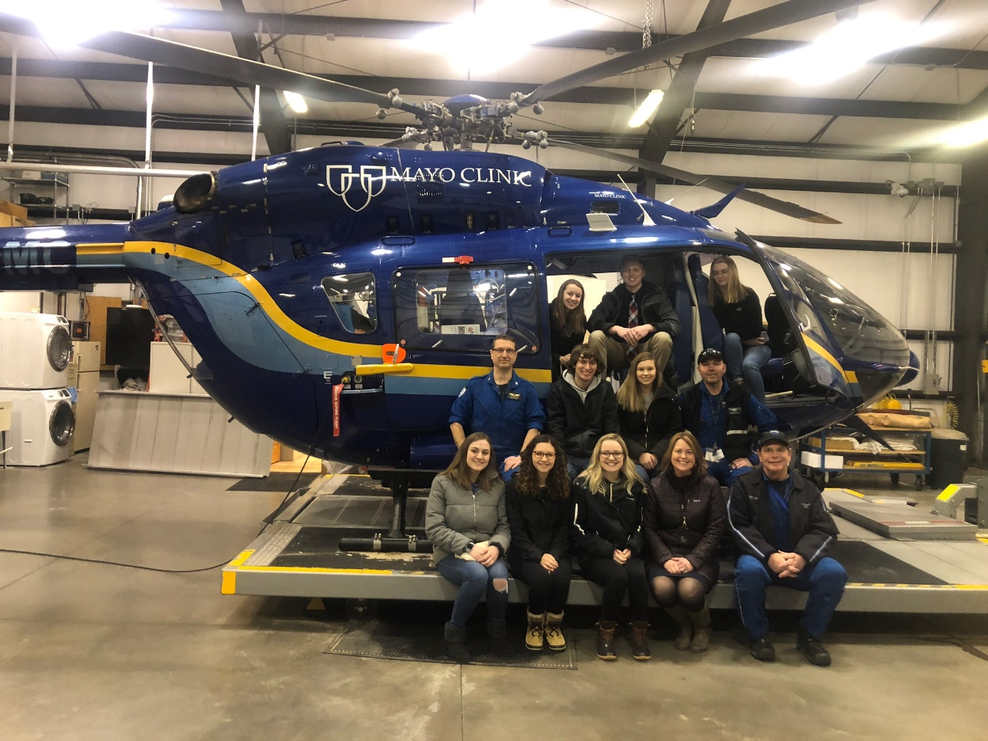
The K12 Perspective
……………………………………………………………………………………………………………………….
Laura Volbrecht: School Counselor, Fall Creek School District,
A K12 Perspective
What role do High School Academies play
from a K12 perspective?
How do High School Academies connect
with K12 Academic and Career Planning?
What are high school student perceptions
of high school academies and college
opportunities offered at CVTC?

Slide 11
GROWTH IN DUAL CREDIT
OPPORTUNTIES
……………………………………………………………………………………………………………………….
What are the benefits to the stakeholders?
High Schools
Students
Post Secondary
Employers
How do high schools fund these opportunities?
CTE Incentive Grant Funding
EMT1/EMR, EMT2, Firefighter
Notes:
Word to the wise- Kristel

Slide 12
Healthcare Academy
https://www.youtube.com/watch?v=Zl99hWUPzkQ&feature=youtu.be

Slide 13
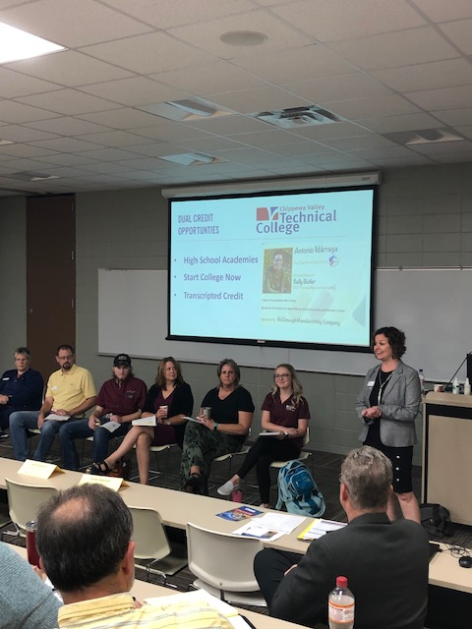
Academy Process
……………………………………………………………………………………………………………………….
How do you coordinate a high school academy?
Healthcare Chippewa Falls School District
ECASD Healthcare Academy
How do you determine the need for a high school academy?
Notes:
Kristel/Laura: Work with high school and college dean to determine location, resources, and faculty availability.

Slide 14
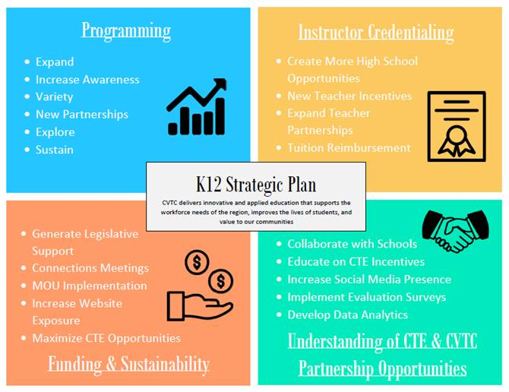
THE FUTURE
DETERMINING THE NEED ……………………………………………………………………………………………………………………………….
What do we offer?
Studer Group Strategic Planning 2018-2019 with our 42 districts
Identify school district needs
Focus on the K12 Strategic Plan
Coordinate with Deans and Program Directors

Slide 15
College Credit Opportunities
DUAL CREDIT OPPORTUNTIES
…………………………………………………………………………………………………………………………….
https://www.cvtc.edu/admissions/college-credit-opportunities-in-high-school/hs-academies
Notes:
Keith: Share different academy options, application process, stacked academies

Slide 16
Business Management Embedded Associate’s Degree Partnership
………………………………………………………………………………………………………………………….
Students:
Apply online as incoming freshmen
Earn both high school and college credit (dual credit)
Explore Career Pathways
Graduate with Associate’s Degree & High School Diploma
Notes:
Keith Review all academy opportunities for students in high school.

Slide 17
Business Management Embedded Associate’s Degree Partnership
………………………………………………………………………………………………………………………….
Benefits: Time & Money
Enter workforce sooner
Bachelor’s Degree within 2 years
$11,920 plus books and fees
Time
Money
Notes:
Keith Review all academy opportunities for students in high school.

Slide 18
Business Management Embedded Associate’s Degree Partnerships ………………………………………………………………………………………………………………………….
Notes:
Review all academy opportunities for students in high school.

Slide 19
High school partnerships Opportunities
Transcripted Credit Courses (Cost Neutral)
High school teacher meets the higher learning commission requirements
High school teacher works with CVTC faculty to create 100% course match
High school teacher in the high school offers CVTC courses
AP Credit Courses (Student pays for AP Test Cost)
Instituted and administrated by high school
Courses delivered by high school instructors
Student must get appropriate score on AP test for college credit
High School Academies Courses (High School Pays for Course and Materials)
A series of courses taught by CVTC instructor for a group of high school students
Section is set up exclusively for high school students.

Slide 21
Associate Degree Timeline
River Falls Business Management Academy
2016
2017
2018
2019
2020
September
September
September
June
Planning
First Cohort
Second Cohort
Third Cohort
First Graduates
River Falls staff and CVTC staff meet to put together Associate Degree Program.
First cohort of students, class of 2021, began program.
Second cohort of students, class of 2022, began program.
Third cohort of students, class of 2023, began program.
Two students graduated in Spring of 2020.

Slide 22
What we provide ………………………………………………………………………………………………………………………….
Learning Opportunities
Students:
Develop leadership skills
Learn how to make effective business decisions
Evaluate the functions of business that lead to outstanding organizations
Notes:
Review all academy opportunities for students in high school.

Slide 23
What we provide ………………………………………………………………………………………………………………………….
Business Aspects:
Human Resources
Marketing
Accounting
Ethics
Economics
Management
International Business
Notes:
Review all academy opportunities for students in high school.

Slide 24
What we provide ………………………………………………………………………………………………………………………….
CAREER OPPORTUNITIES:
Logistics Supervisor
Office Manager
Operations Manager
Salesman
Service Manager
Supply Chain Planner
https://www.cvtc.edu/academics/programs/business-management
Notes:
Review all academy opportunities for students in high school.

Slide 25
Business Management-Associate Degree Academy
https://www.youtube.com/watch?v=ehTJjS5xsRE&feature=youtu.be

Slide 26
Email: highschoolacademies@cvtc.edu

Slide 27
Business Management Embedded Associate’s Degree Partnerships ………………………………………………………………………………………………………………………….
Learning opportunities:
Develop leadership skills
Learn how to make effective business decisions
Evaluate the functions of business that lead to outstanding organizations
Business aspects in the program:
Human Resources
Marketing
Accounting
Ethics
Economics
Management
International Business
CAREER OPPORTUNITIES:
Logistics Supervisor
Office Manager
Operations Manager
Salesman
Service Manager
Supply Chain Planner
https://www.cvtc.edu/academics/programs/business-management
Notes:
Review all academy opportunities for students in high school.

Slide 28
Resources PAGE
Content | URL
CVTC PK-12 Relations (Webpage) | https://www.cvtc.edu/collegecreditnow
CVTC - College Credit Opportunities in High School (Video) | https://www.youtube.com/watch?v=hr6qibu_oDU
CVTC High School Healthcare Academy (Video) | https://www.youtube.com/watch?v=Zl99hWUPzkQ&feature=youtu.be
For You, For Life- River Falls Business Management-Student Testimonial (Video) | https://www.youtube.com/watch?v=ehTJjS5xsRE&feature=youtu.be

