Slide 1
The Human Experience:
Career Pathing and Development for Employability
Kelsey Underwood
Product Manager
kelsey.underwood@georgiaopportunity.org
Michael Simpson
CEO, PAIRIN
msimpson@pairin.com
Notes:
Description: By integrating career exploration and soft skill development (also known as essential skills), workforce programs can support their client’s development of the fundamental skills that adapt for employability and contribute to lifelong success. Georgia Center for Opportunity has created a leading model that supports an individual’s choice through career pathing, and personalized online and classroom curriculum. This combination of exploration and focused skill development provides individuals with a strong foundation for success in career and life. Learn how to create an integrated program model and track your impact.

Slide 2
Agenda
Introductions
What does it take to succeed in a career?
How do skills “imperatives” factor into development
Integrated program model example
Measuring impact

Slide 3
Your Presenters
Kelsey Underwood
Product Manager
kelsey.underwood@georgiaopportunity.org
Michael Simpson
Co-founder and CEO
michael.simpson@PAIRIN.com
@PAIRINceo
@PAIRINinc
Notes:
Tell a bit about yourself and what your organization does, who it serves and why you choose to work there.

Slide 4
Ask yourself . . .
“If you had to pick one skill that most determines success in a career, what would it be?”
Notes:
We will give them a few seconds to think of it, and then discuss what I’ve heard from other times asking this of a group. All soft skills, all different. The point is that it is these skills that matter the most, but they are different for different jobs, and levels of intensity are important by position. So, we must match people to the right jobs, understand their gaps and develop those skills to ensure success.

Slide 5
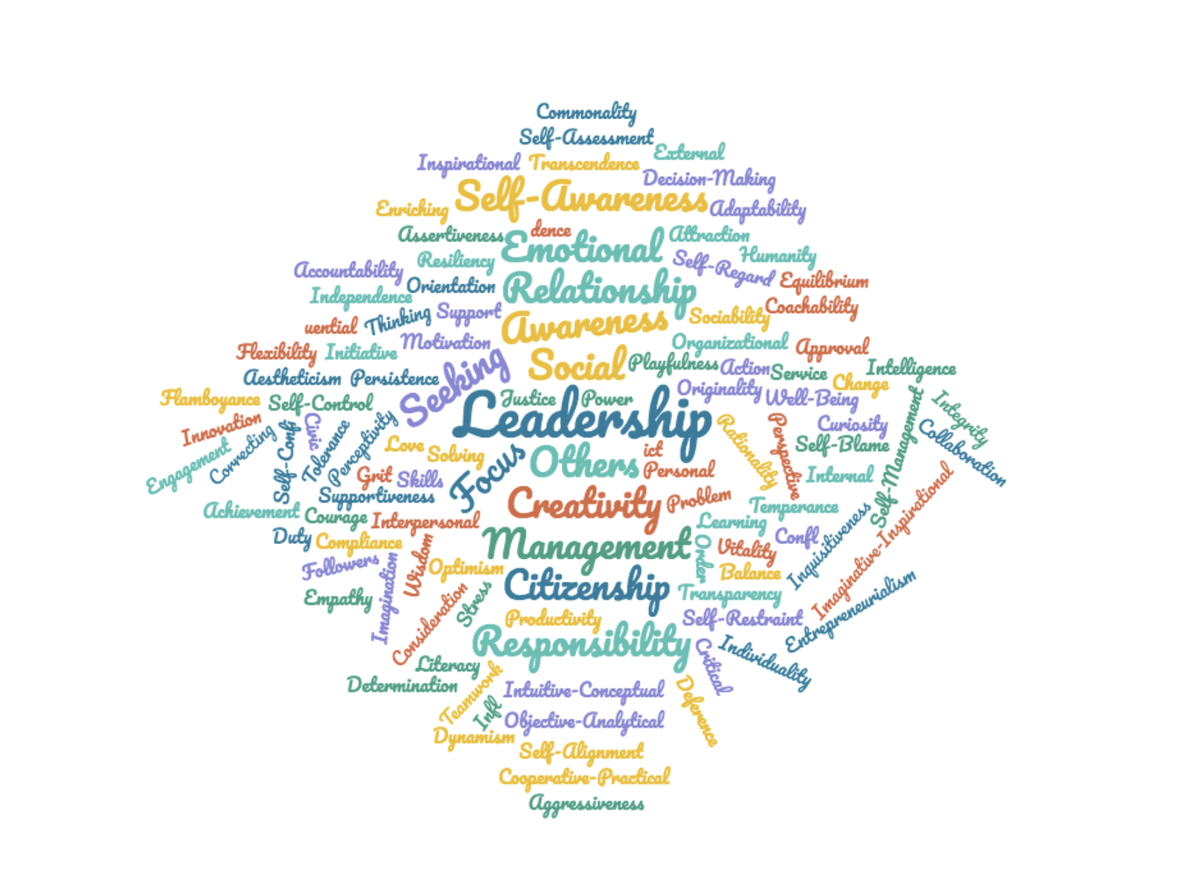
What words come to mind?

Slide 6
Right Job
+
Right Skills
The Perfect Combination

Slide 7
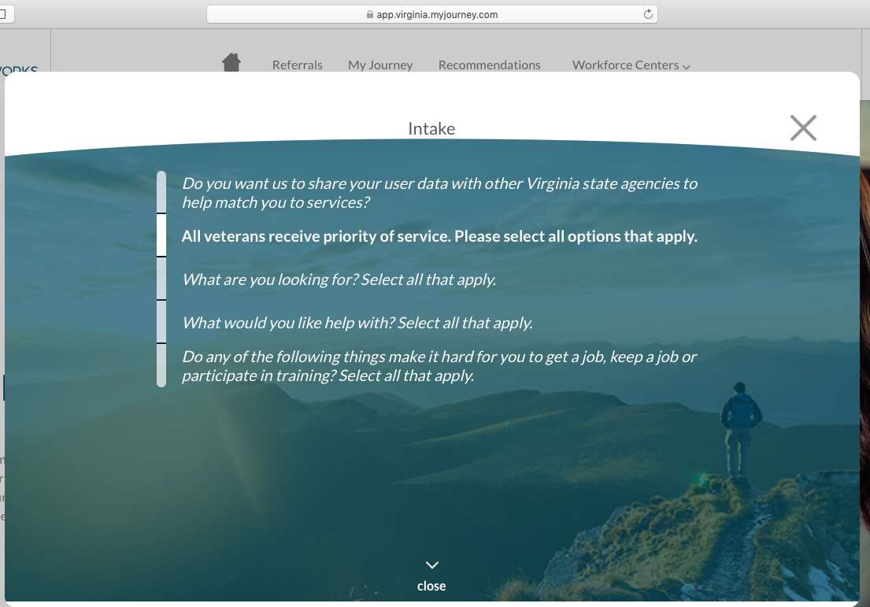
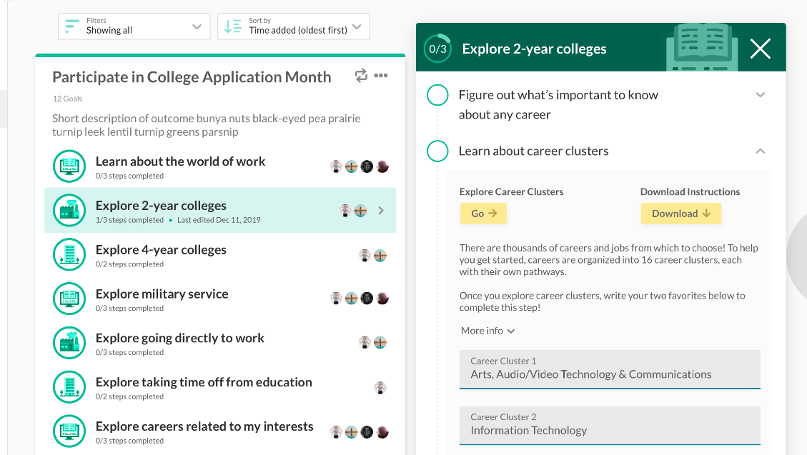
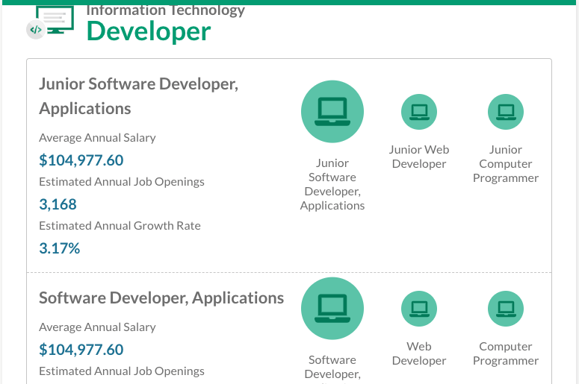
My Journey Framework
Personalization engine
Content framework
Integrated or external tools
Captures user information and personalize recommendations
Connects user to tools needed to accomplish desired Outcome
User information + configurable logic drives personalized recommendations
Outcome: Large objective
Goal: Milestones within an Outcome
Step: Small to-do items
Connects user to tools, websites, forms, etc., needed to accomplish desired Outcome

Slide 8
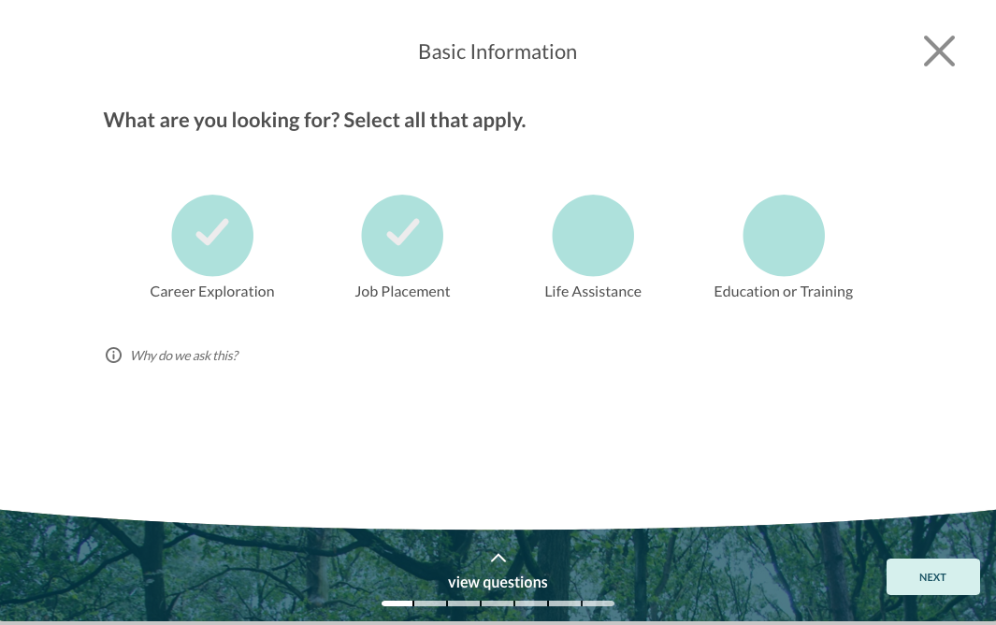
Personalization engine
Personalized journeys based on each user’s
barriers, skills, and desires
My Journey asks users questions to personalize recommendations

Slide 9
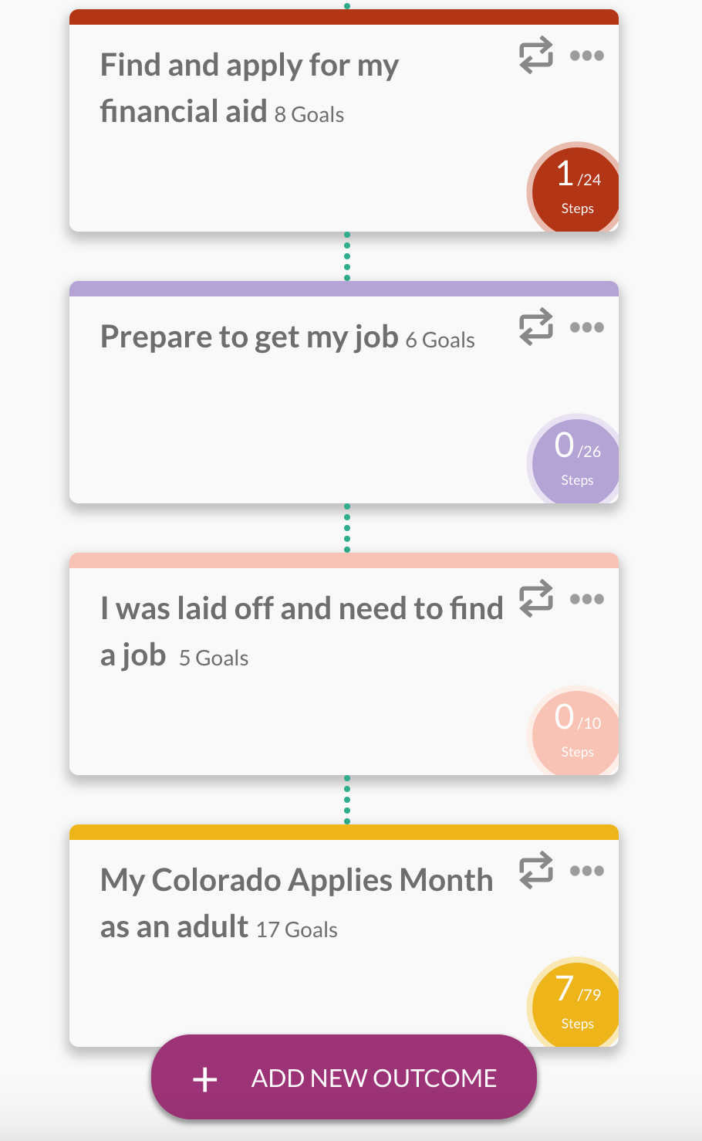
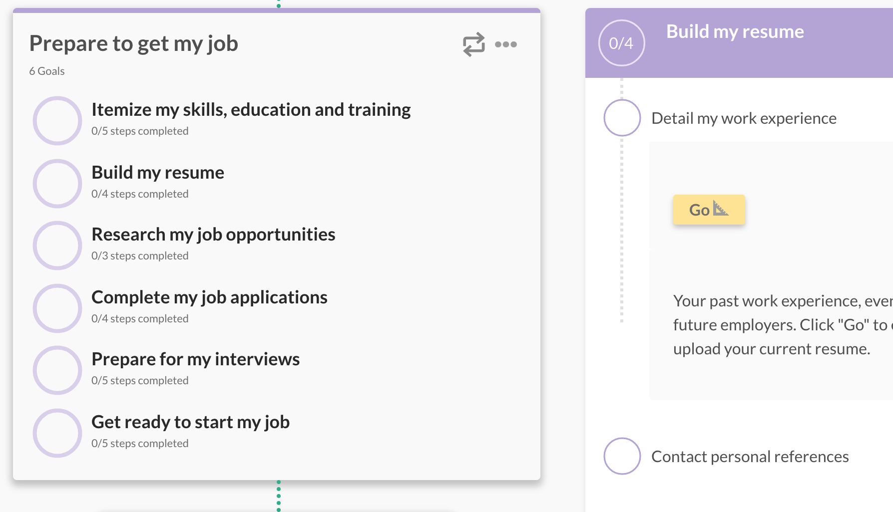
Content Driven = Easily Configurable

Slide 10
Example Tool
PAIRIN Pro
Essential Skills Measurement and Development

Slide 11
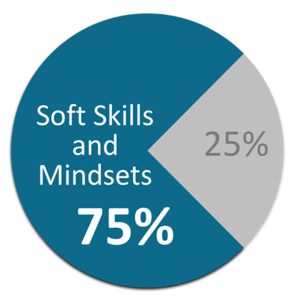
Soft Skills and Mindsets Chart
Academics
Experience
Technical Skills
SOURCE: Stanford Research Institute International and the Carnegie Mellon Foundation
Notes:
And what matter most is the essential skills that get people promoted or fired. Some people call them soft skills, but we call them essential skills. Gallup researchers even set the soft skill and mindset contribution% at 83!
The economic impact of soft skills is estimated to grow 44% in less than 10 years.

Slide 12
The PAIRIN Survey
<10 Min.’s Avg.
6 Languages
(English, Spanish, Thai, Russian, Mandarin)
Any Device
8 Validity Checks
7th Grade Reading Level
(Flesch-Kincaid Grade Level, Gunning Fog Index, Coleman-Liau Index, SMOG Index, and the Automated Readability Index.)
Notes:
A bit about our survey and how we measure

Slide 13
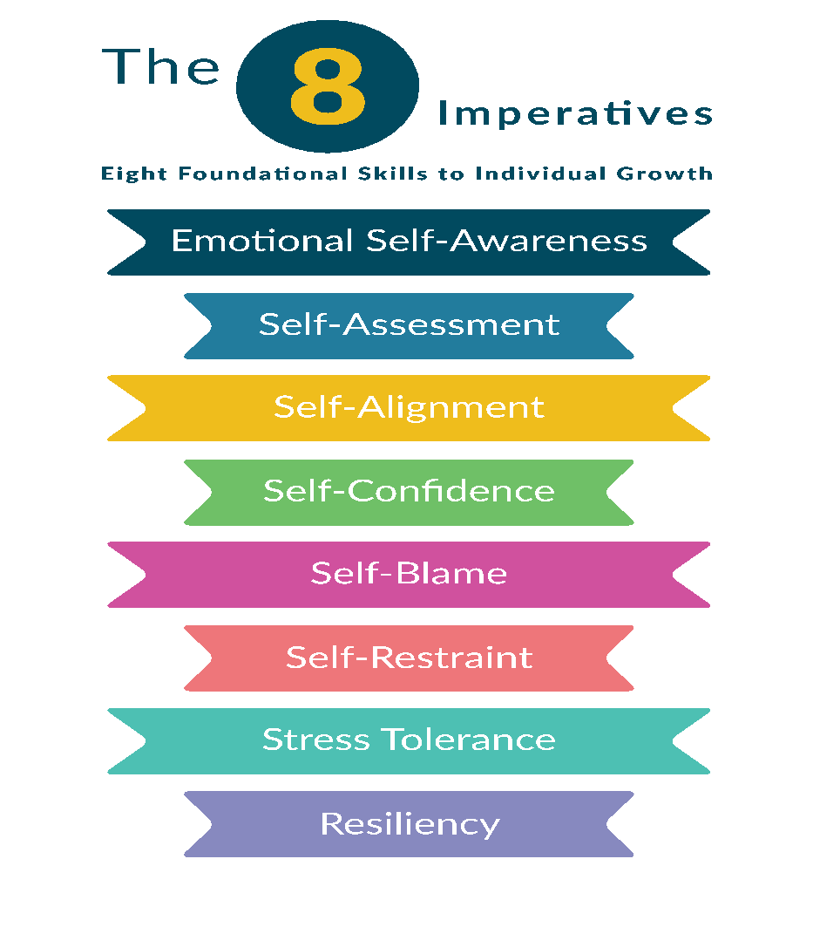
IMPERATIVES
CAREER READINESS
JOB MATCH
SUMMER ASSOCIATE
Behavioral Profile
Notes:
What are targets? and dig into the imperatives

Slide 14
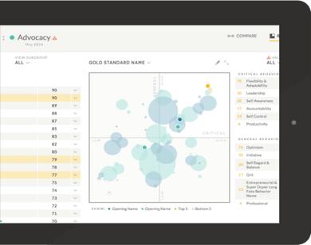
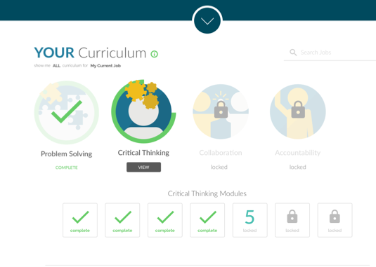
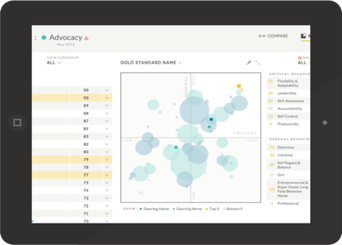
Personalized Development
Coaching tips, insights and reports
54 classroom modules
300 online micro lessons
Integrates with any LMS
Credly badging
Notes:
What tools are available to develop skills

Slide 15
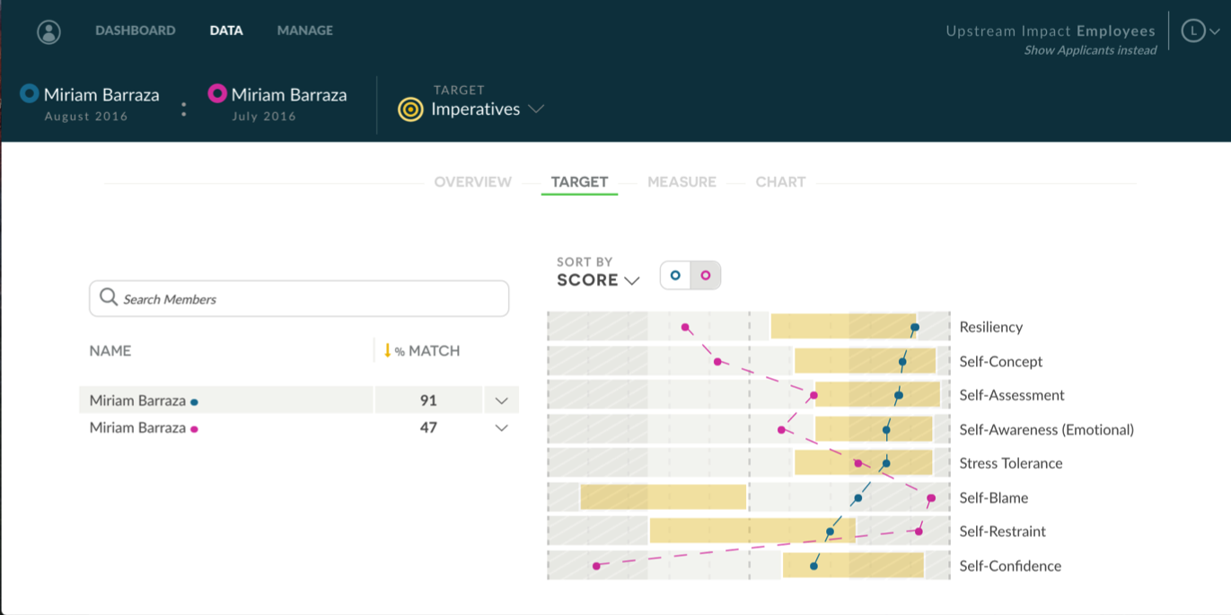
Meet Maria
Notes:
Story of Maria and how her imperatives were developed in 8 weeks

Slide 16
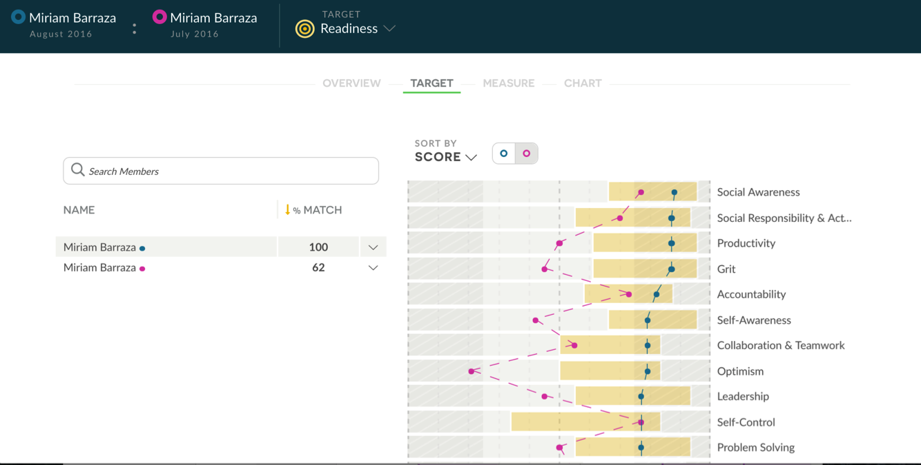
Meet Maria cont.
Notes:
And how developing her imperatives impacted her employability skills without explicitly teaching them

Slide 17
HIRINGWELLDOINGGOOD.COM

Slide 18
Several industries have been significantly disrupted by COIVD-19
Many people don’t understand how soft-skills translate across job types & industries
Un- and underemployment challenges are amplified by barriers
The job application process is overwhelming and inaccessible
HIRINGWELLDOINGGOOD.COM
THE PROBLEM

Slide 19
Provide single-source solution for support/resources, training and development, and job application
Focus on economically viable career paths, not just ‘jobs’
Combine product and program to maximize results
Help NPO’s work more efficiently and effectively
Reduce supply/demand gap for employers
HIRINGWELLDOINGGOOD.COM
A BETTER SOLUTION

Slide 20
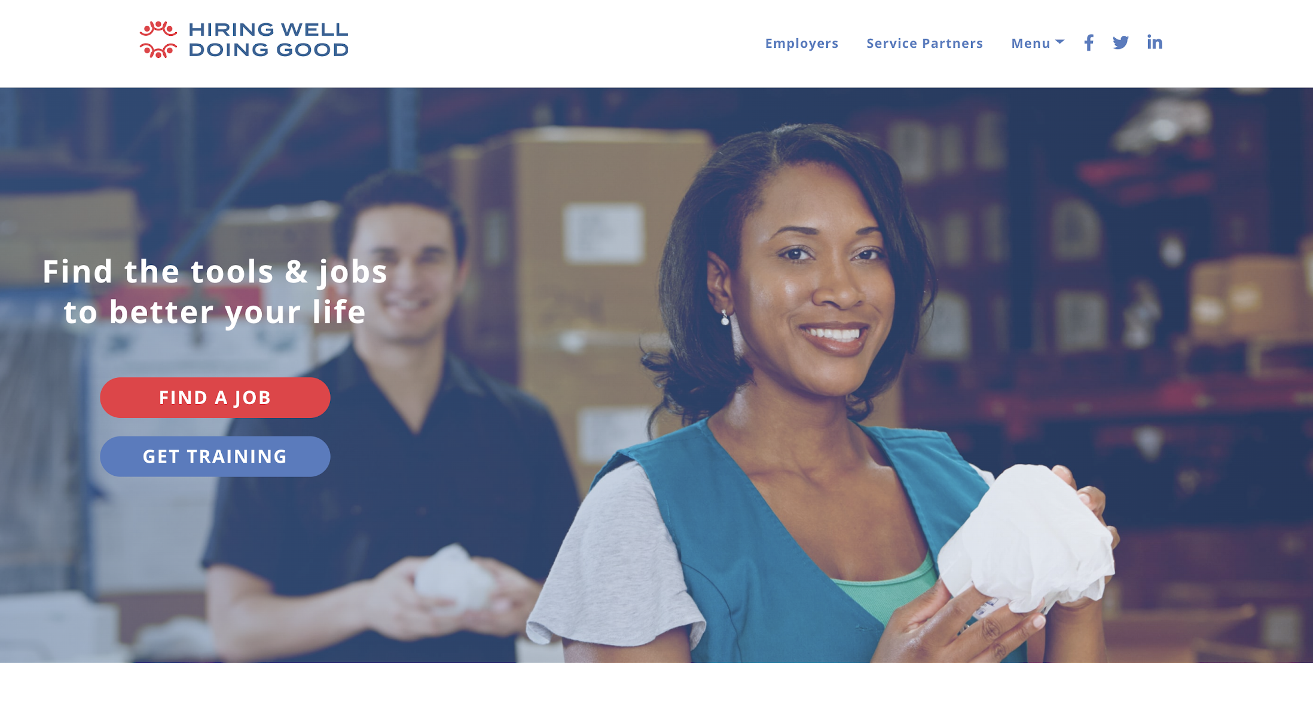

Slide 21
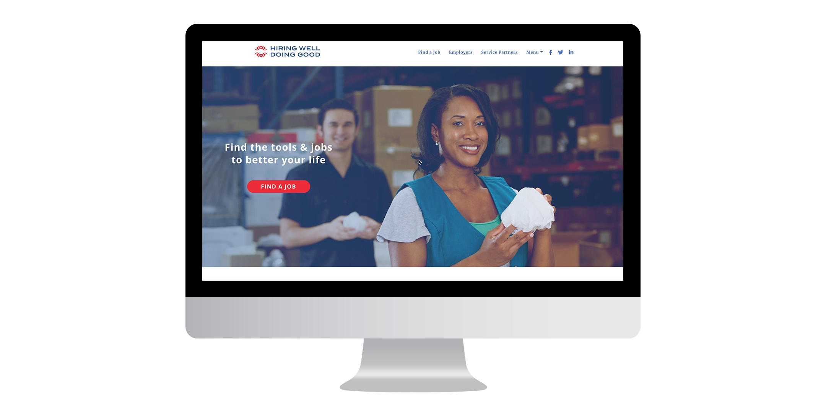
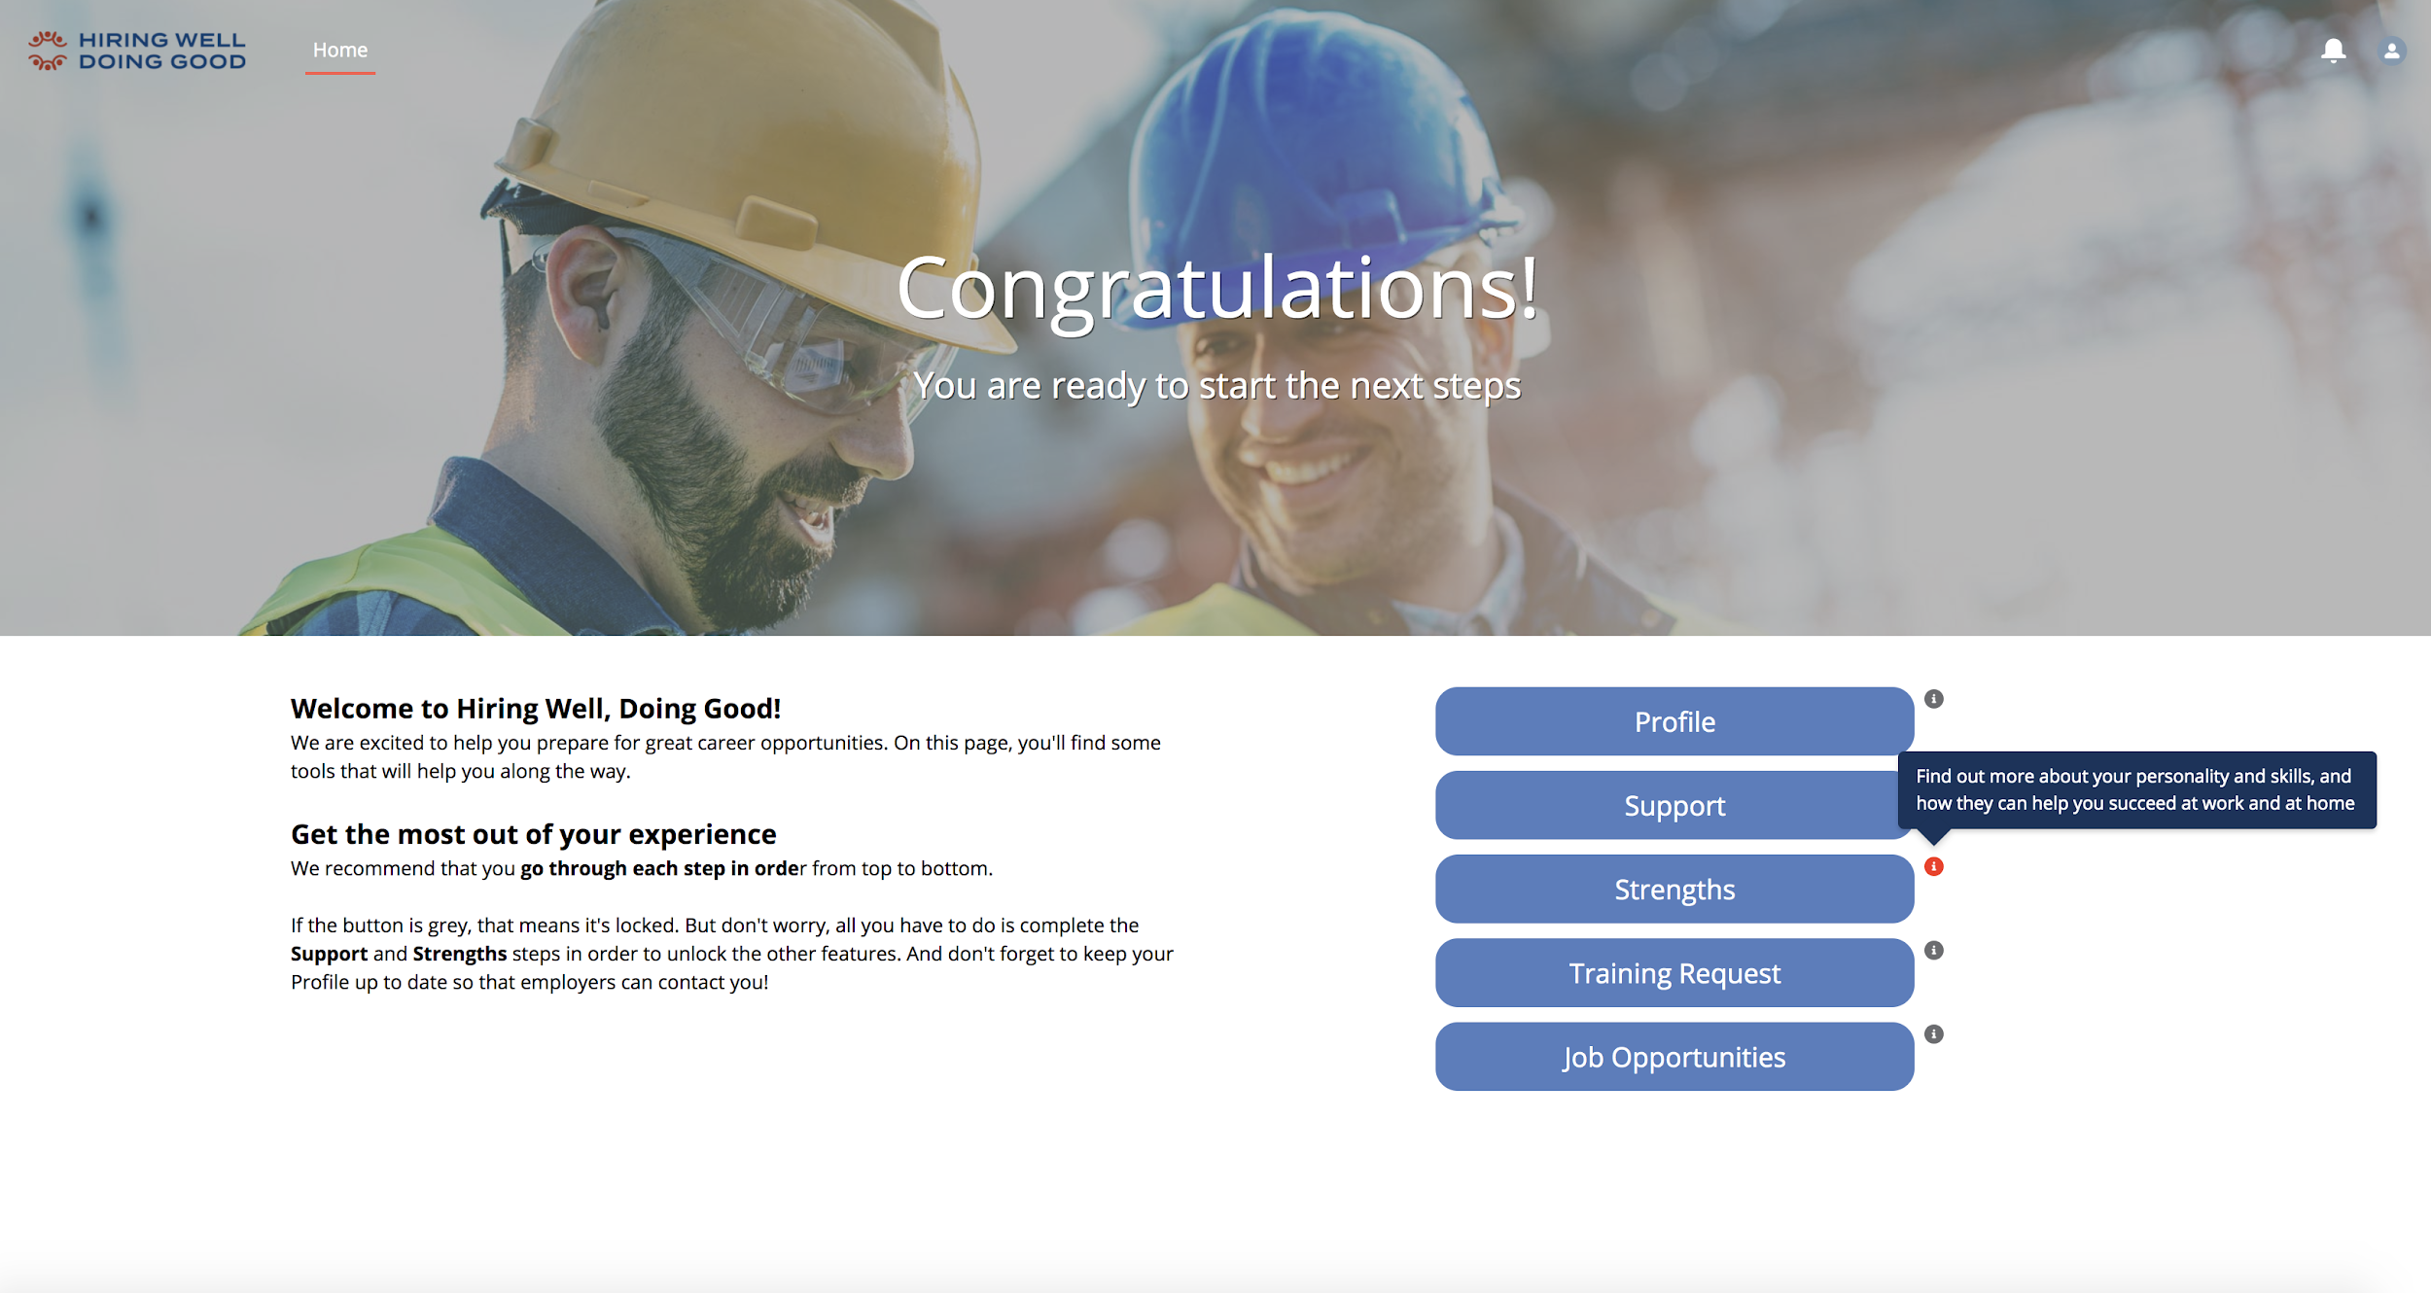
SOFT SKILLS
HIRINGWELLDOINGGOOD.COM
STRENGTHS-BASED
ASSESSMENT & REPORT
A simple assessment and comprehensive results report that allows candidates to learn more about how their soft skills and strengths can help them succeed at work and at home.

Slide 24
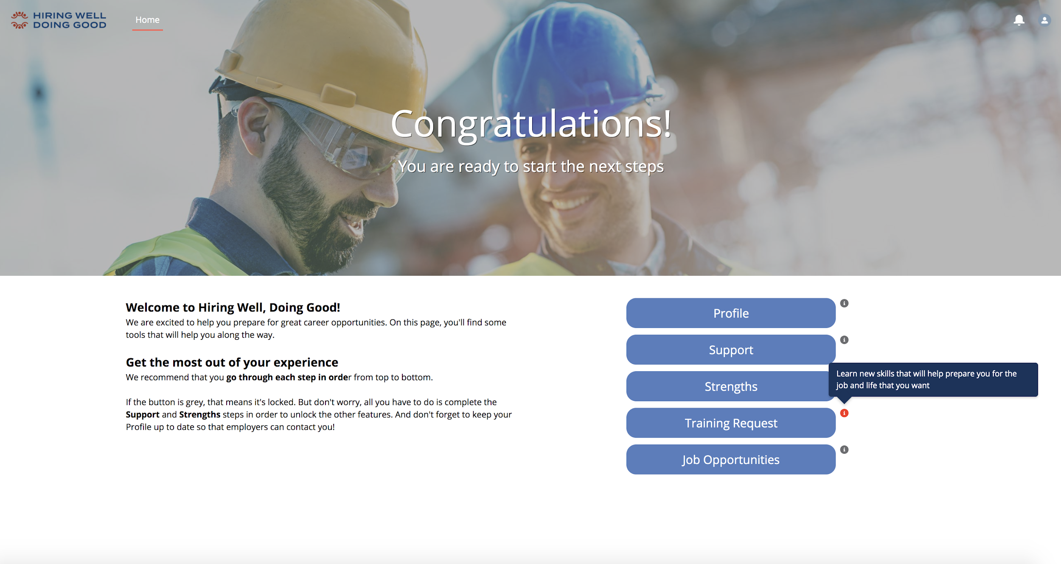
TRAINING
HIRINGWELLDOINGGOOD.COM
VIRTUAL SOFT-SKILLS TRAINING COURSES
A suite of over 50 virtual courses focused on developing soft skills that will prepare candidates for the job and life that they aspire towards.

Slide 25
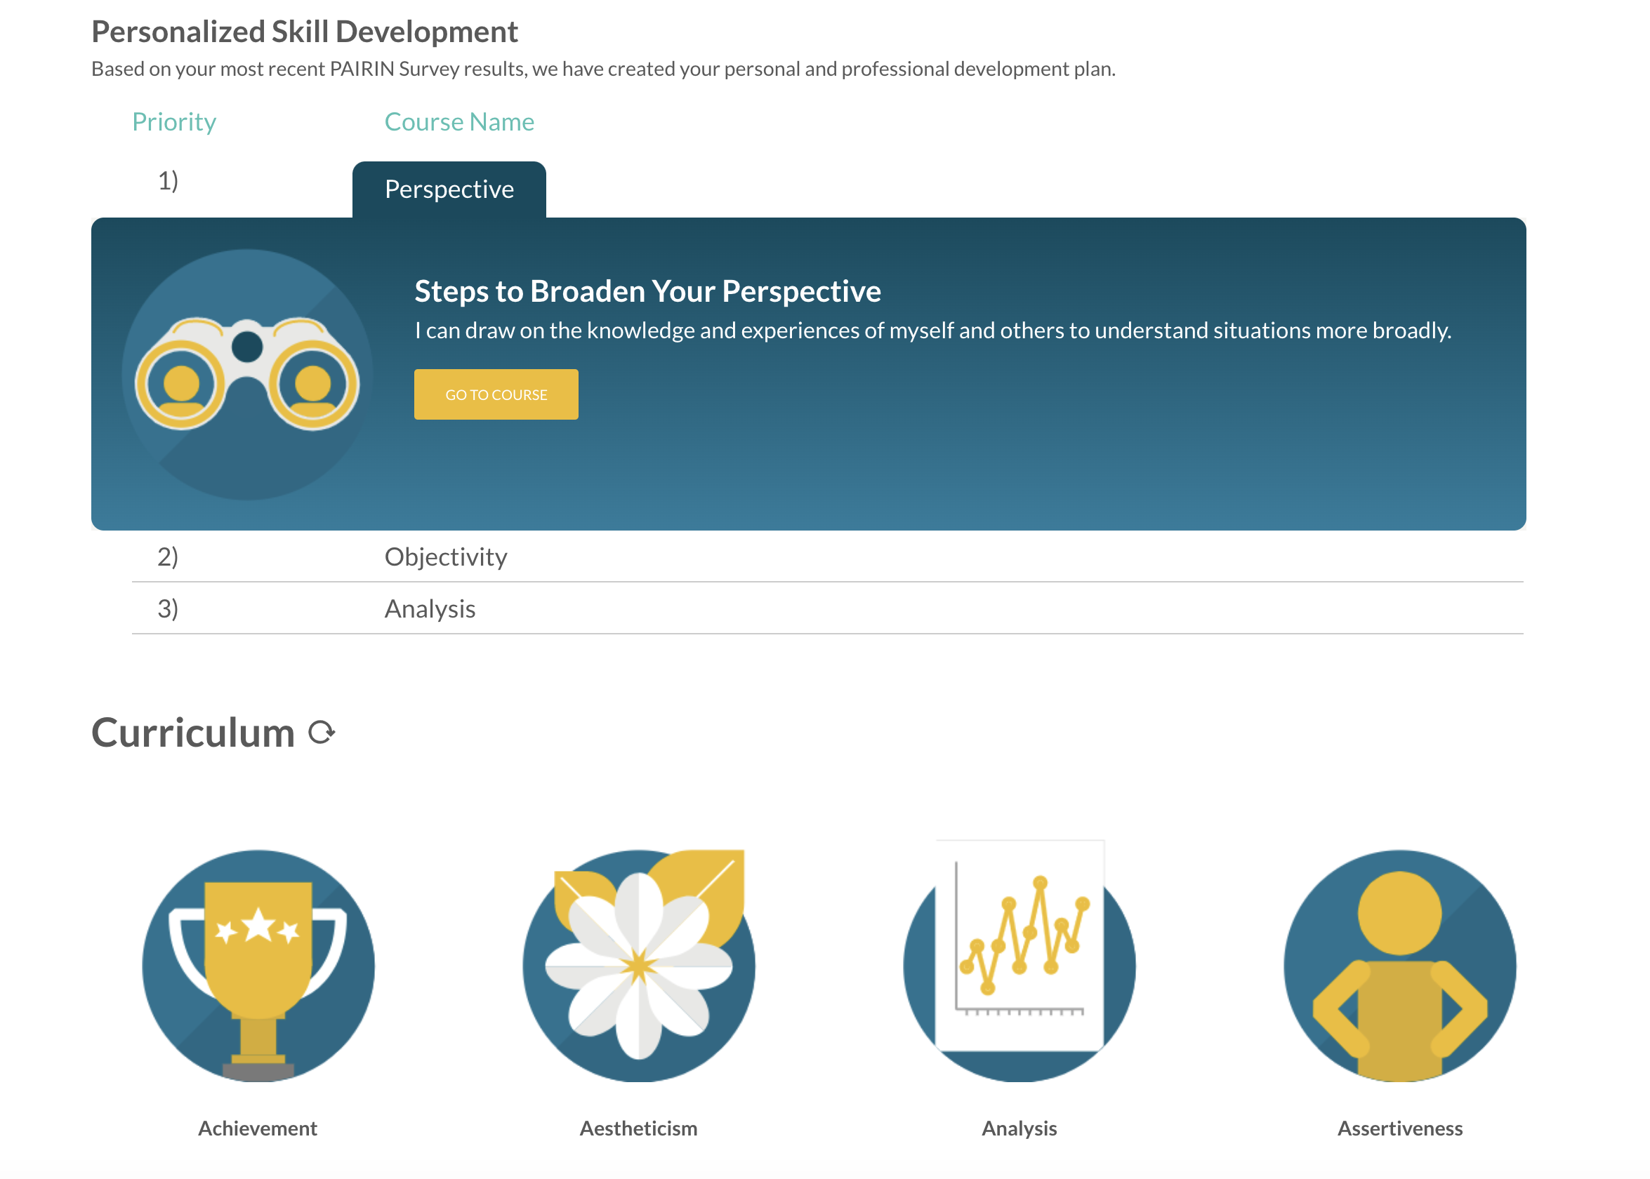

Slide 26
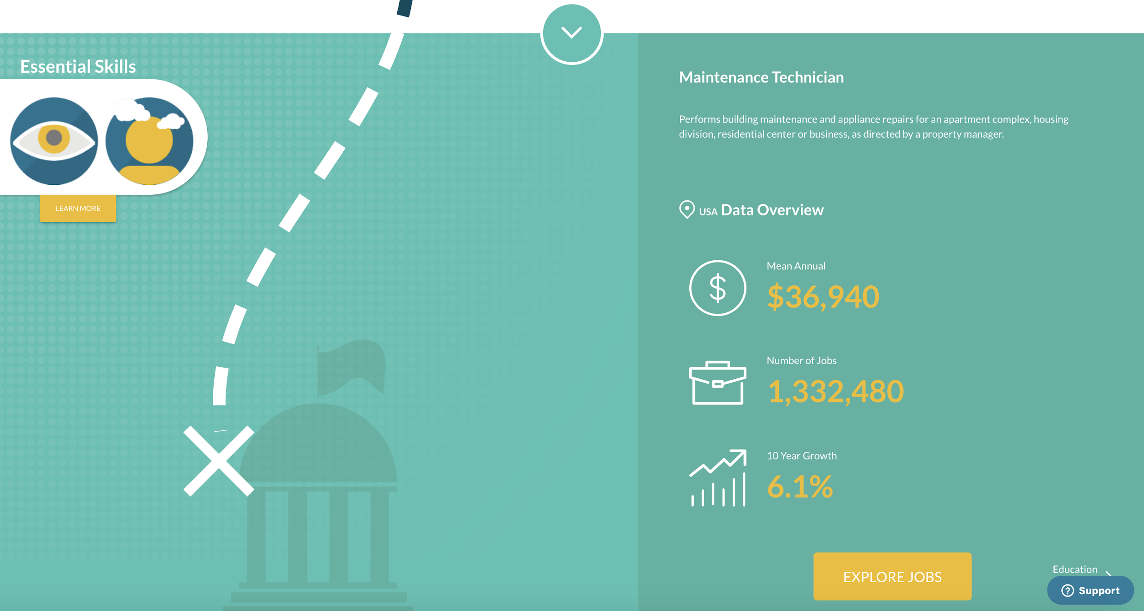

Slide 27
Using Skills Growth Over Time Data for Measuring Impact
Notes:
We will give them a few seconds to think of it, and then discuss what I’ve heard from other times asking this of a group. All soft skills, all different. The point is that it is these skills that matter the most, but they are different for different jobs, and levels of intensity are important by position. So, we must match people to the right jobs, understand their gaps and develop those skills to ensure success.

Slide 28
Questions? Please reach out!
Kelsey Underwood
Product Manager
kelsey.underwood@georgiaopportunity.org
Michael Simpson
Co-founder and CEO
michael.simpson@PAIRIN.com
@PAIRINceo
@PAIRINinc
Notes:
Tell a bit about yourself and what your organization does, who it serves and why you choose to work there.

