Slide 1


Take Ten⁺!
Unleashing the Power of Partnerships in
Gwinnett County Georgia through IET
NCPN Conference
October 15-16, 2020

Slide 2
Vision & local plan
The Workforce Innovation and Opportunity Act (WIOA) vision is to increase access and opportunities to employment, education, training, and support services to employment. WIOA strengthens the Title II Adult Education programs by positioning adult education services as a key component of the workforce development system in local communities and
improving alignment among adult education programs, postsecondary education providers, and employers.
WIOA required Workforce Boards to develop a Local Plan:
Training along career pathways
Increased access to relevant training

Slide 3
Vision & local plan
The Workforce Innovation and Opportunity Act (WIOA) vision is to increase access and opportunities to employment, education, training, and support services to employment. WIOA strengthens the Title II Adult Education programs by positioning adult education services as a key component of the workforce development system in local communities and
improving alignment among adult education programs, postsecondary education providers, and employers.
WIOA required Workforce Boards to develop a Local Plan:
Training along career pathways
Increased access to relevant training

Slide 4
Meeting the need
Industry
  Hard to find workers with strong employability or “soft” skills.
  No pipeline of trained or “willing to be trained” workers.
HSE and English Language Learning (ELL) students can fill this need
Good for industry and the community

Slide 5
quote
First, education isn’t just another issue. It is the most powerful force for accelerating economic growth, reducing poverty and lifting middle-class living standards. Well educated adults earn much more, live longer and are happier than poorly educated adults.
When researchers try to tease out whether education does much to cause these benefits, the answer appears to be yes!
~ DAVID LEONHARDT

Slide 6
quote
First, education isn’t just another issue. It is the most powerful force for accelerating economic growth, reducing poverty and lifting middle-class living standards. Well educated adults earn much more, live longer and are happier than poorly educated adults.
When researchers try to tease out whether education does much to cause these benefits, the answer appears to be yes!
~ DAVID LEONHARDT

Slide 7



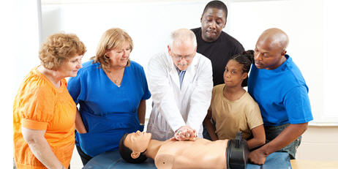
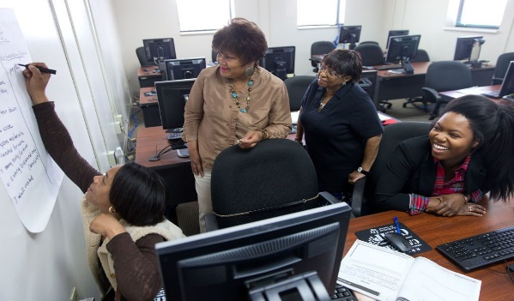


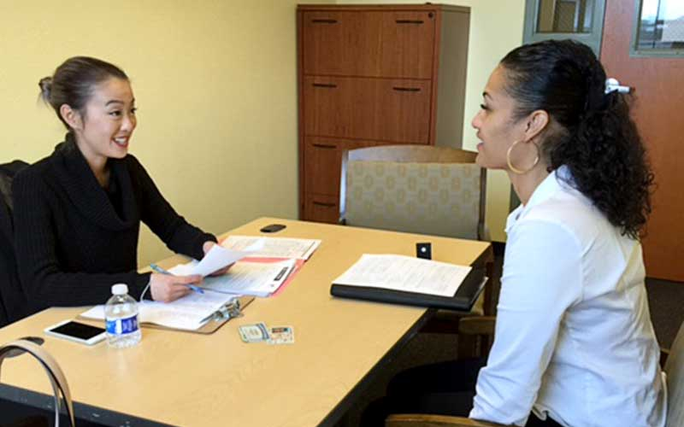
So what is iet?
Basic Skills Education
Technical Training
Workforce Experience
Integrated at the SAME time in the SAME classroom

Slide 8
Integrated education & training (iet)
IET is a service approach that provides adult education and literacy activities concurrently and contextually with workforce preparation activities and workforce training for a specific occupation or occupational cluster for the purpose of educational and career advancement (Final WIOA regulations at 34 CFR §463.35).
Aligns with the skill needs of industries in the economy
Puts students on a career pathway
Recognized credential earned

Slide 9
The big three
Adult Education and Literacy
  HSE preparation
  English language improvement
  Civics education
  Taught contextually
Workforce Education
  Basic academic skills, critical thinking skills, digital literacy skills and self- management skills
  Skills necessary for successful transition into and completion of postsecondary education, training, or employment
  Georgia Best (Business Ethics Student Training)
Workforce Training:
  Gwinnett Tech Sponsored 40-hour externships
  Gwinnett Tech Continuing Education -Training programs
It is only called IET when all three are happening at the same time.

Slide 10
Take ten⁺!
10 – 16 weeks (Schedules vary per certification)
Morning Schedule:
  Contextualized instruction
  HSE prep
  ESL and Civics Education - Instruction on the rights and responsibilities of citizenship and civic participation
Afternoon Schedule:
  Workforce Training
  Gwinnett Tech-Continuing Education Dept.
  Medical Administrative Assistant, Phlebotomy and Welding
Fridays - Georgia Best (Business Ethics Student Training)
40 hour externships

Slide 11
August 2019 - present
CompTIA A+
Phlebotomy Technician
Welding for Manufacturing
Medical Administrative Assistant
August 2019 - September 2020 Enrollment
CompTIA A+ - 5 Phlebotomy Technician – 13 Welding for Manufacturing - 9 Medical Administrative Assistant – 16

Slide 12
Worksource Atlanta regional Gwinnett tech wioa
Determine participant eligibility and suitability for WIOA funded training.
  Participants must meet Adult Ed requirements i.e. TABE scores and complete prerequisite college/workplace readiness academy.
  Interview to determine readiness
Assists in aligning proposals with local and regional Workforce Plans (strategic elements, in-demand industries/occupations).
  Certification courses must be approved by Atlanta Regional Workforce Board

Slide 13




Worksource Atlanta regional Gwinnett tech wioa
Track: credential attainment, training related employment, wage targets and employment retention - ensuring performance metrics are met.
Provides wrap-around services (JobSmart, Resume, Job Search, Job Application Strategies, Interviewing, Salary Negotiation, Elevator Pitch, Community Resources).

Slide 14
Career experience: internships & apprenticeships
Constant communication with industry partners regarding student performance in class, on the job.
Partner input in curriculum before during and after training is a MUST. Instructors are nimble and make adjustments when needed so interns & apprentices are prepared.
Working with industry partners to identify need FIRST allows for seamless transition from intern/ apprentice to employee.

Slide 15
Internal support
& lessons learned
Participant Evaluation- Carefully choose who to accept into the program.
Interdepartmental Communication is Crucial
  Department have different objectives and success metrics.
  Scheduling
  Keep, Delete, Add, Modify
Community Support- Select trainings that meet industry needs in our area.
  Medical Administrative Assistant
  Phlebotomy
  Welding for Manufacturing

Slide 16
Internal support
& lessons learned
Participant Evaluation- Carefully choose who to accept into the program.
Interdepartmental Communication is Crucial
  Department have different objectives and success metrics.
  Scheduling
  Keep, Delete, Add, Modify
Community Support- Select trainings that meet industry needs in our area.
  Medical Administrative Assistant
  Phlebotomy
  Welding for Manufacturing

Slide 17
Thank you for listening!
Stephanie Rooks
Vice President
Adult Education Division
srooks@GwinnettTech.edu
(678) 226-6323
Michael O’Neal, III
IET Coordinator
Adult Education Division
moneal@GwinnettTech.edu
(678) 226-6369
Cher Brister
Director, Green Technology
Continuing Education Department
cbrister@GwinnettTech.edu
(678) 226-6756
www.GwinnettTech.edu/Programs/Take-Ten-Program

