Slide 2
Finding and Engaging Employer Partners
Presented by
Brett Pawlowski
Executive Vice President

Slide 3
What You’ll Learn
Where to find partners
How to connect
How to “seal the deal” with a formal agreement

Slide 4
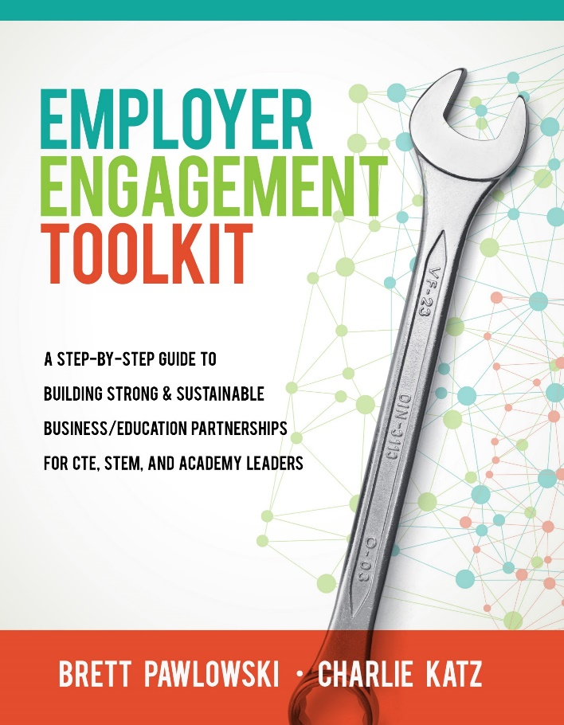
About the Presenter
Brett Pawlowski
Executive Vice President
NC3T

Slide 5
About the Company
Every learner with a dream and a plan
Every community with a capable and ready workforce
www.NC3T.com

Slide 6
About the Company
Work-based learning and advisory board management
Step-by-step guides for building Pathway Programs and Systems

Slide 7
About the Company
Helps core content educators to incorporate career information and employability skills into their instruction
Helps students think about and explore their career futures and build an actionable college and career plan

Slide 8
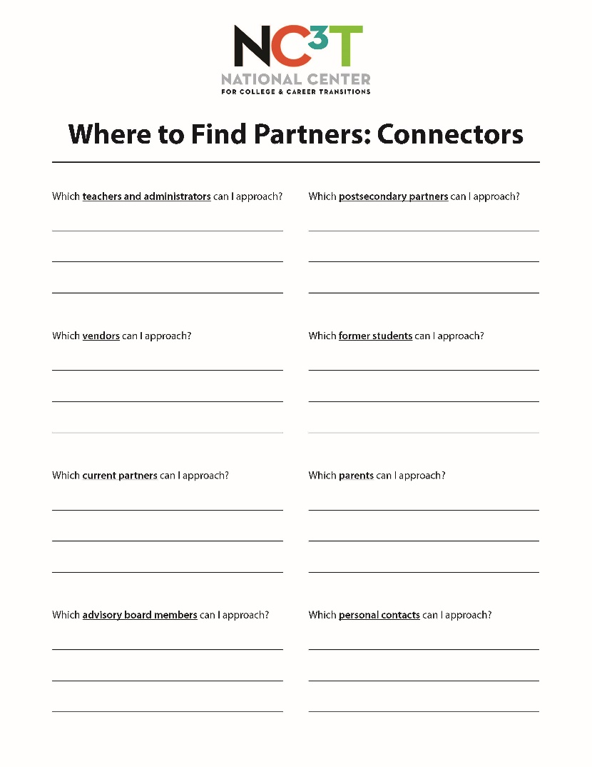
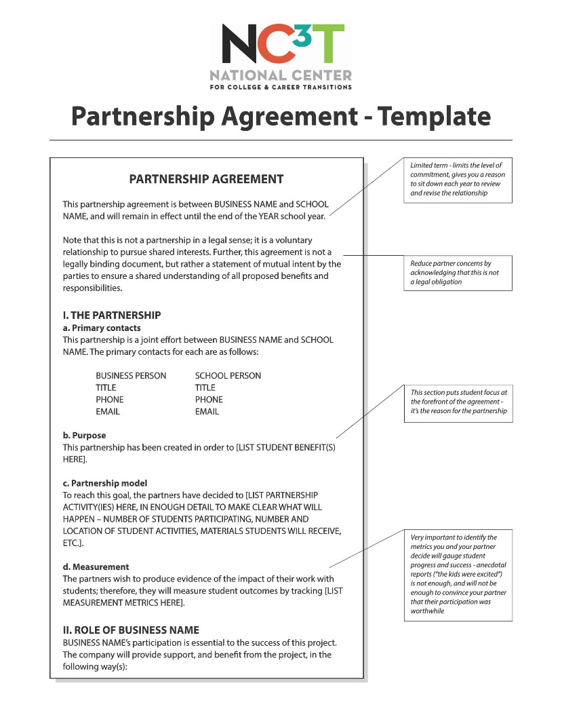
Handouts

Slide 9
Finding Partners

Slide 10
Most Common Sentiment:
“I don’t know anybody”

Slide 11
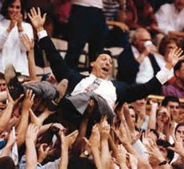
Reality:
You’re connected to lots of people!

Slide 12
Activity Goal:
Five people/groups you can contact next week

Slide 13
Handouts

Slide 14
1. Teachers and Administrators
Who are their partners?
Who do they know, personally or professionally?

Slide 15
2. Vendors
Are they possible partners?
Who else do they sell to?

Slide 16
3. Current Partners
Can they do more?
Who else in their companies might be interested?
What other companies or organizations do they know?

Slide 17
4. Advisory Committee
Partnership development should be one of your board’s core functions
Leadership?
Dedicated committee?

Slide 18
5. Parents
Where do they work?
Who do they know?

Slide 19
6. Post/Secondary Partners
Who do they partner with?
Can you share resources, including a common advisory committee?

Slide 20
7. Former Students
Where do they work?
Can they volunteer themselves, or help you make connections inside their companies?

Slide 21
8. Personal Contacts
Are you involved in civic organizations, a church, or some affinity group (sports, hobbies, etc.)?

Slide 22
9. Established Networks
Chambers of commerce
Industry hubs/associations
EDCs
WIBs
Union

Slide 23
9. Established Networks
Get involved – attend meetings
Join committees
Host meetings
Ask for introductions

Slide 24
Engaging Partners

Slide 25
The Introduction
Use an intermediary if possible – who are your shared and trusted connections?

Slide 26
The Introduction
If no shared contacts – shared membership?
If no shared membership – direct contact

Slide 27
Sample Email:
SUBJECT: Guidance on welding instruction needed for [School]
Dear x,
I run the welding program at [School]. I was hoping for a chance to meet with you at some point: I understand that your company hires welders on occasion, and I’d like to learn what you’re looking for in your new employees. We prepare students for this field, and we rely strongly on industry feedback to tailor our instruction.
Would you be interested in connecting by phone? When would be a convenient time for you to talk this week?

Slide 28
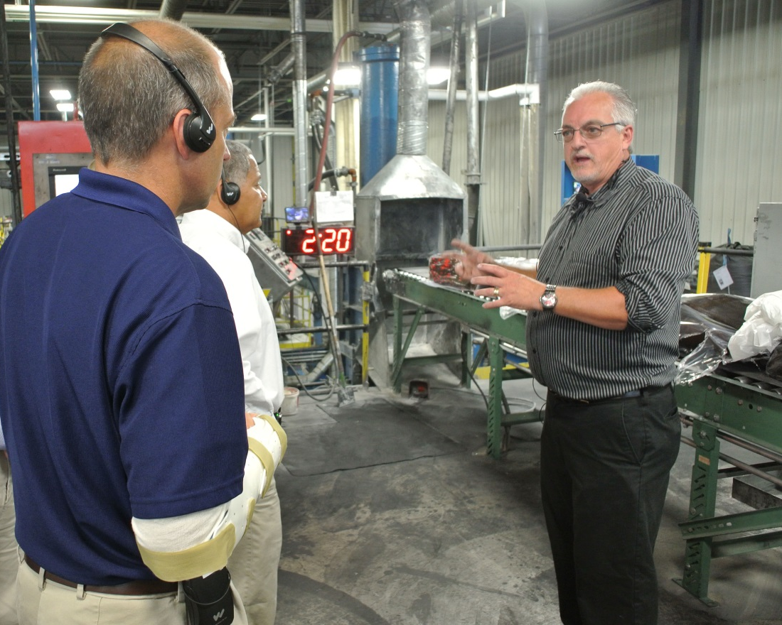
The First Meeting
Goal: Learn about them and their needs
If possible, bring a shared contact

Slide 29
The First Meeting
Try to meet at their location
Minimal effort on their part
Opportunity to keep up on industry standard equipment and practices

Slide 30
The Second Meeting
Goals:
Build on initial interest
Increase knowledge and comfort
Identify concrete opportunities to work together

Slide 31
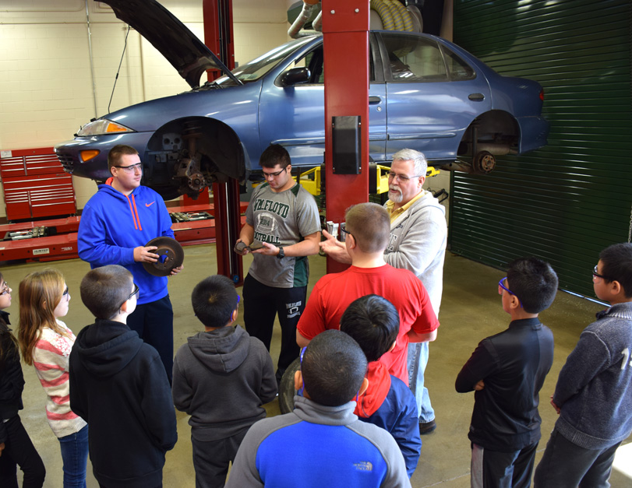
The Second Meeting
Meet at your location
Give tour
Introduce to teachers and students

Slide 32
Giving a Tour
Focus on the positive – building on strengths, not shortcomings
Share your vision
People, not things

Slide 33
Giving a Tour
Prepare staff and students
Not scripted, but on-point

Slide 34
Securing Partners

Slide 35
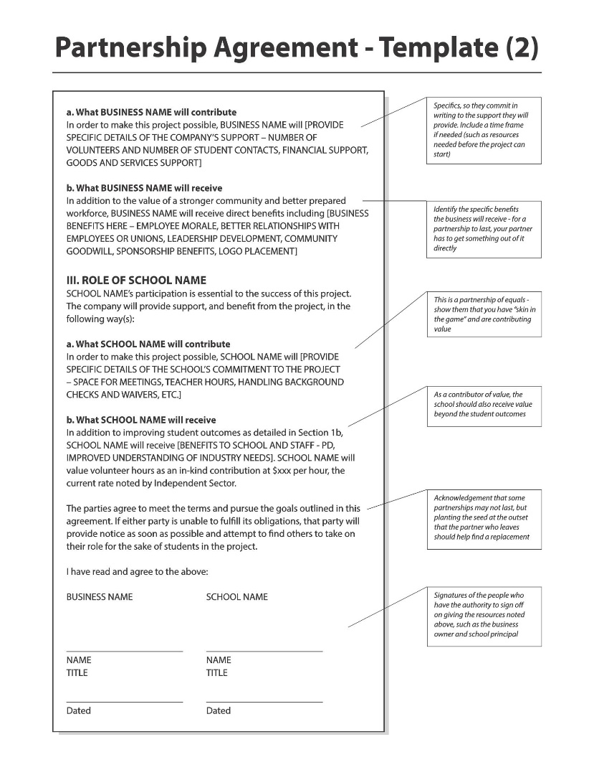
Writing an MOU

Slide 36
Once You’ve Started
Get some early wins
Start to build other relationships within each organization
Make sure you’re generating data on the outcomes they care about

Slide 37
BRETT PAWLOWSKI
brett@nc3t.com
Website
www.nc3t.com

