Slide 2
Dr. Chris Laney
Blair Bloomston
Workforce Education Director
CareerSource Suncoast
claney@careersourcesc.com
Partner & VP of Business Development
Game On Nation
blair@gameonnation.com

Slide 3
GAMIFICATION
The practice of applying game-based elements, techniques, and strategies to non-game activities.
GOAL
Create authentic engagement and buy-in, in order to bring about behavioral changes that last.

Slide 20
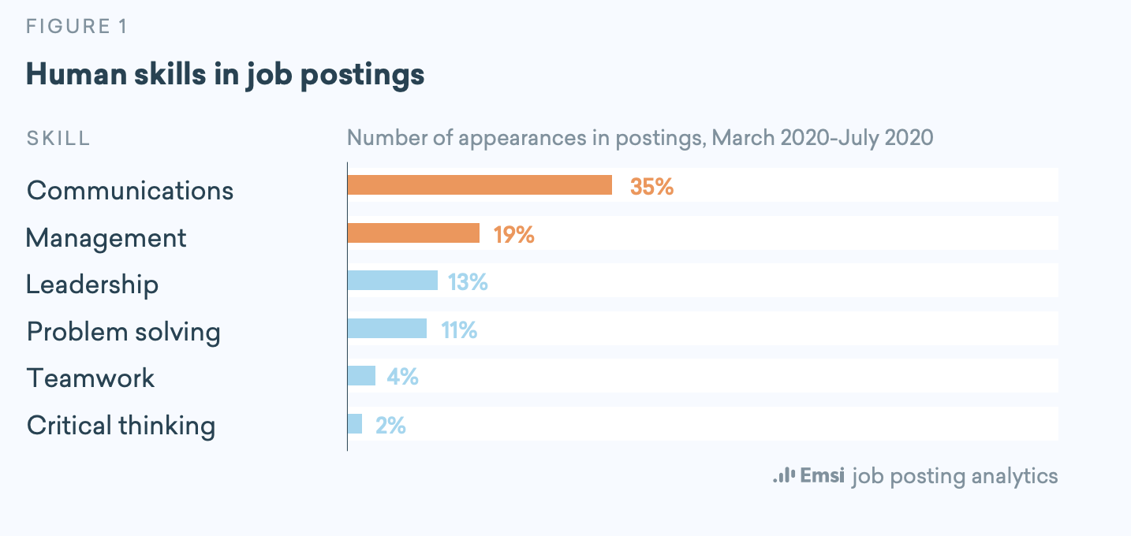
Essential Skills
Notes:
Chris to speak to the essential skills

Slide 21
EMSI Report Skills
Communication
Management
Leadership
Problem Solving
Teamwork
Critical thinking
NACE Report Skills
Communication (written)
Problem-Solving
Teamwork
Initiative
Analytical/quantitative
Work Ethic

Slide 22
BUILDING A MINDSET OF ESSENTIAL SKILLS
Notes:
Chris

Slide 23
WHAT MOTIVATES PEOPLE TO PLAY?
EXTRINSIC
Behavior that is driven by external rewards, such as recognition, income, or stuff.
INTRINSIC
Behavior that is drive by internal inspiration, such as purpose, curiosity, or belonging.

Slide 24
CASE STUDIES

Slide 25
CASE STUDIES
“Great course. I love the takeaways! Excited to really implement a number of these techniques into my everyday life. Awesome job! Thank you!!!”
“I really enjoyed all of the modules. I feel like they are great lessons to help improve both professionally and personally.”
“Excellent course with simple take a ways that change be game changers. Thank you!”

Slide 26
Notes:
Chris to intro/start this and how it was used within CareerSource; discuss the connection of essential skills learning to an on-demand virtual platform Game On had available

Slide 30
Notes:
Connect to tangible techniques for infusing Game Mechanics and Dynamics

Slide 31
Dr. Chris Laney
Blair Bloomston
Workforce Education Director
CareerSource Suncoast
claney@careersourcesc.com
Partner & VP of Business Development
Game On Nation
blair@gameonnation.com

