Slide 1
Building a Sustainable Funding Model for Community-Based Workforce Initiatives
The Story of the North Carolina Manufacturing Institute
David Hollars – Centralina Workforce Development Board
Craig Lamb – Rowan-Cabarrus Community College

Slide 2

Building a World-Class Workforce
for Regional Manufacturers

Slide 3
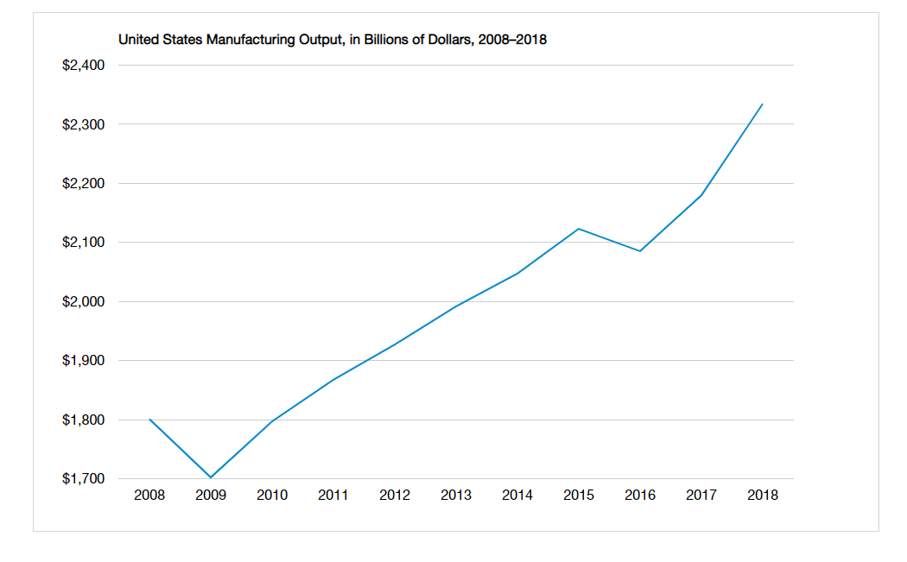
Manufacturing is Alive and Well
Forces Driving Output
Onshoring
Tarriffs
Productivity/Efficiency
Innovation
Latent Demand

Slide 4
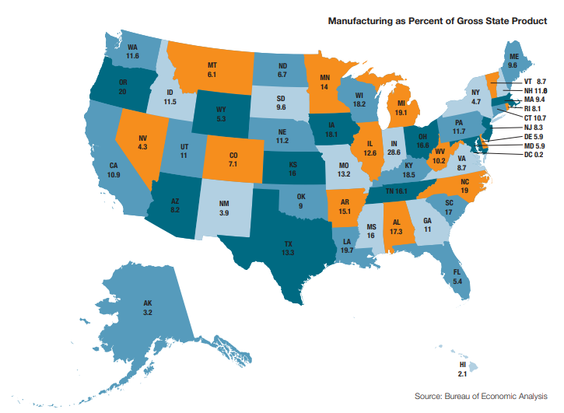
Manufacturing in North Carolina
Top States by Share of GSP
  Indiana (28.6%)
  Oregon (20.0%)
  Louisiana (19.7%)
  Michigan (19.1%)
  North Carolina (19.0%)
  Kentucky (18.5%)
  Wisconsin (18.2%)
  Iowa (18.1%)
  Alabama (17.3%)
  South Carolina (17.0%)

Slide 5
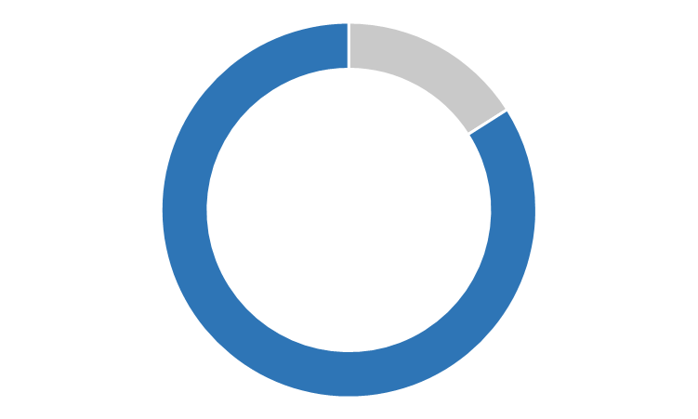


The Talent Gap is Real
It takes 70 days to recruit skilled production workers
84%
Of executives surveyed agree there is a talent shortage in U.S. manufacturing
SIX out of TEN
open skilled positions are unfilled due to talent shortage
Source: 2015 Manufacturing Institute and Deloitte Skills Gap Study

Slide 6






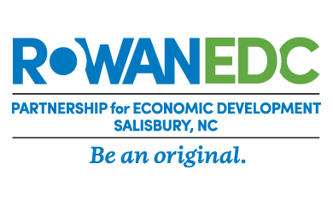




Community Partners
--Addressing a Critical Need

Slide 7
Strategic Vision:
To build a world class talent pool to support the retention and growth of regional manufacturers
Key Focus Areas:
Deliver training that closes the skill gap between job seekers and available jobs
Provide services and systems to more effectively match job seekers and available jobs in the manufacturing sector
Improve the image of manufacturing employment among job seekers, students, parents, and school personnel

Slide 8

Investors
Scholarships
Visibility
Commitment
Community Partners
Vision
Focus
Organization
Job Seekers
Talent
Time
Productivity
Employers
Return On Investment
Reduce Turnover
Reduce First Year Injuries
Lower Staffing Costs
Build Talent Pipeline
Grow Career Awareness
Support Suppliers
Build Shared Value
Jobs
Opportunity
Payroll

Slide 9

So What Makes NCMI Different?
Not Just a Class—a Movement
  Training & Certification
  Better Person-Job Fit
  Manufacturing Image
Balanced & Diverse Portfolio
  Full Scholarship to ALL interested
  Not Reliant on Short-Term Grants
No Overhead Model
  Sustainability
  All Employer Funds to Scholarships

Slide 10

Balanced, Dynamic Portfolio = Sustainability
Federal, State and Local
  Workforce Innovation and Opportunity Act
  Federal Grants
  County Funds
Foundations
  Utilities
  Community Foundations
  Corporate Foundations
Private
  Advertising Fund
  Sustainability Fund

Slide 11
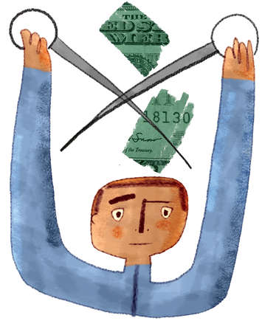
Low No Overhead
Partners Link and Leverage Existing Resources to Manage Projects:
No Grants
No Staff
No Lease
No Assets
Provides agility, sustainability and stability.

Slide 12

Redefine “Qualified”
Manufacturing Skills Standards Council (MSSC) Certified Production Technician
Skills
  Safety
  Quality
  Manufacturing Processes
  Maintenance Awareness
  Workplace Accountability
Align
  Educators
  Employers
  Workforce Development
  Economic Development

Slide 13
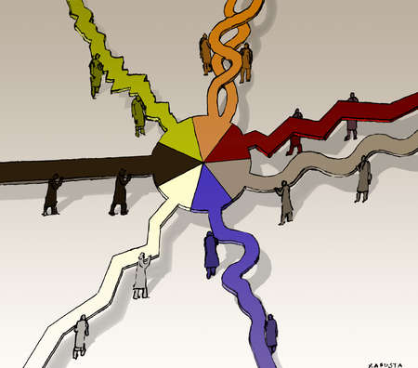
One Credential—Many Paths
MSSC CPT Certification
  National Exams
  Independently Proctored
NC Manufacturing Institute
High School Courses
Employer Training
Self-Study

Slide 14
Our Value Proposition
Recruit Candidates
WorkKeys Testing
Drug Screening
Interview
AWARD
SCHOLARSHIP
High Potential Candidates
+
Safety
Quality
Manufacturing Processes
Maintenance Awareness
Workplace
Accountability
Certified Manufacturing Skills
=
Partners
Certification
Screening
Placement
Follow-up
Value-Driven Results

Slide 15

Recruiting, Screening and Scholarships
Recruit
Screen
Train
Certify
Place
Retain
Sustain
Scholarship
Online scholarship application
WorkKeys Testing
  Reading for Information
  Locating Information
  Math
  Observation
5-Panel Drug Screen
Orientation/Discovery Session
Sign Training Agreement
Scholarship Awarded

Slide 16
Training and Certification
Recruit
Screen
Train
Certify
Place
Retain
Sustain
Scholarship
160 Hours of training
  Safety
  Quality
  Manufacturing Processes
  Maintenance Awareness
  Workplace Accountability
Exemplary Attendance
4 national certification exams
Certified Production Technician (CPT)

Slide 17
Placement and Follow-up
Recruit
Screen
Train
Certify
Place
Retain
Sustain
Scholarship
Resume’ Books
Interview Fairs
Employed by your firm
+90 Days on the job=VALUE
Sustainability Fund
  Certified Worker
  =90 days on the job
  $750 paid back to fund

Slide 18

Scholarships—No Asterisk*** Funding
Everyone is Eligible
Scholarship Funding Sources:
  Trade Adjustment Assistance (TAA)
  Workforce Innovation & Opportunity Act (WIOA) Youth
  WIOA Adult
  WIOA Dislocated Worker
  State Employees Credit Union (SECU) Scholarships
  Rowan-Cabarrus Foundation Scholarships
  Better Jobs for Better Lives Fund
  Sustainability Fund
Paying it Forward

Slide 19
Community Partners
--Roles and Responsibilities

Slide 20

Structure and Alignment
Core Team
  Policy
  Budget
  Strategy
Operations Team
  Recruiting
  Scheduling
  Advertising
  Business Partner Relations
Combined into One Team 2017

Slide 21

Link and Leverage
  NCWorks Career Center
    Match candidates with funds
    Career Management
  Centralina Workforce Board
    Website Management
    Labor Market Information
  Community Colleges
    Deliver CPT coursework
    Deliver CPT assessments
    Manage Sustainability Fund
  Economic Development and Chambers
    Maintain employer engagement
    Organize interview fairs
    Manage Advertising Fund

Slide 22

Why Do Our ED Partners Partner?
Economic Development IS Workforce Development
Business Retention
  Solves key customer problem
  Provides value
  Low investment
Business Attraction
  Capacity to create candidates
  Shows investment in manufacturing
  Low investment

Slide 23
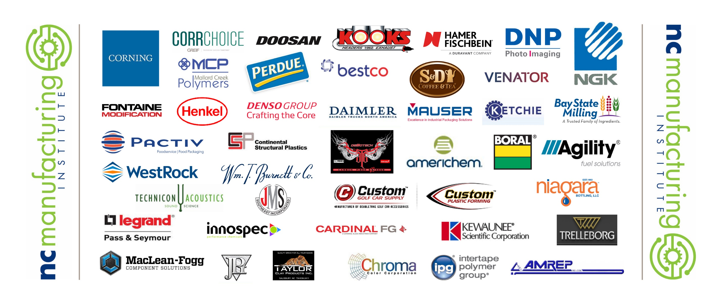
Our Business Partners

Slide 24

Becoming a Business Partner
Endorse CPT Program
Actively Participate
Field Trips
Hire Graduates
Sustainability Fund
Cooperative Advertising Fund
Applicant Screening
Creating Shared Value

Slide 25
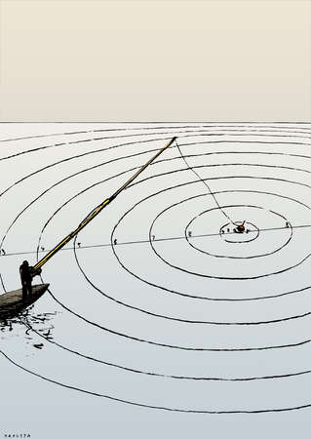
Business Recruitment
Recruiting is a Team Sport
Pledge Form/Obligations
Welcome Letter
Targeting Premier Employers First
Large and Small Firms Benefit
Communicating After Sign-on
Partner Engagement
Setting Employer Expectations

Slide 26
So What Makes the NC Manufacturing Institute Different?
Not Just a Class—a Movement
  Training & Certification
  Better Person-Job Fit
  Manufacturing Image
  Partner Commitment
Balanced & Diverse Portfolio
  Full Scholarship to ALL interested
  Not Reliant on Short-Term Grants
No Overhead Model
  Sustainability
  All Employer Funds to Scholarships

Slide 27
Building a World-Class Workforce
for Regional Manufacturers
www.ncmanufacturinginstitute.com

Slide 28
Questions??
David Hollars, Executive Director
Centralina Workforce Development Board
(704) 348-2717 / dhollars@centralina.org
Craig Lamb, Vice-President – Corporate & Continuing Education
Rowan-Cabarrus Community College
704-216-3500 / craig.lamb@rccc.edu

