Slide 1
Improving Quality Management
Through Workforce
Training and Development
John Henshaw, PhD.
Farhana Proma, PhD.
Mount Wachusett Community College
Devens, MA
October 2020

Slide 2
Quality Management Systems:
Help an industry or organization that provides a product and/or service meet customer/ regulatory expectations.
Require training of employees at all levels of an organization.
Are Continuous Improvement Processes.

Slide 3
Developing Quality Programs begins with identifying local need and partners.
Survey of need in terms of skill levels and content, etc.
Employer Engagement to determine job opportunities and workforce training needs.
Partners include: Workforce System
Chambers of Commerce
Direct Employer relationships
Industry Advisory Boards
Work-based experience
Interviewing/ hiring participants

Slide 4
It’s the economy,
Local economic conditions impact the scope of training to be provided. This is influenced both by the available potential workforce and employer demand.
Quality Training can be a component of an entry level or middle skills training program, or as a stand alone program focused on specific Quality roles in an organization.

Slide 5
Examples: Great Recession
High unemployment rate with many skilled workers seeking career change.
Career changers needed broad program to address new career pathways.
Training: Biomanufacturing Workforce Training Program
Economic Recovery
Low unemployment rate focused opportunity for incumbent worker upskilling.
High underemployment rate due to workers with multiple jobs.
Training: Quality modules within entry level program.
Stand alone Quality Training for middle skills.

Slide 6
PROGRAM CHALLENGES
Funding: Curriculum development
Training and Certification Costs
Support Costs
Grant funding (federal and state) has been critical for the development, implementation and sustainability of programming.
Identifying Participants: Recruitment / Assessment
Employment status
High School / Adult Education
Comprehensive approach attempts to develop pathways for participants of all levels.

Slide 7
PROGRAM CHALLENGES
Training Logistics: Scheduling challenges
Instructor availability
Flexibility in scheduling is the key (time, format, location)
Job Placement: Employer/ Workforce System partnerships
  Work-Based-Learning Opportunities
  Internships / Job Shadowing
  Registered apprenticeships
Regular communication with employers is essential.

Slide 8
Workforce Development Programs at MWCC
Quality Training as part of comprehensive programs include:
  Biomanufacturing Workforce Training Program (DOL)
    Quality Training as part of 220-hour program co-developed with Bristol Myers Squibb.
  Industry Readiness Training: Advanced Manufacturing Training (DOL)
    Entry-level Job Training
    Created as 15 – 20 hours of 160 hour program.
    Led to development of stand-alone higher level training (Quality Systems Training).

Slide 9
Stand-Alone quality Training
Guided by American Society for Quality certifications as Industry-Recognized Standard. MWCC coordinated ASQ examination on site following program and review.
Quality Systems Training: 40- hour training geared towards Certified Quality Process Associate.
Quality Technician Training: 100 to 140-hour training programs geared to support appropriate certification based on prior knowledge and experience.
Quality Yellow Belt Training: Focus of DOL-funded TechHire program aimed at young adults (17-29).
  Enabled students to seek Green Belt if prior experience suitable.

Slide 10
Corporate Training in Quality
OEM Biomedical Device Manufacturer (Injection Molded Plastics):
  Quality Department Staff from 2 shifts met mid-day (4-hours/ week) for 10 weeks.
  Most had little formal Quality Training
  Empowered employees to fulfill Quality Mission.
    Incorporated company-specific documentation through Non-Disclosure Agreement.
    Several staff sought further training/ advancement
Biomedical Equipment Manufacturer (Diagnostics):
  Selected candidates from 2 plants for Registered Apprenticeship Training (150 hours Related Technical Instruction).
  Program challenges included spreading out training over several months.
  Hiring managers highlighted job performance improvements; employees and HR indicated frustration over pass rate of about 50%. Needed to better manage expectations.

Slide 11
Corporate Training in Quality
Biomedical Equipment Manufacturer (Filtration Systems):
  Quality Department Staff from multiple areas and shifts participated.
  Most had received Quality Training, some to higher levels.
  Extensive review of company documents and processes for incorporation into training.
  Coordinated 15-week program, 2 afternoons per week to reach 120 hours.
  Mid-March (75% complete) needed to pivot due to COVID-19 restrictions.
  Completed program on-line and facilitated certification exam using ASQ-certified employees to proctor exam on site (no external visitors allowed).
Workforce Training Fund Programs: Commonwealth of Massachusetts funding for employers to receive 50% cost share for training based on corporate needs analysis.

Slide 12
Recent Companies with Lean or Quality Training
Spectro Coating (manufacturing): Lean, ISO 9001, Auditing
Main Street Bank (financial): Lean
Biotechne (medical manufacturing): Lean, ISO 13485, Quality
Van Pool (transportation): Lean
Fosta – Tek (manufacturing): ISO 9001, Auditing, QMS
DS Smith (manufacturing): Lean, Kaizen
Catania Spagna Oils (food manufacturing): Lean

Slide 13
Overview of Quality content
Farhana Proma, PhD.

Slide 14


QUALITY TRAINING at MWCC Workforce Development
We provide recognized six sigma fundamentals training with the aim to
  Prepare individuals for ASQ green belt/ yellow belt tests
  Prepare employees for supporting quality issues in industry
  Impart six sigma and quality fundamentals to employees so that they can deliver tasks guided by quality experts
  Make adult learners acquainted with quality and continuous improvement concepts, enhancing their industry-readiness
  Provide knowledge base for employees on industry-specific topics, as needed

Slide 15
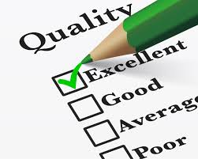
MWCC Workforce development
Quality Yellow Belt Training
Quality Green Belt Training
Quality Basics –Intro level
Industry Readiness Training
Custom Quality Training
  based on specific industry needs

Slide 16

Quality yellow/green belt training
Training with the aim to pass the yellow/ green belt exam of American Society for Quality (ASQ)
Highly sought-after credentials in manufacturing/ biotech industries
Training is delivered in four modules based on the body of knowledge suggested by ASQ
ASQ suggests at least 80 hours study for yellow belts
MWCC provides 120 hours of trainer- assisted content, including study materials, exercises and practice tests
Content and training for Green Belts are more in-depth and technical

Slide 17
QUALITY - Certifications
https://asq.org/cert/faq/career-track
Notes:
These are example certification career paths only.

Slide 18
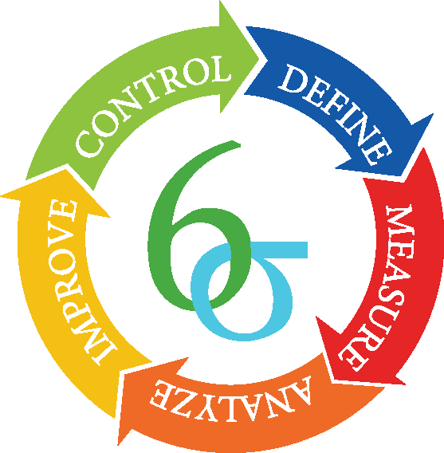
Quality yellow/green belt training
Content for quality is organized in four modules.
Module 1 introduces the concepts of quality, customer, supplier, and quality management principles
Module 2 introduces the six sigma methodology, and fundamentals of measurement and analysis
Module 3 is more math – based. It revisits mathematical concepts and basic statistics to build on statistical process control methodologies
Module 4 introduces Lean concepts and process validation
DMAIC Methodology

Slide 19
Quality green/yellow belt modules
A continuous flow on DMAIC methodology is created
Module 1
Definition and History of quality
Module 2
Lean concepts
Definition of process
Customer Vs Supplier
Cost of poor quality
ISO 9000
Non-Conformation
CAPA system
Module 4
Module 3
Six Sigma structure
Define – Project selection
Root Cause Analysis in Define phase
Project planning
Teamwork
Voice of customer
Specifications
Measurement fundamentals
Data collection
Measurement fundamentals
Introduction to metrology
Shop Math review
Introduction to Statistics
Descriptive Statistics
Hypothesis testing
Graphical analysis
Statistical Process Control
Process Capability Analysis
Root Cause Analysis in Improve phase
Validation
Change control
Define
Measure
Analyze
Improve
Control

Slide 20
Quality Basics/ white belt
The quality basics training content includes but is not limited to
  Continuous Improvement concepts and philosophies
  Concepts related to Descriptive Statistics and Key Performance Indicators (KPIs)
  Seven tools of Quality
  Lean – concepts and tools
PLAN
ACT
DO
CHECK
(STUDY)
Notes:
The sequence of the course will follow the PDCA cycle

Slide 21

Transition to online learning
MWCC successfully transitioned to online quality yellow belt training after Covid.
  All content was transformed into self-paced learning material on Blackboard online learning platform
  Learning material was combined with instructor-led learning and assistance one – two times in a week
  Lectures (voice over PowerPoint), exercises, homework assignments, and practice tests were uploaded and paced by instructor
Notes:
The sequence of the course will follow the PDCA cycle

Slide 22

Transition to online learning success and challenges
Success
  Time flexibility
  Availability of all materials electronically
  Access to online content any time via Blackboard
  Exam preparation done systematically
  Review of learned concepts on request
Challenges
  Progress tracking
  Class / group discussions
  Team tasks
  Online and paper material coordination
  Technologically challenging
  Limited live interaction/ question-answer
Notes:
The sequence of the course will follow the PDCA cycle

Slide 23

Tale of two trainees
Katrina (pseudo name) was in one of our yellow belt cohorts. When she started, she was unemployed. She highlighted the class in her resume, and successfully obtained employment as a quality assurance specialist at a medical device manufacturing company. She got the job on week 2, but still completed the full 6-week course, and passed the Yellow Belt exam. Her company was more than excited to assist her with flexible schedule and encouragement.

Slide 24

Tale of two trainees
Jennifer (pseudo name) was in our latest cohort. She learned about six sigma project charter in class and used it the next day at her job. She received heavy accolades from her manager, and the company encouraged and funded her to get a six sigma green belt certification.

Slide 25
Thank you

