Slide 1
Powering Todays Industrial Revolution
Funded by the Massachusetts Executive Office of Housing and Economic Development and Managed by MassHire North Central Workforce Board

Slide 2
Massachusetts Statewide Advanced Manufacturing Training System
Four Regional Manufacturing Consortiums throughout Massachusetts created 5 year local plans in 2018-19 using labor market data projecting out to 2023. We are entering year three of a five year grant.
Central Region REMAKE 4.0, Northeast Region, Southeast Region, Western Region
Leadership and funding provided by the Executive Office of Housing and Economic Development
Statewide Priorities are based on similar workforce issues across the four consortiums
Close the talent/skill gap in manufacturing
Create guaranteed funding resources for training
Change the negative public perception of manufacturing careers
Increase the number of trained workers entering the manufacturing industry
Increase training capacity by recruiting teachers to upskill incumbent workers

Slide 3
What is REMAKE 4.0
A revolutionary partnership between employers, educators and workforce boards in the central region of Massachusetts.
REMAKE 4.0 actively works with Massachusetts manufacturing leaders to enroll and fund new and experienced workers alike into quality training and leadership programs.
REMAKE 4.0 training invites the daring, the bold, and the free thinkers to experience and learn the skills necessary to make change and build your career.
REMAKE 4.0 programs are designed to spark interest and ignite passion from experienced workers and new recruits alike, while buildings skills and attributes that make workplaces thrive
Educators
Employers
Workforce Boards
Affiliates

Slide 4
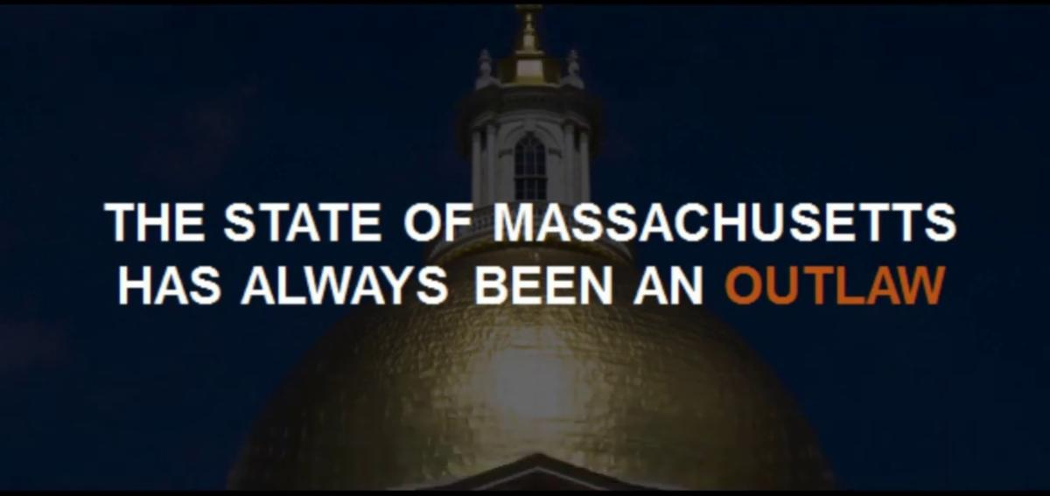
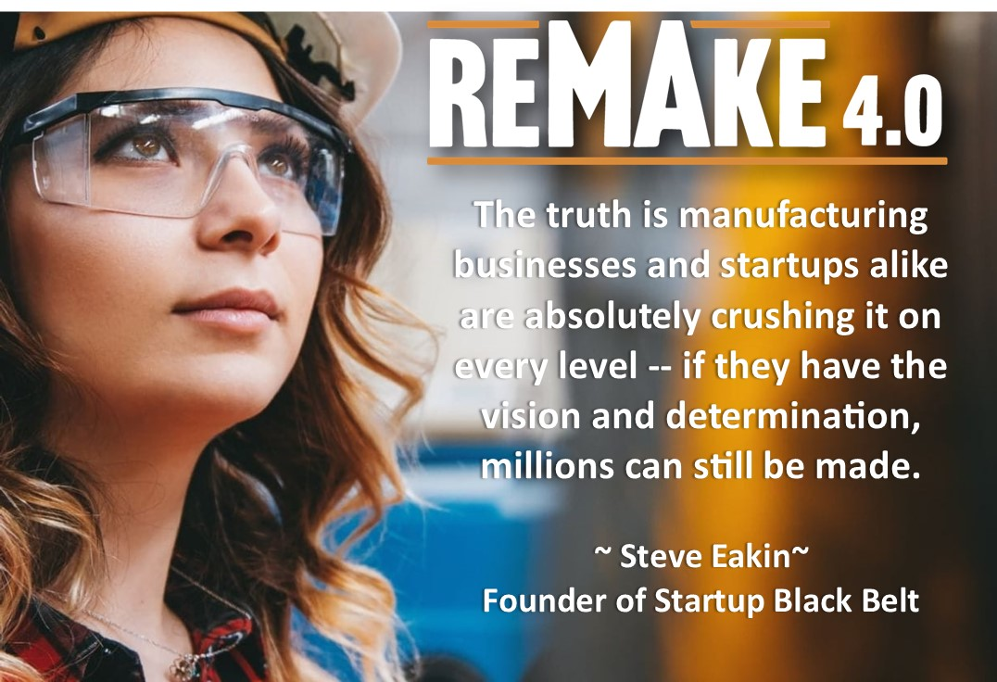
Powerful Branding
We work collaboratively with our partners to capture and brand the spirit of the manufacturing efforts in our region.
The “REMAKE 4.0” brand, a bold movement that reaches back to our states revolutionary roots and invites the daring, the bold and the free thinkers to forge their future.
REMAKE 4.0 branding is big enough for all of the partners to identify with and narrow enough to have a laser beam focus on our mission.
We embody an innovative attitude and vision that shifts the perception of what it means to work in manufacturing today.

Slide 5
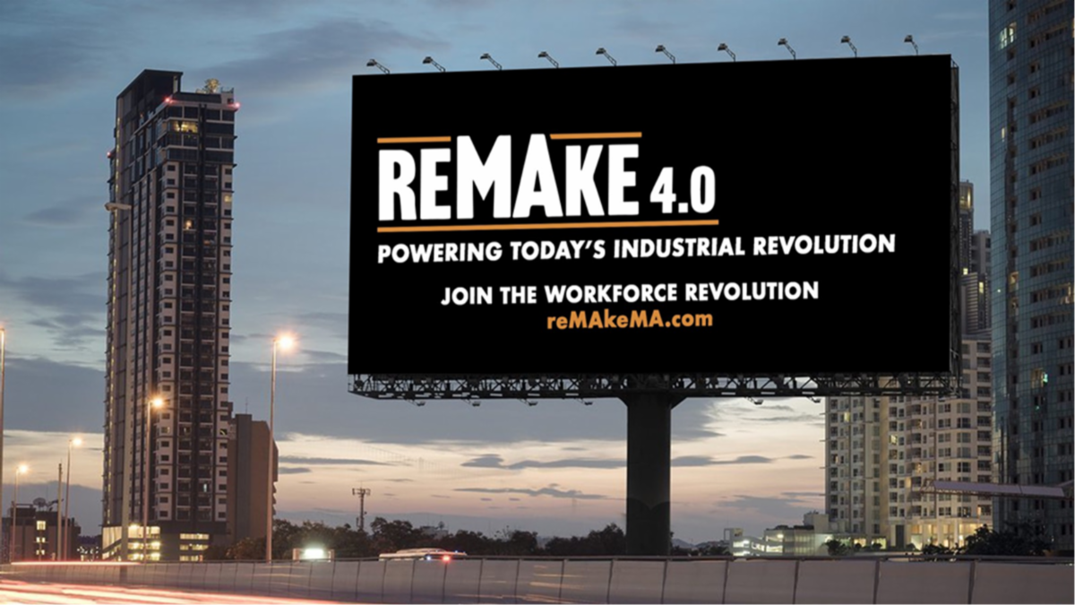
Aiming At Multiple Targets
Incumbent workers
Those in career transition
Those yet to enter the job market
Manufacturing employers
We invite others to join us in seeing how a career in manufacturing is creative, liberating and revolutionary

Slide 6
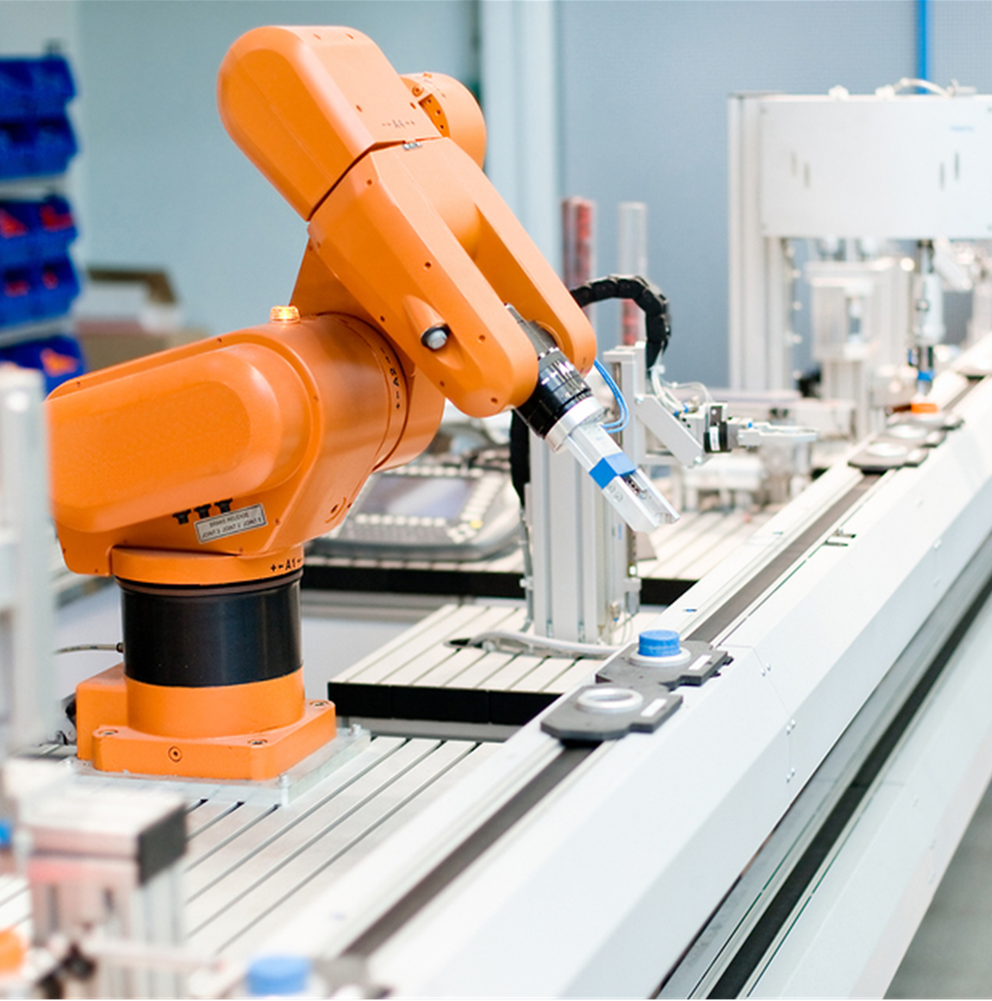
Recruitment
REMAKE 4.0 powers manufacturing recruitment by deploying a campaign to drive public interest in manufacturing as a great career pathway and to connect people with job opportunities in the industry.
REMAKE 4.0 uses Social Media to spread the message about virtual and in-person job fairs, training classes, industry advancements and other REMAKE 4.0 initiatives
Outreach to the diverse talent pool at local High Schools, Tech Schools and Community Colleges
Initiate the development of certificate programs at community colleges and vocational technical schools
Ongoing relationships with MassHire, MassMEP, Veteran’s Inc, Worcester Housing Authority, local Chambers of Commerce and municipalities

Slide 7
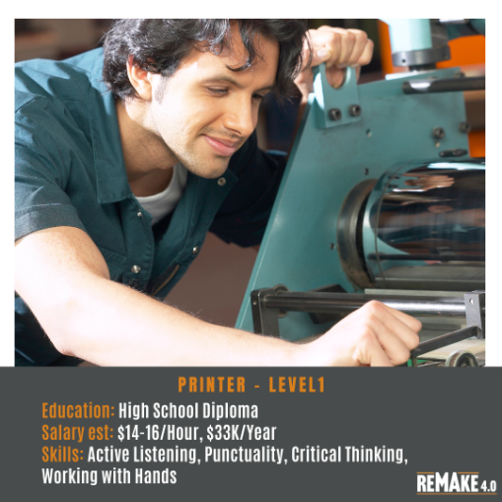
Recruitment
Partnering with local manufacturers to identify entry points and career pathways
Created a Manufacturing Job Page for current job postings on the REMAKE 4.0 website
Coordinate hiring events, employer meet & greets, and manufacturing tours, pivoting to create virtual job fairs and currently planning a virtual company tour for this year's annual Manufacturing Day
Production of a REMAKE 4.0 Employer Newsletter that specifically focuses on the needs of employers with reader access to training and other funding opportunities
Promote STEM, apprenticeships, work studies, co-ops and other programs to attract targeted students into the manufacturing training pipeline

Slide 8
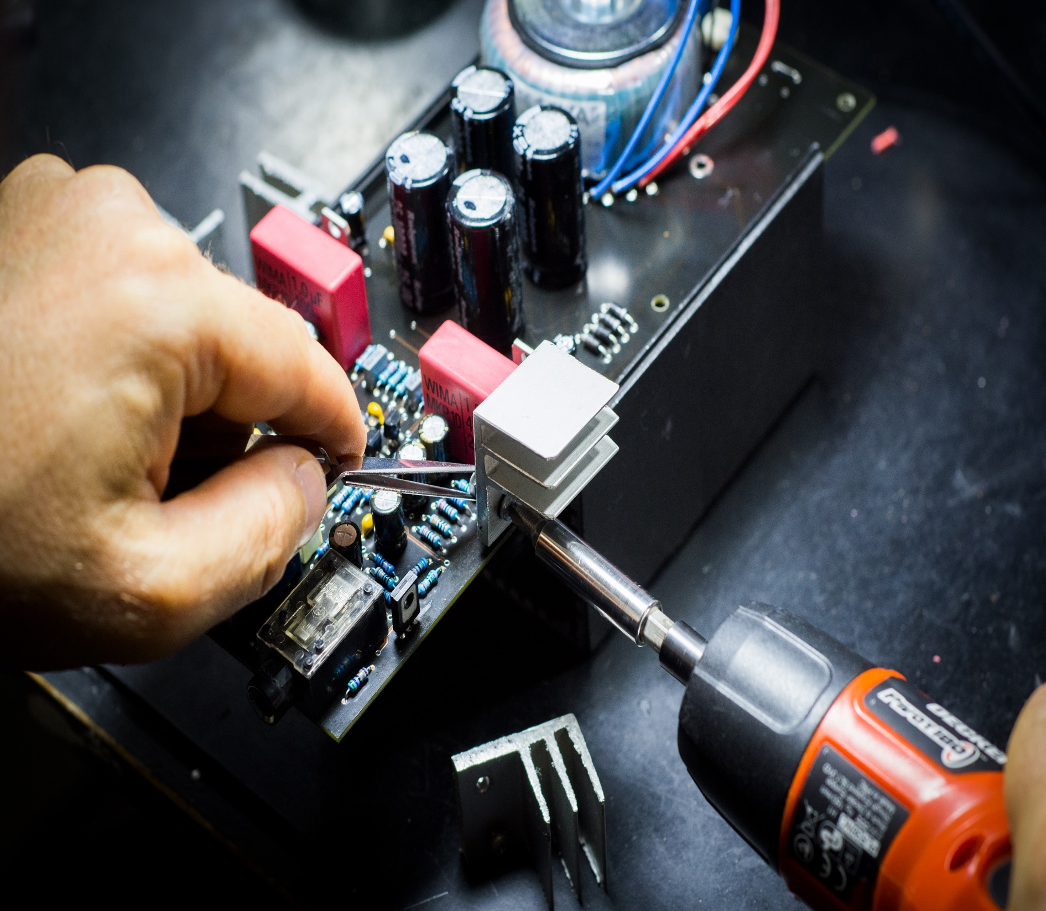
Training
reMAke 4.0 actively works with Massachusetts manufacturing leaders for input and guidance in developing the best possible courses to create a skilled and sustainable manufacturing labor pool. Classes include:
Introduction Machine Operation
CNC Machining
CAD
Lean Six Sigma Yellow Belt
Essential Supervisory Skills
Shop Math
OSHA 10
Interpreting Prints & Drawings
Welding

Slide 9
Funded by the Massachusetts Executive Office of Housing and Economic Development and Managed by MassHire North Central Workforce Board

