Slide 2
Integrating Leadership Soft Skills Into Your CTE Program
Notes:
Do your students understand the importance of vision, diplomacy, coaching or team building? Whatever career path they choose, employability skills, or soft skills, will help them succeed as leaders. In this session, we share tips and best practices for integrating the leadership skills into any program to teach students the soft skills they'll need for leadership beyond the classroom.

Slide 3
What we will discuss today
The Need for Leadership Soft Skills – Why They Matter
Best Practices for Teaching Leadership Soft Skills
Best Practice #1 – Engage Your Students
Best Practice #2 – Instill Professionalism in Your Classroom
Best Practice #3 – Integrate leadership Skills in every Class
#4 – CTSO Competitive Events
Notes:
First we will briefly discuss why soft skills even matter and then we will get into a variety of activities and ideas you can use for weaving leadership soft skills into your courses. We also would like to share ideas that you may already be doing at the end of the session.

Slide 4
What are leadership soft skills?
Notes:
First, let’s define what these skills are. Leadership employability skills also known as soft skills, are the skills needed to help get and keep a job. Soft skills are also incredibility important as they relate to leadership.

Slide 5
Important Leadership Soft Skills
Trust
Professionalism
Coaching and Mentoring
Conflict Resolution
Decision-Making & Goal Setting
Delegation
Honesty & Integrity
Diplomacy and Tact
Determination
Empathy
Servant Leadership
Team Building
Visionary Leadership
Optimism
Public Speaking
Observation
Creativity
People Skills
Notes:
Helping your students become college and career-ready is a primary goal of your programs. Developing young leaders is another. One way to ensure career readiness is to give students the opportunity to actively practice a variety of soft skills. Use scenarios and activities to introduce students to many important soft skills such as these, desired by employers. Through a variety of activities and discussions you can relate each soft skill which ties it into leadership development.

Slide 6
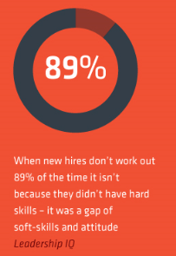
The Need for Soft Skills
“57% of business leaders say soft skills are more important than hard skills.”
2018 Linkedin Survey
https://www.eab.com/daily-briefing/2018/01/29/the-24-most-in-demand-skills-of-2018-according-to-linkedin
McClelland, Geordie (June, 2014)
A More Human Approach to Human Capital Retrieved from http://www.slideshare.net/GeordieMcClelland/start-your-career-no-matter-where-you-are-starting-from
Notes:
Do not underestimate the importance of soft skills in the workplace. In a recent study conducted by Linked In, 57% of business leaders rated soft skills more important than hard skills.
Another statistic by Leadership IQ is the fact that 89% of new hires that don’t work out is because of a soft-skills gap!!

Slide 7
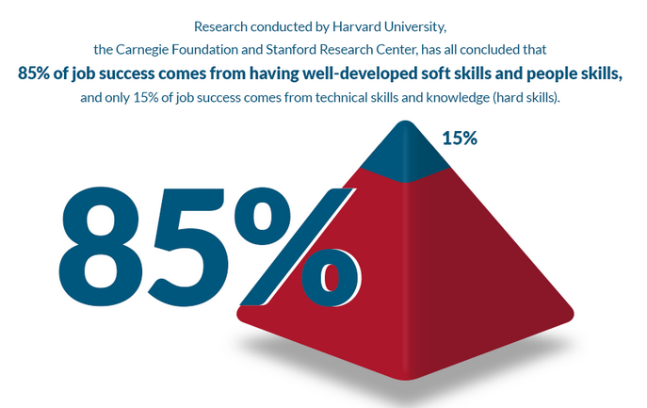
Soft Skills Job Success
https://www.nationalsoftskills.org/research-publications/
Notes:
Job success is deeply dependent on an employee’s soft skills. Take a look at this recent study conducted by Harvard:
Let’s take a deeper dive into how we can integrate leadership soft skills into every day lessons.

Slide 8
Best Practices for Teaching Leadership Soft Skills
Notes:
Now we will get into some activities and ideas for incorporating leadership soft skills into your everyday lessons.

Slide 9
#1 – Engage Your Students
Notes:
The first best practice for integrating leadership soft skills into your CTE program, or any CTE program is to engage your students. CTE in general is all about hands-on, experiential learning. It is no different as you introduce leadership soft skills for practice and application into your lessons.

Slide 10
Lesson Idea: A SPECIAL Way to Instill Confidence
Smile
Posture
Eye contact
Confidence
Introduce yourself
Ask a question
Learn and listen
Notes:
Helping students learn self-confidence important soft skill for any occupational areas. We know that in a post-COVID work environment things like handshakes may not longer be the norm. So practicing a professional way to introduce yourself, and initiate a conversation, making a solid first impression is a great way to engage your students.
Introduce the acronym SPECIAL as a way to practice professional introductions.
Start with a smile, be confident.
Stand up straight!
Look ‘em in the eye
Be positive and self confident – you are worth getting to know
Introduce yourself – practice what you’d say in a short elevator speech about yourself
Ask questions to show you are engaged and interested
Learn and listen from the other person by using active listening techniques
Have students pair up and practice with each other.

Slide 11
Activity: Using Confidentiality Scenarios to Teach Trust
Notes:
So starting with a strong introduction is a great quick way to engage your students. Now we will share a variety of other lesson activities you can use to engage students as you introduce leadership soft skills. Here is one way you can use scenarios to teach the skill of trust.

Slide 12
Teaching Trust Through Confidentiality Scenarios
Sample Scenario:
Your friend, who is also your partner and co-owner of the restaurant, decides to go solo and open his own restaurant. It will directly compete against you. You’ve been through a lot together and have plenty of information that could negatively influence his reputation. Do you leak this information?
Notes:
Helping students learn about how trust and confidentiality are important to leadership is key.
Using confidentiality is a great strategy for building trust. It is important to keep any confidence that you have been entrusted with by someone else. You can’t expect to be an effective leader if you betray the trust someone has placed upon you. One of the most common signs of someone who cannot be trusted with confidential information is the person who says, “So-and-so told me this in confidence, but I know you won’t say anything.” While you may feel special that this person trusts you, what about the person whose information they promised not to divulge? Has this ever happened to you or with someone you trusted? Have students share any examples they are comfortable with.
Discussion questions could be:
Are you someone who can be trusted with private and confidential information? Why or why not?
To gauge your trustworthiness in this area, ask yourself how you would handle the following scenario.
Divide your class into small groups of three or four students. Give students a Confidentiality Scenario. You can use one for everyone group or come up with several so each group has their own.
Have each group come to a consensus as to how they would recommend handling each scenario, along with the reason(s) why they chose their answer.
Scenario:
Your friend, who is also your partner and co-owner of the restaurant, decides to go solo and open his own restaurant. It will directly compete against you. You’ve been through a lot together and have plenty of information that could negatively influence his reputation. Do you leak this information?
Bring the class back together. Have each group choose one scenario to read through and then have a representative from the group explain their answer as well as why they chose to handle the scenario the way that they did. When you keep things confidential that should remain confidential, you will gain the reputation as a person who can be trusted and grow strong in character and value.

Slide 13
Activity: Resolving a Real-World Work Conflict Using Conflict Approach Styles
Notes:
Conflicts in the workplace can be a distraction, destroy motivation, reduce productivity, and lead to anger and frustration overall. As a leader, it is your job to successfully facilitate conflict resolution. We know that some conflict is natural in the workplace and can many times lead to healthy discussions and innovative solutions. There are five conflict approach styles to choose from according to the Thomas/Kilmann Model.

Slide 14
Using Conflict Approach Styles to Resolve Conflicts
You are the head chef in a local cafe. Anna and Jose both work in the kitchen. Jose was hired a few months ago and Anna has worked there for nine years.
Jose, while a competent worker, tends to procrastinate. Anna works more steadily and keeps on top of her tasks. Anna complains to you that she feels she has to worry now about Jose's work, along with her own. Anna and Jose rely on each other for certain tasks to be completed. Anna is uncomfortable with waiting until the last minute.
Because of the conflict, Jose is missing more work and you suspect it’s because he wants to avoid Anna and her
anger. How do you resolve this conflict? Which conflict approach style would you choose and why?
Competing
Collaborating
Compromising
Avoiding
Accommodating
Notes:
Give an overview of the 5 conflict approach styles:
Competing: Leaders use their position, knowledge, or persuasion to control subordinates. This style is typically used in emergencies when a decision must be made quickly using autocratic leadership to resolve a problem.
Collaborating: This participatory leadership style fosters an environment of cooperation and collaboration. Employees learn to function and solve problems as a team.
Compromising: Both sides in the conflict give up something to gain an agreement. Leaders using this approach encourage team members to concede when necessary to maintain productivity rather than continuing to argue.
Avoiding: This strategy means ignoring the conflict. Effective leaders recognize that delegating conflict resolution to a third party on occasion can be effective in situations where emotions run high and mitigates the temptation to ignore the issues.
Accommodating: For the greater good of the team, a team member may surrender their position. When the stakes are low, this can promote unity and foster a productive environment. However, this doesn’t work in the long term.
Students read through a workplace scenario and are tasked with using a conflict approach style to solve it.

Slide 15
#2 – Instill Professionalism in Your Classroom
Notes:
I was recently in an Illinois CTE teacher’s classroom, and the instructor, who had come from industry, was lamenting the fact that her students couldn’t communicate, didn’t know the value of showing up on time, etc.
Well, a great place to start developing those skills is in the classroom – especially if they are not experiencing those requirements anywhere else. By demanding professionalism, you’re setting your students up to succeed in the workplace
That said, the key here is consistency.
Every day, make sure your students know they’re expected to:
Arrive on time
Come prepared
Use proper spelling and punctuation
Dress for success
Now, we know you might not be able to do every one of these items every day. The idea is to mimic a work environment, and get your students used to those professional habits.

Slide 16
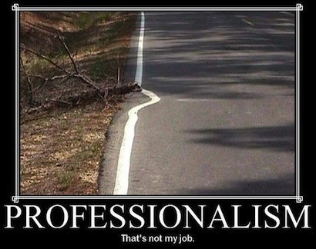
Lesson Idea: Set Expectations & Lead by Example
Notes:
Begin by introducing the definition of the term ‘professionalism’ to the class. The Merriam-Webster dictionary defines professionalism as “the conduct, aims, or qualities that characterize or mark a profession or a professional person” and it defines a profession as "a calling requiring specialized knowledge and often long and intensive academic preparation.“ Professionalism integrates a number of different attributes which, together, serve to identify and define a professional.
Have students complete answer the question What are the Attributes of a Professional?. Give them five minutes to identify as many professional attributes as they can.
Continue by sharing an image with a professionalism saying – there are many in google.
Most of the attributes or characteristics of a professional can be summarized as how you act, how you look, and how you think. Ask students to share the attributes they identified in the previous step.
Provide some thought-provoking questions to facilitate discussion. Are professionalism and leadership the same thing? Are there characteristics that you would consider professional, but not characteristic of a leader? Why or why not?

Slide 17
Activity: Coaching as a Leader
Leading and Coaching TedX Talk
https://www.youtube.com/watch?v=VradB8Hka1c
Notes:
As a leader, there is a difference between telling people what to do and working with employees on professional development. A core competency for an effective leader is coaching skill, which focuses on developing employees. One way you can introduce the concept of coaching as a leader is through a Tedtalk. If you google ‘coaching’ you’ll find many that could be used. Here is one example that I found that runs about 18 minutes

Slide 18
How to Coach as a Leader
Recognize strengths.
Stay objective.
Own the results.
Show empathy.
Know how to partner.
Remain curious.
Pick up and give subtle communication.
Develop a process you can replicate.
Ask open-ended questions.
Create a strategic vision for transformation.
Notes:
Ask students to identify coaching skills that leaders should have. Students could write them on a piece of paper individually or you could ask this question as a class exercise and come up with a master list.
Share these 10 if not on the list:
Recognize strengths: Embrace and capitalize on the strength of each team member.
Practice involved detachment: Be fully engaged emotionally while remaining non-judgmental and objective.
Own the results: Be accountable when things go well and when they do not so that you can improve and grow.
Show empathy: Connect with others by walking in their shoes, without an agenda or judgment.
Know how to partner: Pull with and for team members. Don’t direct, but ensure that individuals are heard, valued, and validated.
Remain curious: This is the difference between knowing and discovering. Encourage consideration and inclusivity.
Ability to pick up on and give subtle communication: Listen for what is said and what is NOT said.
Develop a process that you can replicate: Find a coaching methodology that works and refine it so that it is efficient and replicable.
Ask open-ended questions: Create openings for new action. Don’t just problem-solve!
Create a strategic vision for transformation: Set visions for others to reach for and to achieve greater for themselves.
Now using these 10 skills, share the following scenario (or create one of your own). After reading it to the class, ask students how they could use some leadership skills to coach their employee in the scenario.
You are the manager at a local convenience store. On Monday, you observed your cashier, Michael, being rude to a customer. The customer said that they received the wrong drink. Michael said he gave them just what they ordered and that he was right. He said he would not give them a new drink unless they paid for it. The customer walked away very angry and left the building.

Slide 19
Activity: Setting SMART Goals
Notes:
Smart goals is a goal-setting technique that allows leaders the opportunity to set actionable objectives that receive results. Many managers and leaders may use this method to further breakdown longstanding vague or unclear goals. Each letter in the acronym is a principle that can be used in the process to create goals that make sense.

Slide 20
Creating SMART Goals
Notes:
Share a scenario and have students write a smart goal for Maria:
Maria is a recent college graduate. She has a degree in interior design. It has always been a dream of hers to start her own business using her own designs for things like office spaces. She likes the idea of having her own business so she can work when she wants and travel. She loves to travel with her family and she uses some of the pictures from her trips in her room designs. She would really like to be able to quit her part-time job in a couple of years to run her own business full time.
Maria’s broad goal is: I want to start a business.
Now, write a SMART goal to help Maria.

Slide 21
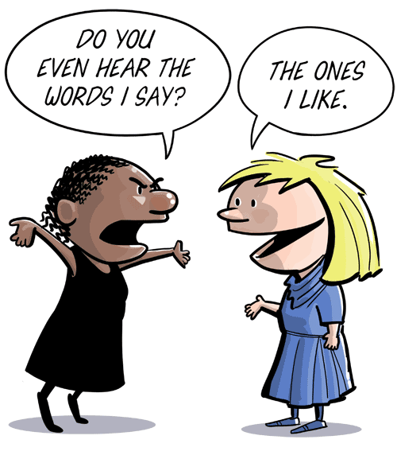
Activity: Communicating With Tact
Notes:
Diplomacy in leadership refers to the use of tact in such a way that negotiations, policies, conflicts, interests, and benefits are agreed upon, and both parties are happy with the outcome. It is a unique skill set that some people have naturally while others develop through practice, trial and error. A leader who uses diplomacy and tact excels. This activity will help students understand what diplomacy and tact are and how to use these skills in the workplace.
Share the following strategies for communicating with tact:
Consider the other person’s viewpoint and acknowledge it.
Consider cultural differences.
Be discreet.
Be gracious at all times.
Have empathy.
Be an active listener.
Be respectful.

Slide 22
Tactful Communication
I want that accident report right now.
You are always late to work.
I think my idea for marketing our childcare center is the best.
I don’t have time to stop everything and clean these toys up for you.
You need to stop wasting time on your cell phone and spend more time doing your job.
You get so emotional over every little thing that happens at work.
Notes:
Now that you have shared strategies for communicating with tact, have your students put this into practice. How would they restate each of the following statements to be more tactful. You could create a dozen or more of your own, or have each student contribute one statement that another student has to restate.
For example for statement 1: I want that accident report now. Restated: Could you submit the accident report as soon as possible so that we can brief our insurance company?

Slide 23
#3 – Integrate Leadership Skills Into Every Class
Notes:
Here is our third best practice and that is to strive to integrate some sort of leadership skills into every class.
Good, effective leadership is a skill that can be learned, practiced, and improved upon. And while we tend to notice the more obvious charismatic leaders with the loud and bold personalities, the fact is that anybody, even the quiet kid in the back who hardly speaks a word in class, can be a leader.
In fact, it is highly likely that at some point in their life, everyone will be called upon to lead in some capacity. With this in mind, it is crucial that we provide what training we can to prepare our students for leadership roles — to prepare them to be good, effective leaders that will take others in a positive direction.
Our world needs good, effective leaders. And with a bit of training and encouragement, our students have the potential to meet — and even surpass — that need.

Slide 24
Lesson Idea: Ice Breakers
Collaborative work helps build communication skills
Open-ended questions help build problem-solving skills
Reflection activities help build critical thinking skills
Oral speaking assignments help build self-confidence
Prioritizing can help students develop time-management skills
Notes:
One easy way to integrate leadership skills into every class is through the use of ‘ice breaker’ activities. These could be a 30-second introuction or a focused 5-minute activity, leadership skills can be addressed in every classroom
Often, students might not even be aware they’re learning them. Remember that:
Collaborative work helps build communication skills – Start class with a quick think-pair-share activity where students pair up for a quick discussion
Open-ended questions help build problem-solving skills – Write a ‘big idea’ question on the board and have students journal their answers.
Reflection activities help build critical thinking skills – Use a K-W-L chart at the beginning and end of class to help students reflect on what they know and what they’ve learned
Oral speaking assignments help build self-confidence – Do “Introductions but with a twist.” Ask everyone to introduce themselves and state something unusual about themselves that no one knows.
Help students develop time-management skills. Give each small group a bowl with (pre measured)dried beans in it and ask them to put in a few larger objects (i.e. fruit or other) The beans spill out, and the students will be doing their best to pile them back in again. Then show them the trick of putting in the fruit (or larger objects) in first and the beans around them. It illustrates the point of prioritizing the big stuff and fitting the smaller things around it. Interruptions for the rest of the day can be referred to as beans.

Slide 25
Activity: Observation Scenarios
Notes:
Observation is a powerful tool for learning for all of us; but as a leader, it is perhaps even more important. As a leader, we need to be aware of how individual team members are doing and watch for engagement, team dynamics, behavior and communication. Leaders must be looking, noticing, asking, and being aware to spot trends, learn more, and lead more effectively. This activity is to help students harness the power of observation as a leadership skill and put it to practice.

Slide 26
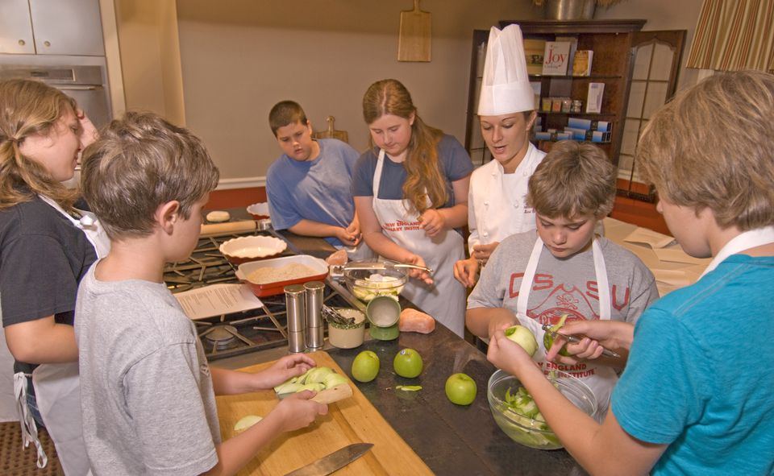
How Observant Are You?
Notes:
For this activity, find a photograph that has a lot of detail in it. You may wish to choose on that relates to your CTE area. Explain to your students that they will view a photo (or several is desired) for 30 seconds. After the 30 seconds are up, students will be asked a series of questions. Make sure to advance the slide presentation or stop showing the photo after 30 seconds so students must recall using their powers of observation.
Ask the following questions verbally after showing slide for 30 seconds. So right now, look at this image for 30 seconds. Then I will advance to the questions. Good luck!

Slide 27
How Observant Are You?
What fruit was being used?
How many apples were uncut on the table?
How many students were in the photo?
How many culinary instructors were in the room?
What are the students making?
Was measuring spoons present in the photo?
How many students are wearing aprons?
Notes:
What fruit was being used? Answer: apple
How many apples were uncut on the table? Answer: 3
How many students were in the photo? Answer: Six
How many culinary instructors were in the room? Answer: 1
What are the students making? Answer: An apple dessert of some sort
Was measuring spoons present in the photo? Answer: no
How many students are wearing aprons? Answer: 4

Slide 28
Activity: Honesty and Integrity at Work
Notes:
Having honesty and integrity in the workplace is one of the most important qualities of great leadership. In this activity students learn what this means and how to apply these skills to their work and personal lives.

Slide 29
Honesty and Integrity Quote
Notes:
You can begin, if students are not familiar with these words, by defining each. Honesty is defined by a person's relationship to truth and deception (or lack of it), while integrity is defined by a person's relationship to principles, such as codes of conduct and/or morality. Integrity stands as a more broadly demanding concept, morally, in comparison to honesty. You can see how both are an essential part of being an effective leader.
For this activity find quotes or sayings online that focus on honest and/or integrity. Share these with students and then as a writing exercise, have them journal and ask for students to tell you what they think that quote really means and why. Here are two examples you could use.

Slide 30
Activity: Visualization
Notes:
The visionary leader can clearly articulate their view of the future, allowing followers to understand how they play an important role in that future state. By doing this, the followers become committed to making that vision come true. This activity will help students understand what it means to be visualize something and how they can apply this to their own life.

Slide 31
Visualization Exercise
Think of a career
See the environment
Imagine the path
Identify the steps
Notes:
The activity will include a visualization exercise that includes thinking about goals, future and dreams. They are led through the visualization with a series of questions.
Ask students to close their eyes and lead them through a visual imagery exercise. Use the following prompts to guide students to not only think about but also to visualize their goals, futures, and dreams. Be careful to pause between prompts in order to give time for students to create visual pictures and really imagine the possibilities.
Think of a career or educational goal or dream you want to accomplish. This might be something you are currently doing or something for your future. It could be something you’ve considered but haven’t truly thought you could do.
Imagine what the day would look like when you achieved your goal. Picture yourself in that environment. What do you look like? What are you saying and doing? Who else is there with you?
Now see the environment. What does it look like? Smell like? Sound like? How do you feel?
Consider what it took for you to get to this point. How long did it take you? What sacrifices did you have to make? What were the little victories you were able to celebrate along the way? What were the victories that you knew were bringing you that much closer to your goal?
What did that path look like? Was it smooth and even or bumpy and challenging? What difficulties did you encounter? How did you work through these? Think about the time it took to get through to each one.
Now picture yourself today and think about the steps you are going to take to get to that goal. Ask students to open their eyes and take 5-10 minutes to journal what they envisioned.

Slide 32
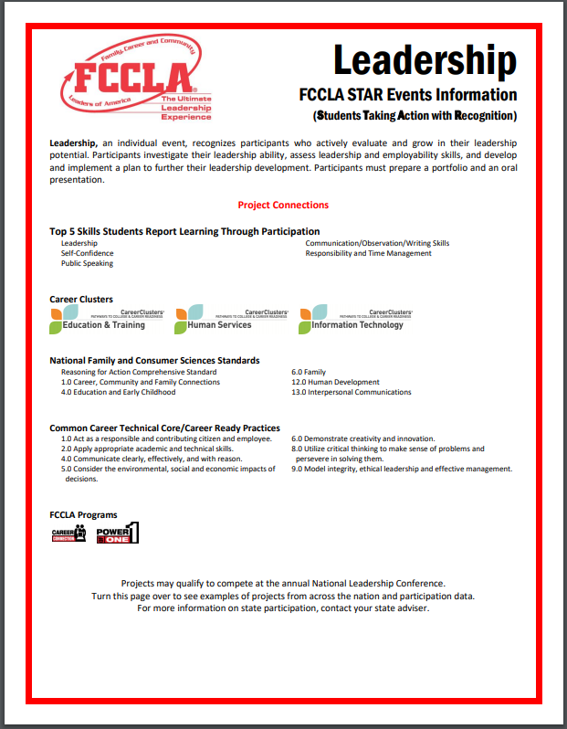
#4 – CTSO Competitive Events
Notes:
We know that many CTSO organizations have leadership competitive events.
FCCLA has Leadership STAR events.
FFA has career and leadership development competitive events and opportunities.
HOSA has 10 leadership events that cover a variety of soft skills.
Some of the ideas shared today can help your students prepare for these leadership events. These ideas give students practice and application of leadership soft skills.
A

Slide 33
RealCareer™ Leadership Soft Skills Program
Teacher Guide
Student Workbooks
Scenario Cards
Notes:
We’ve given you lots of activities and ideas for integrating leadership soft skills into your CTE classes. If you are looking to save time, we have a Leadership Soft skill program has 3 components to it: The teacher guide with 18 ready to use lessons, set of 20 student workbooks and scenario cards, featuring one scenario for each of the 18 soft skills included.

Slide 34
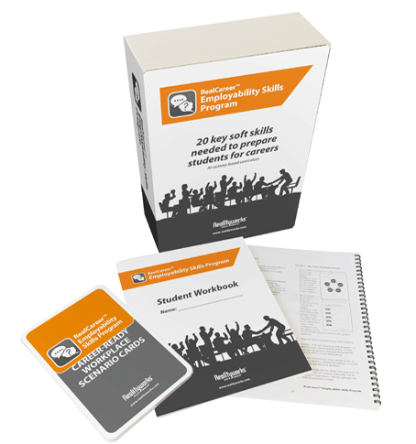
RW Employability Skills Program
Notes:
Similar to this program, we have another program The Employability Skills Program is for use in any Career & Technical Education course as a complete unit on soft skills or as a supplement to an existing career preparation program.
Use this activity-based program to:
Introduce students to 18 soft skills: Communication, Teamwork, Problem Solving, Critical Thinking, Leadership, Time Management, Interviews, Motivation, Work Ethic, Listening, Respect, Responsibility, Flexibility, Interpersonal Skills, Negotiation, Networking, Patience, Presentation Skills, Self-Confidence and Stress Management
Give students the chance to actively practice those skills
Help students become college- and career-ready
Product includes:
19 Career-Ready Workplace Scenario Cards
The Career-Ready Workplace Scenario cards generate discussion
and challenge participants to identify a solution using a variety
of soft skills learned in the program.
19-Lesson Employability Skills Curriculum/Teacher Guide
Presentation Slides
20 Student Workbooks*
* additional class packs available (qty. 20)
$499.00 SKU: 11130945

Slide 35
Additional Resources for Career Success
Realityworks Blog
http://realityworks.com/blog/
Facebook
https://www.facebook.com/realityworksinc
Free Soft Skills Webinars
https://www.realityworks.com/resources/webinars
Notes:
Realityworks wants to connect with you through social media as well.
Visit our blog for additional information from customers.
Like us on facebook to learn even more about our products and industry happenings
We also have several free webinars that are archived and available on demand.

Slide 36
Two new online courses!

Slide 37
Online Soft Skills Training Programs for Employability Skills and Leadership Skills
With increased demand for distance and online learning, we’re taking our soft skills programs online!
Key features include:
Self-paced, guided learning
Information, scenarios and activities about 19 soft skills
Automatic progress monitoring
Exercises that can be submitted to instructors for accountability and grading
Notes:
Self-paced learning and information about the soft skills
Guidance through the lesson, which is broken into sections, and a progress monitor reports when each section of the lesson is completed
Practical application of the soft skills in various scenarios and activities throughout the lesson
Exercises that are completed and may be submitted to instructors for accountability and grading
Interactive ways to engage students in the content bringing concepts to life through:
Video clips Animations
+ to access more information Drop and drag
Exercises Self-Assessments
Hover over Scenarios
Flip to learn more Matching
Employability program includes 74 exercises that may be submitted to instructors.
There are over 100 different interactive ways to engage students throughout the course including videos, animations, puzzles, self-checks and learning objects

Slide 38
Be the first to know!
Go to this page:
https://www.realityworks.com/online-softskills-programs/
Fill out the form
We will send you information on when it is ready!

