Slide 1
Rebuild Your future
Rebuild your future:
Connecting former offenders with the construction industry
Keri Allman & Tashina Mahatha
Presented By:

Slide 2
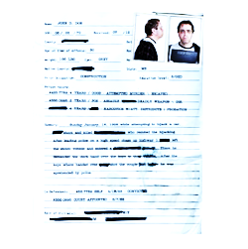
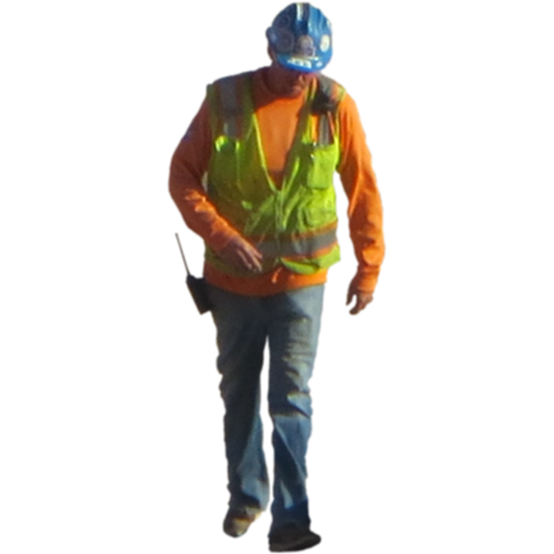
Justice involved
North Carolina's 3-year recidivism rate is 40%
65% of all new jobs require some postsecondary education and only 22% of people in the NC state prison system have had at least some postsecondary education
92% of employers conduct criminal background checks; an applicant with a criminal record is 50% less likely to receive a call back
Notes:
Statistics supplied in the grant that show the needs associated with this population

Slide 3
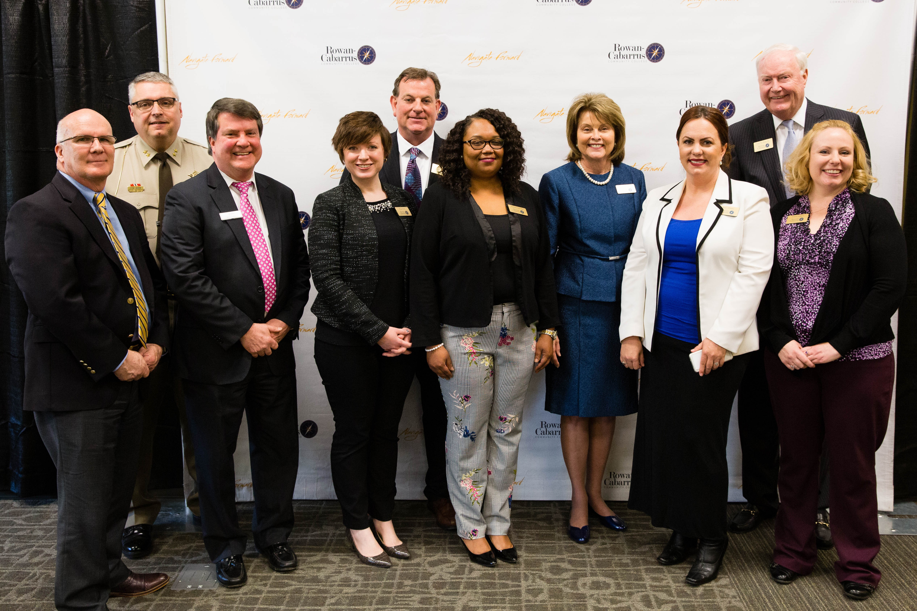
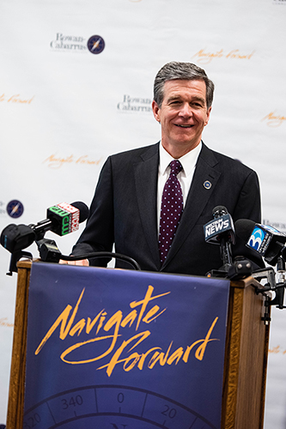
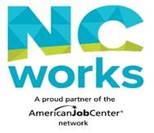

Slide 4
Rebuild your future Goals
Connect justice involved job seekers and potential students to construction employers in the area
Provide post-secondary training to justice-involved in the light construction industry by offering courses to obtain a Construction Trades Certification and/or Class B CDL
Train community college and frontline workforce staff to deal with issues faced by the re-entry population
Notes:
Quick overview
Information direct from grant

Slide 5
Partners
Employers

Slide 6
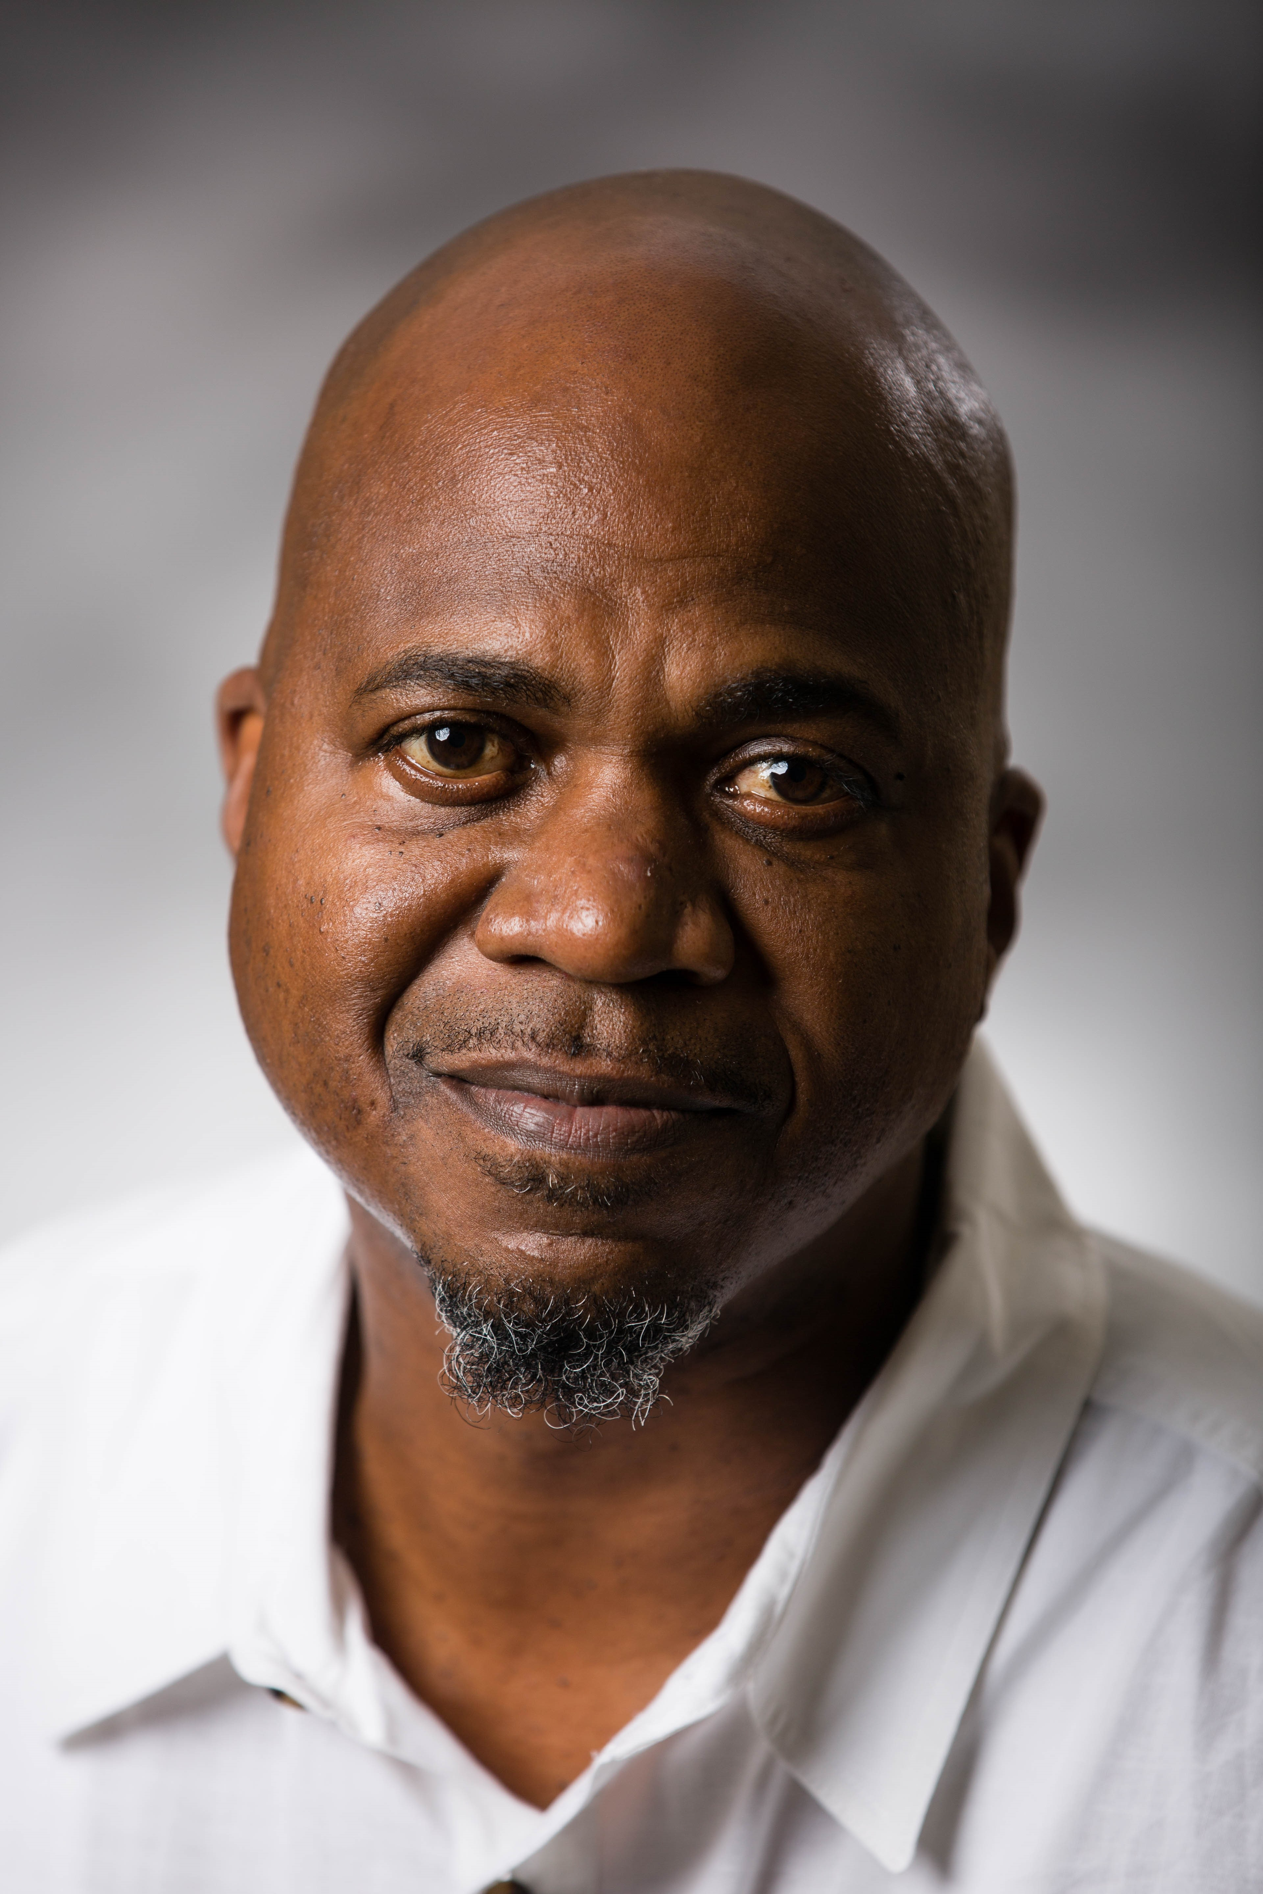
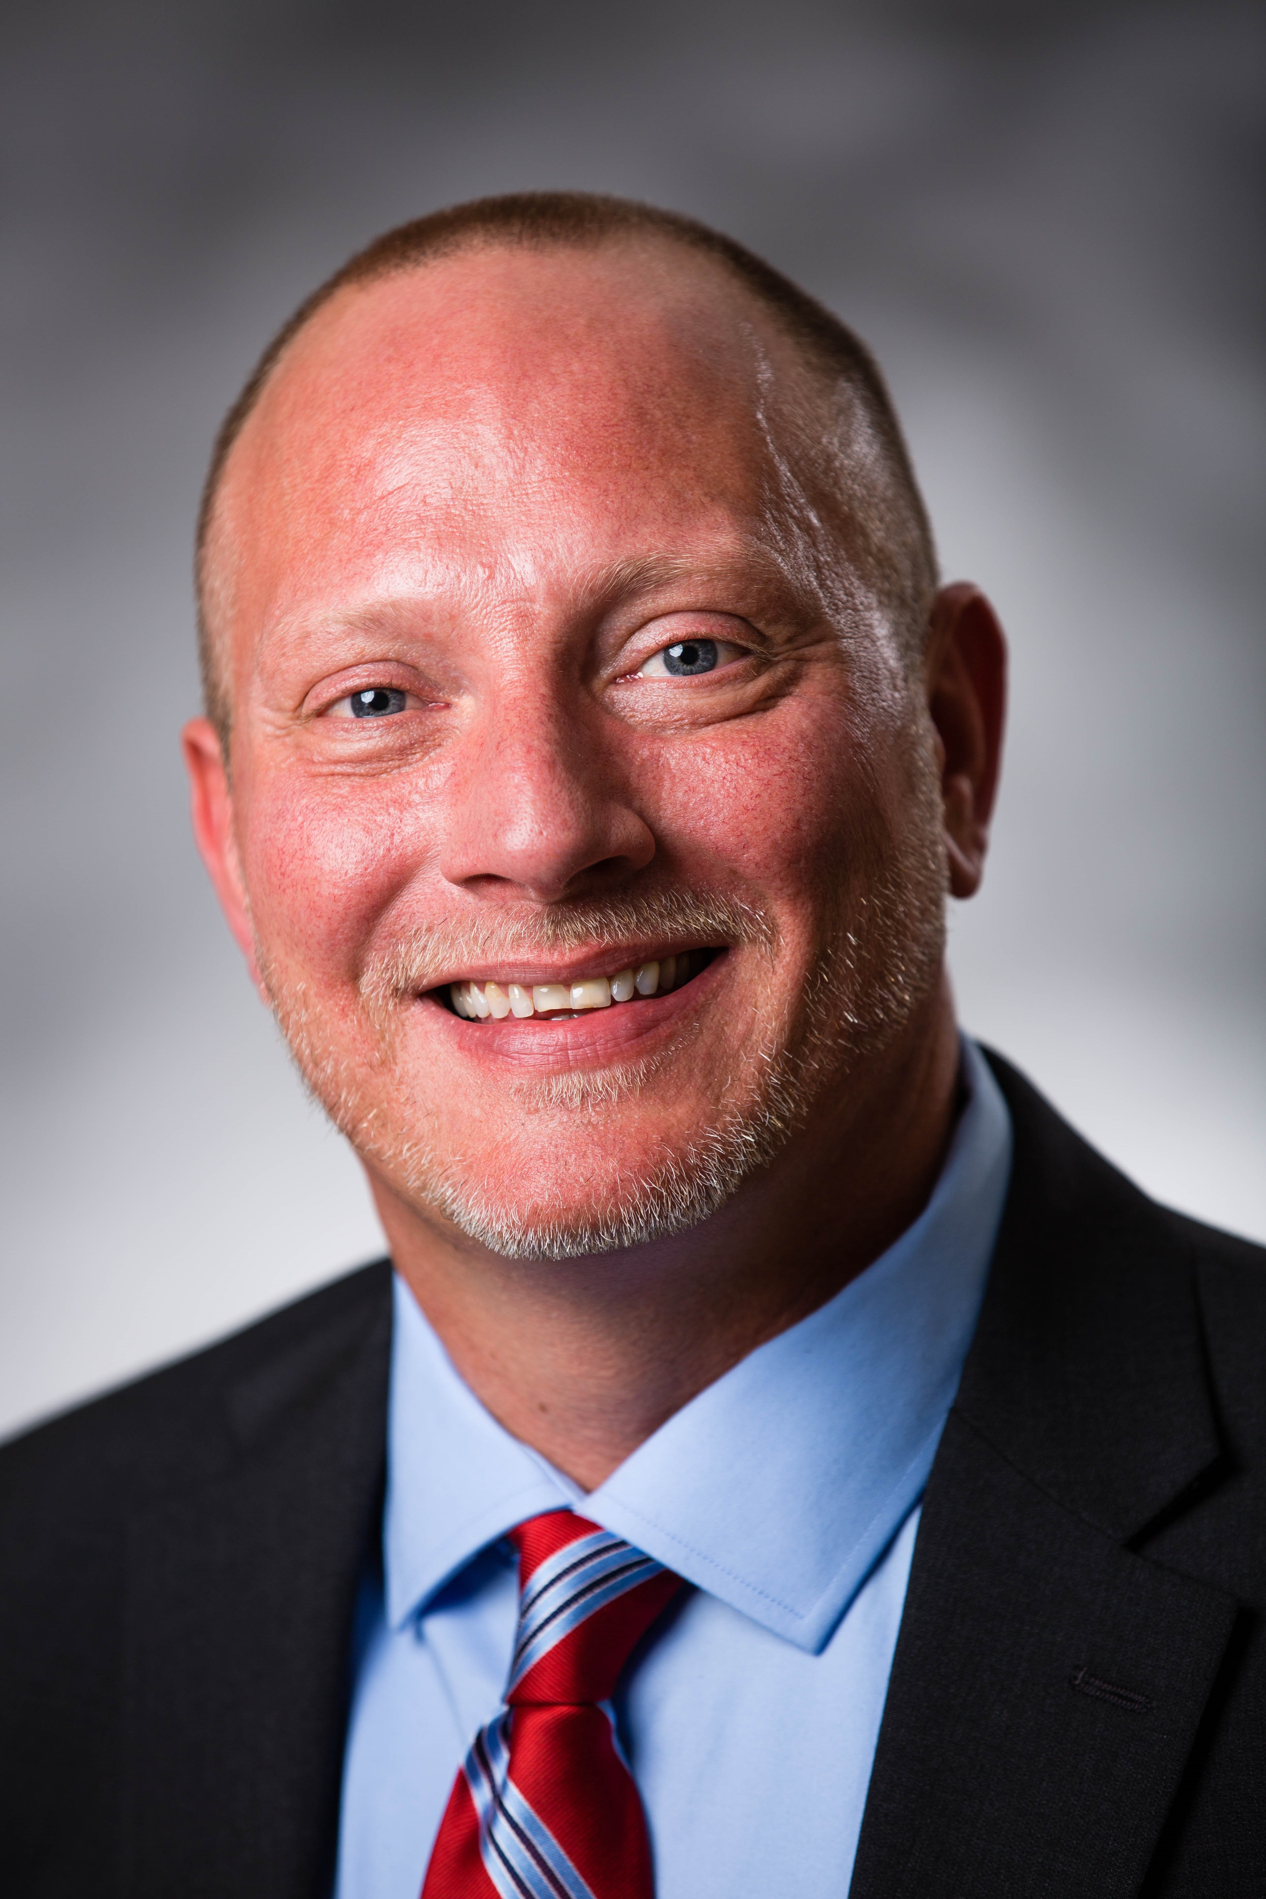
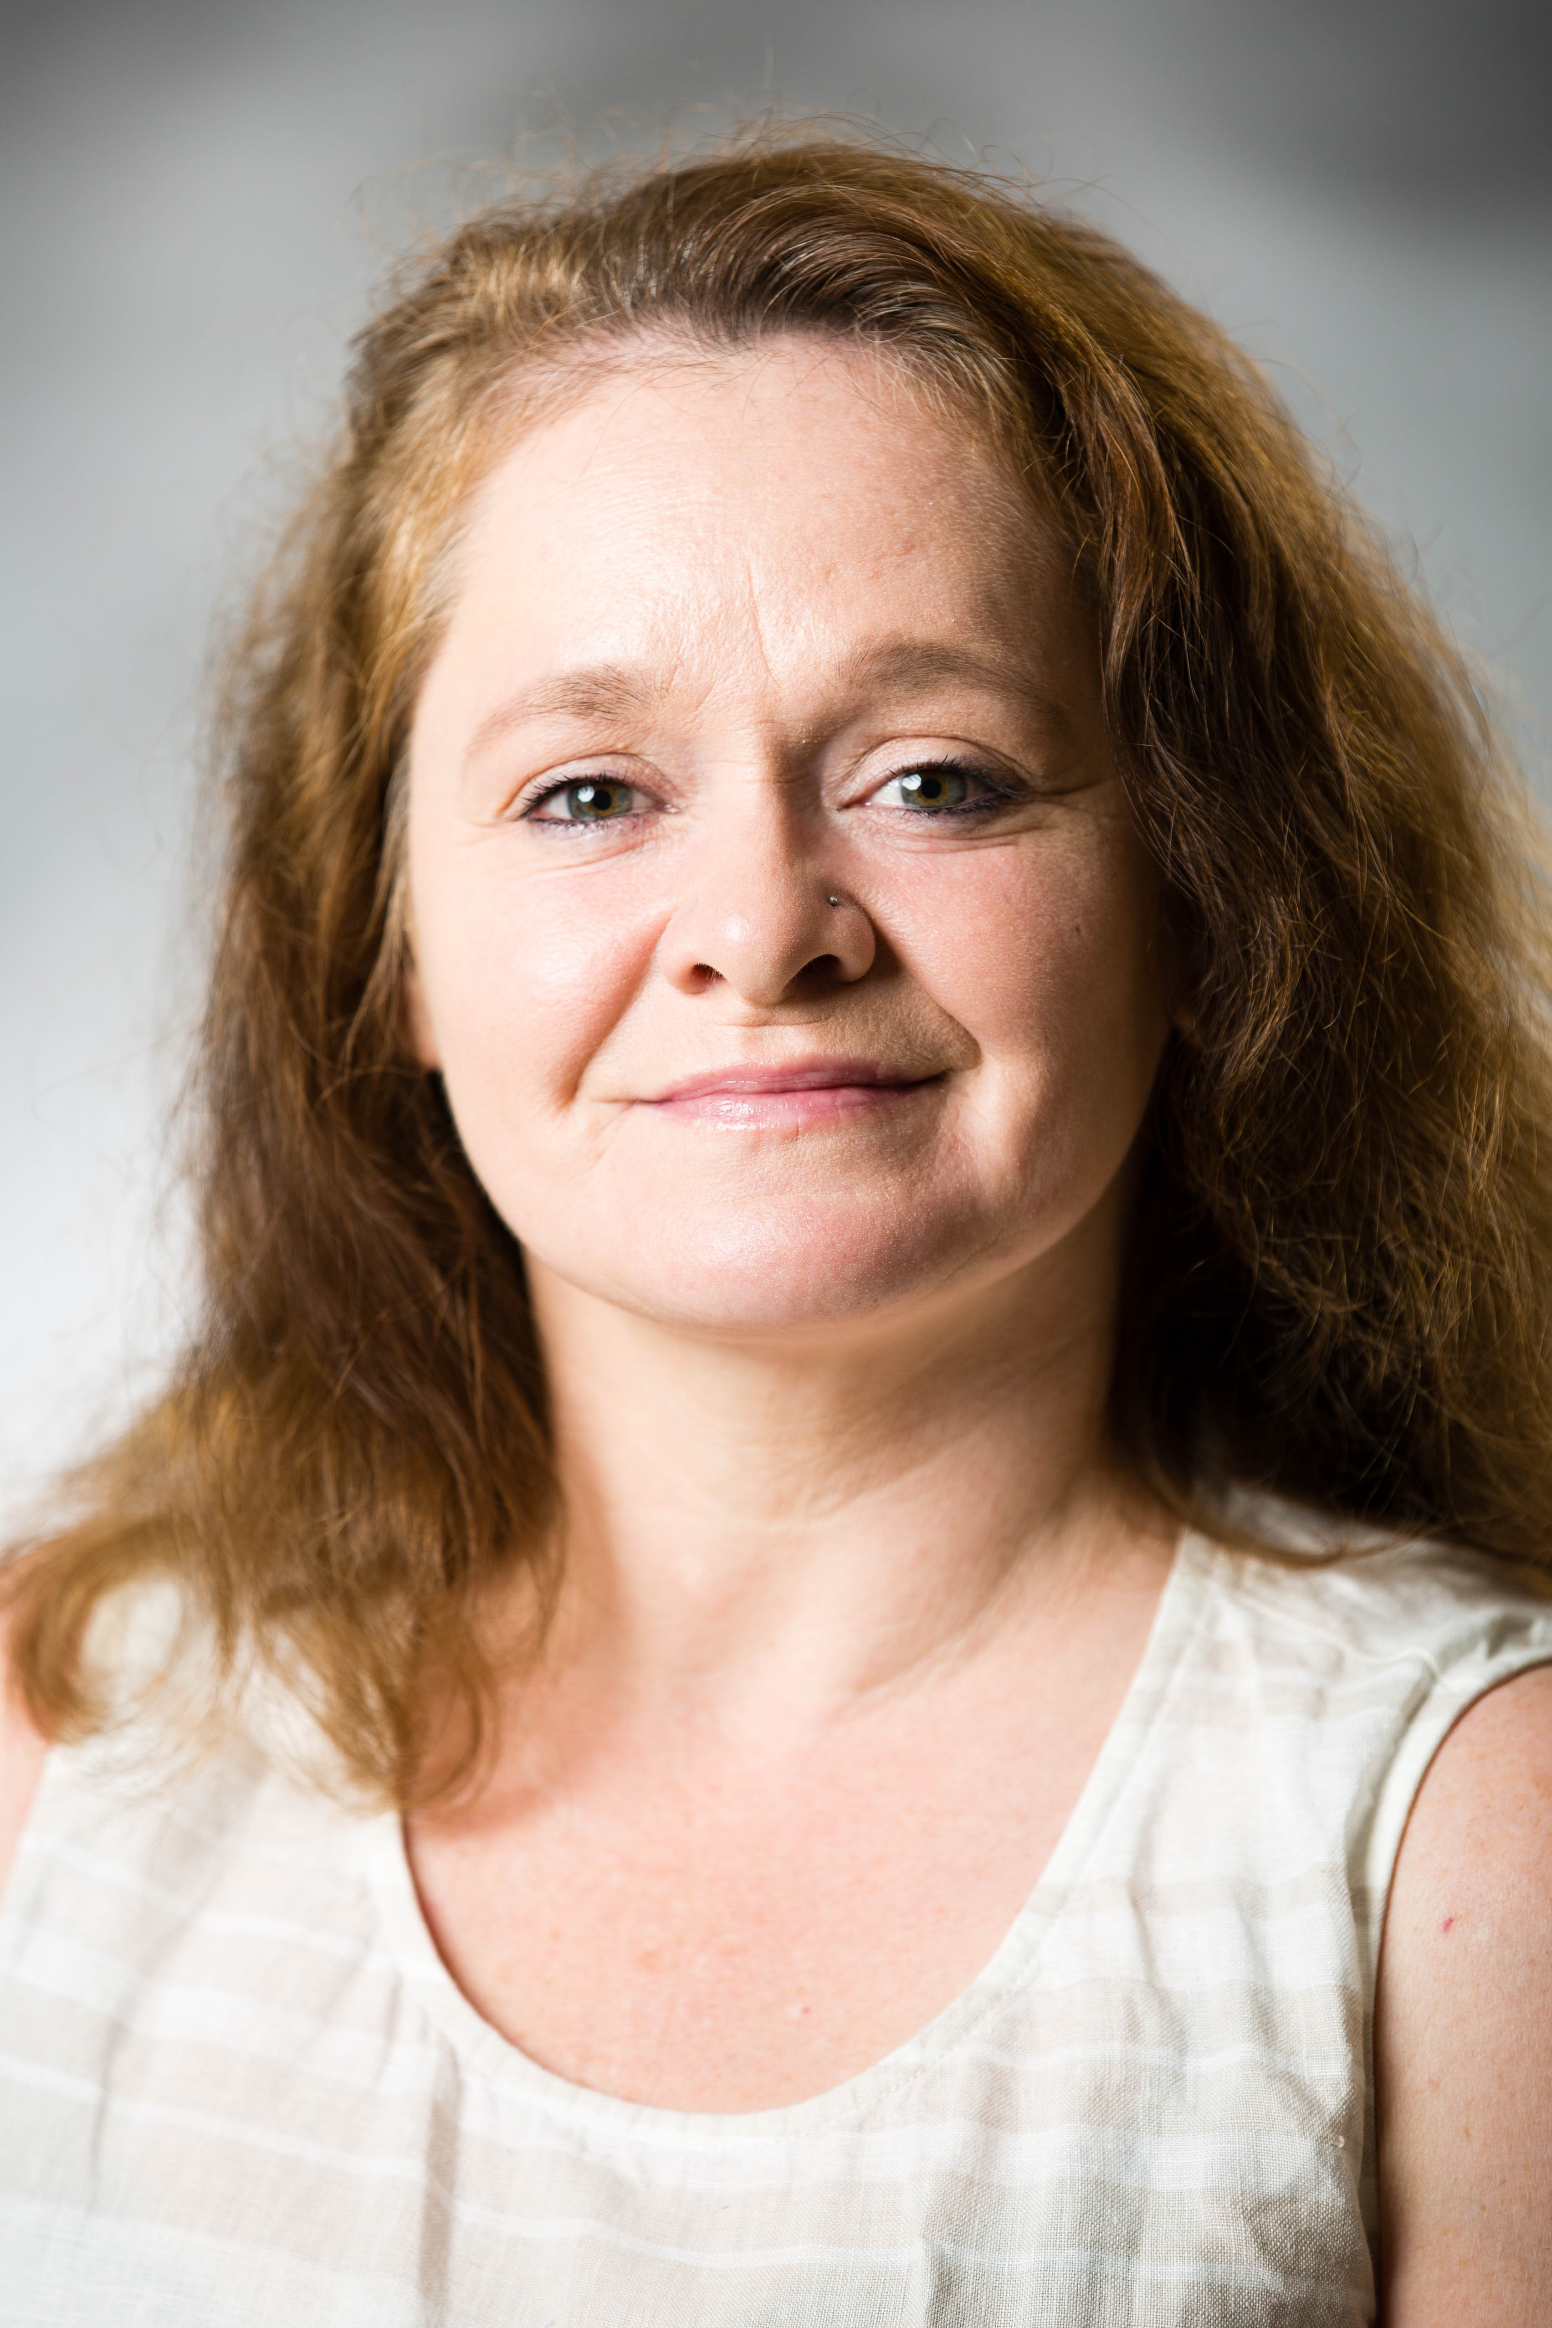
The dream team: rebuild recruiters
Dennis Brown
Derek Wilson
Jessica Corum
Notes:
Brief discussion about the skill sets of the recruiters
Acknowledgement they have collectively worked with over 200 people
Will list the organizations they are working with currently

Slide 7
Participant Path

Slide 8
Construction Trades Certification Course
*NCCER (National Center for Construction Education and Research) offering industry-recognized credentials for the construction and maintenance industries.
Class B CDL Course
*Class B Commercial Drivers License
Notes:
Construction Trades
Construction trades is a 16 week course requiring 16 hours of contact hours/week. The Construction Trades Certification course introduces students to construction building trades. In this course, students can expect to learn about construction safety, proper tool use, carpentry, masonry, cabinetry, drywall, building code and inspections, restoration, estimation and much more.
Students will also receive NCCER (National Center for Construction Education and Research) Core Curriculum covering basic safety, communication skills and an introduction to construction drawings, and will be eligible for the certification examination upon course completion. NCCER offer industry-recognized credentials for the construction and maintenance industries.
Class B CDL:
Our truck driver training program is in partnership with Caldwell Community College. It offers full-time day classes requiring 2 ½ weeks to complete. Classes run Monday-Friday 8am-5pm. Upon completion, students obtain their Class B CDL.
With this license students are able to drive commercial vehicles such as straight trucks, Large Passenger Buses: city, tourist, and school buses, Garbage Trucks, Box trucks for delivery drivers, Dump trucks with small trailers, and Cement Mixers.

Slide 9
Path of Class B CDL Student
Before Class Starts:
*Recruiter Involvement
*Obtain permit
*DOT physical examination
*Drug Screening
Notes:
There is heavy recruiter involvement prior to the class start date. Recruiters assist with gathering the needed documents for both the grant funding process and for meeting class admission requirements. These documents could be anything from birth certificates, proof of selective service, criminal backgrounds, Class B permits, DOT physicals, to drug screenings. They also assist with reducing or eliminating barriers to participation (for example child care and transportation).
Steps to Admission:
Hold a valid North Carolina Driver's License with no limiting restrictions.
Obtain a NC Class B Permit
Secure funding. We work closely with our partners at Centralina Workforce, NC Works, and Rescare to secure funding. Once potential students have their permits, the recruiters make a referral to NC Works. NC Works follows up to start the grant funding process. No student is left behind. If someone doesn’t meet the grant qualifications, We will secure funding through one of our scholarship programs.
Everyone is required to attend orientation. In these sessions we go over program specifics and answer questions.
Must pass a DOT physical
Must pass a DOT drug screening (students are also subject to random drug screening while in class.
Its important to note that all associated fees such as permit, physical, drug screening, and license are reimbursed under the grant. In circumstance where a student is unable to pay upfront, arrangements will be made to make the payment upfront for them.

Slide 10
Class B CDL Training
Students are able to complete training and obtain a CDL B in less than three weeks
.
Curriculum: Training is divided into 3 parts:
Classroom
Hours of Service & Map Reading
Federal Motor Carrier Safety Regulations
Vehicle Inspection
Defensive Driving
Speed & Space Management
Extreme Driving Conditions
Hazard Perception
Range Driving
Pre-trip Inspection
Basic Vehicle Control
Proper use of clutch and gears
Proper Backing Techniques
Road Driving
Defensive Driving
Vehicle Control
Proper use of clutch and gears
Different Roads and Conditions
Observation of Highway Laws
Notes:
Talk about the 3 parts of training curriculum:
During training, we also invite employers who are hiring to come to our classes and talk to our students about employment opportunities.
*During the last two days of class, our third-party testers will administer the Commercial Driver License (CDL) skills test.
When a student completes our program, all they have to do is go to the DMV to pick up their license.
As stated before, our goal with this program is not only to ensure that this underserved population has access to training, but also that they secure gainful employment using the credential earned. Therefore, during and after training, we continuously collaborate with our employer partners, expand our network, and equipment students with the necessary tools to obtain and sustain employment.

Slide 11
Construction Delays
Awareness and obtainment of personal identification materials
Identification and utilization of supportive community services
Workplace readiness, including soft skills
Basic skills assessment and upgrading
Notes:
Challenges
The items are based on the needs recognized first.
Awareness and obtainment of personal identification materials These documents include birth certificates, social security cards, NC and out of state criminal backgrounds, selective service documents.
Identification and utilization of supportive community services : the grant can’t help with probation needs, family issues, disabilities and others. However, these issues have come into play. Our community partnerships play a vital role in our success with reducing or eliminating barriers to participation. Some of things that we have encountered are child care, transportation, and housing.
When it comes to Workplace readiness, including soft skills and Basic skills assessment and upgrading, we utilized R3 services. For example, we often run into students who are unable to obtain their Class B permit. This is usually our first sign that there are some educational gaps. Once referred to the R3 team, potential students are able to access CRC practice material, which has greatly proven to increase their reading and comprehension skills. Most soft skills are addressed during the class. Instructors treat the classroom as a place of employment. There are no excused absents, they are docked for arriving late and leaving early, and participation is a must.

Slide 12
COVID
Recruiters continued to work with participants during quarantine periods and closed facilities
0% Recidivism Reported
Notes:
Recruiters have continued to work with participates during quarantine. They are still connecting with graduates to ensure they are obtaining employment. They are still recruiting new individuals and helping them to navigate through barriers to participation.
We are extremely happy that 0% recidivism has been reported.
In regards to how COVID has affected these trainings, the Construction Trades course is currently unable to run due to the required hands on components. Hands on experience is critical to students wanting to enter this field.
Class B CDL Training has resumed with a few changes to minimize student contact and exposure to others.
Orientation is conducted online
Classrooms used are based on class size to ensure social distance.
Mandatory face mask for any one in attendance (students and faculty). Students must be able to provide their own face mask.
Students and faculty are screened daily prior to entering the building. This includes a questionnaire on COVID symptoms and temperature checks.
Daily cleaning of classroom and trucks.
Only one instructor and one student allowed in the truck at one time.

Slide 13
Tashina Mahatha Account Manager for Rowan-Cabarrus community college Tashina.mahatha@rccc.edu
704-216-7142
Keri Allman R3 Career Services for Rowan-Cabarrus community college keri.allman@rccc.edu
704-216-7205
Notes:
Here is the contact information for both Keri and I. Please feel free to contact us for any questions or clarifications.
Thank you

