Slide 1
Pathways to Employment:
Earning Credentials of Value at Every Level
Notes:
Thanks so much Claudia…thank you for this opportunity to present on what we think are some great things happening in MS…With me today is Wendy Evans, Director of Adult Education & Integrated Pathways at Jones College and Charlie Smart, College & Career Navigator with Northeast MS Community College.
It’s always good to be able to talk about MS, but does it really matter unless you hear from the local level – the boots on the ground and how this looks in the trenches…So, I’ll give a brief overview of state office guidance but I’m really excited for you to hear from them.
In late 2018 into early 2019, I really started asking our previous director Sandy Crist—how can we get our economic/workforce leaders to let us sit at the table – to see that AE is really an untapped resource for employers needs in MS – That we’re more than just a GED program – That is how Skill UP MS came to be –
But we noticed that not only did we have to change the mindset of our external partners, we had to really get in and change the mindset of our local programs & I’m sure that resonates with a lot of people in the meeting – WIOA changed the entire landscape of AE – which is really a good thing, but it’s been a task for sure.

Slide 2
Mississippi Career Pathways System
Mississippi’s State Workforce Investment Board
Oversees statewide strategy for a skilled workforce
4 Local Workforce Regions
Implement career pathway strategies in local workforce areas
WIOA Core Partner Adult Education
Develop, contribute, and participate in career pathways delivery
Notes:
MS has over 361,000 individuals 18 years or older that do not have a high school diploma or equivalency…That effects so many things…poverty, incarceration, health, and our state’s workforce participation rate which sits around the 54-55% mark.
Our SWIB works to consolidate & strengthen our state’s workforce development system – installing an accountability system to track core partner outcomes; consolidating workforce training efforts; and ensuring business/industry define the training needs of our state…
Our state’s plan, calls for closer alignment of all public workforce & education programs – Under SWIB, we have four local workforce regions -- When it comes to business/industry needs, adult education refers to their strategic plan, which I’ll elaborate on in the next slide or so, within their partnerships with CTE/WD.
In 2016, cross training across our state was happening in all agencies– I was a transitional specialist at Holmes Community College at the time, so I remember all the training I attended -- How are all the agencies working together to connect participants to training/education leading to the workforce?

Slide 3
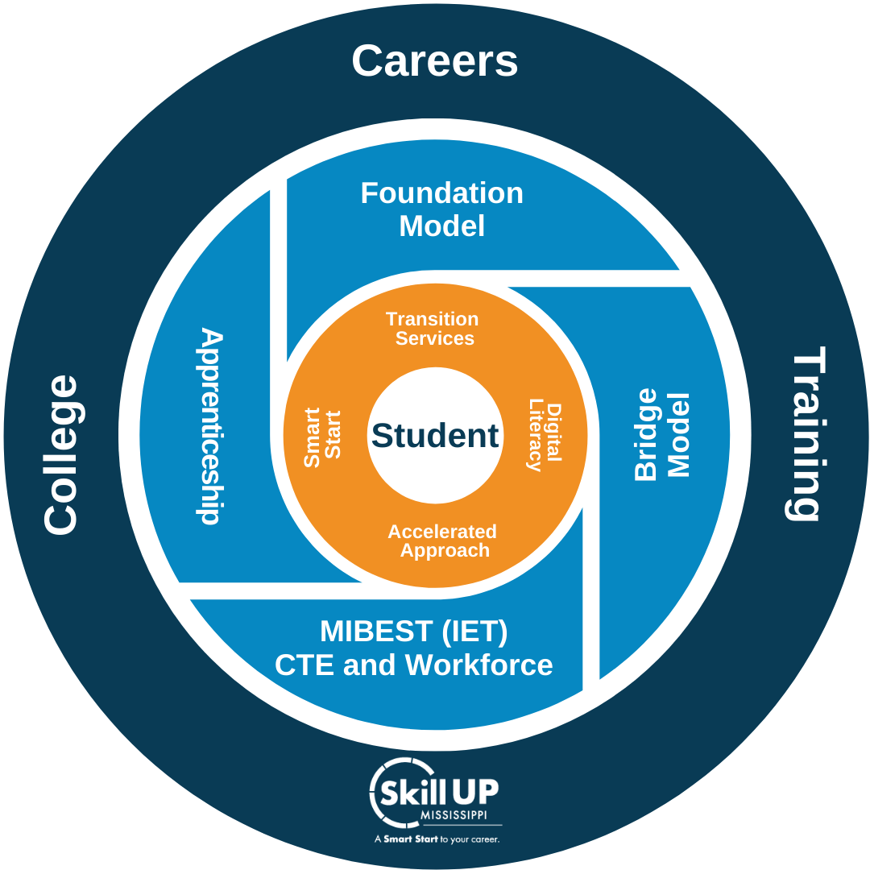
Mississippi
Adult Education
Notes:
The OAE’s mission to offer various options for students at all educational levels – to have the opportunity to participate in training to enhance opportunities to become work ready.
The entire model is student-centered & based on the needs, goals, aptitude, and interests of the individual – Comprehensive student support involving a wrap around approach – Identifying barriers early is critical in order for students to have an appropriate instructional plan – Assists with retention & completion
Components of the model directly around the student which are the foundational units of all our students – Beginning with Smart Start --

Slide 4
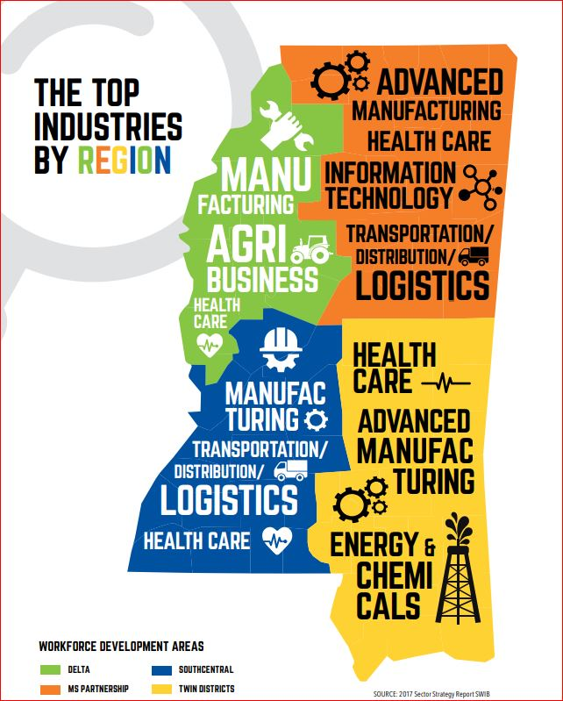
Employment-Focused
Education
NEARLY 6,000 EMPLOYERS LOOK FOR INTERPERSONAL SKILLS – INTEGRITY, TIMELINESS, COMMUNICATION, TEAMWORK WHEN HIRING.
Source: Y’all Business Survey: Secretary of State’s Office
63%
OF MISSISSIPPI JOBS
REQUIRE A MIDDLE SKILL.
Source: Bureau of Labor Statistics, 2019
40%
OF MS EMPLOYERS USE SOCIAL MEDIA AS PRIMARY WAY TO FIND EMPLOYEES.
Source: Y’all Business Survey: Secretary of State’s Office
ALMOST 2,600 EMPLOYERS RECOGNIZE THE NATIONAL CAREER READINESS CERTIFICATE.
Source: ACT Work Ready Communities
Notes:
In 2019, I worked with a team of Smart Start instructors from across the state to update our employability skills class, Smart Start. I really wanted it to be not just about career exploration or job search strategies…but to be MS focused. I also wanted relevant curriculum…not just to our students, but to our teachers – To hear what our employers are saying.
Going back to our State Workforce Investment Board to our local PDD’s…I wanted to show that AE is supporting the overall mission of our state beginning with teaching our students about the employers & training needed to connecting them (statewide & regionally)
MS Works – That is our state’s labor exchange through the WJC, which in many states is called a one-stop center. Students have a direct connect to employers as well as other services the one-stop center offers.
Get on the Grid – Created by the Skills Foundation of MS – Great resource for our students to learn about the top sector strategies of our state – They can click on a sector—choose their choice, for instance, Energy – And career options pop up – They can click on that career– And see all the key facts as well as take it a step further & see all the training programs in our state (requirements to be accepted, etc.)

Slide 5
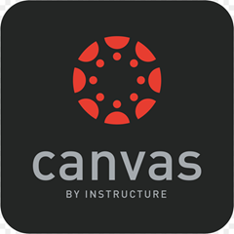
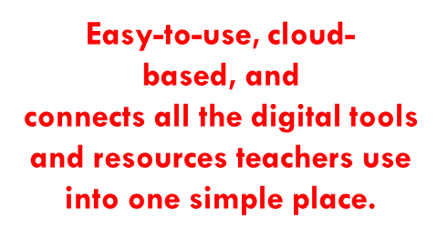
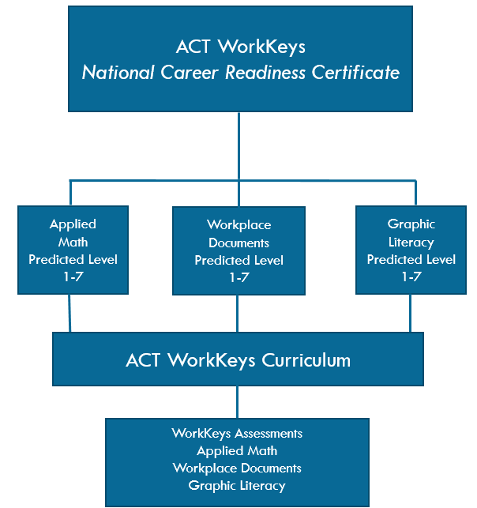
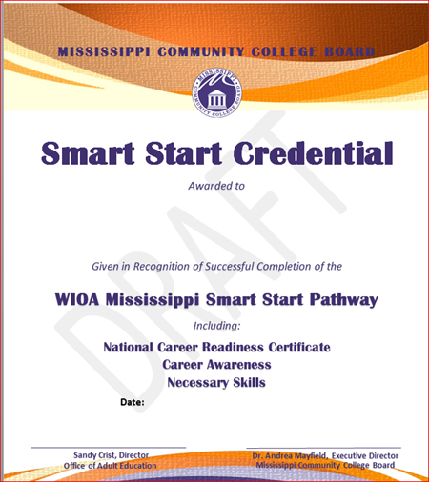
WorkKeys
Assessments
Notes:
As I mentioned earlier, Smart Start is embedded into all of our adult education programs --- With in Smart Start, since we are a state working toward becoming a work-ready state, we have also included ACT’s WorkKeys Curriculum into Smart Start – Not to mention 85-90% of CTE/WD programs require it for entry.
I’ll say this too – We are seeing our students progress toward HSE completion faster than those who choose to not finish Smart Start – This was a selling point to our instructors in the very beginning.
So, we believe these two elements are crucial for our programs to have the opportunity to counsel and really get to know a students – their interest and capability to enroll in other opportunities which is how we have provided guidance to our programs.

Slide 6
Career Pathways…Things to think about?
Demonstrate need/demand (state & regional) needs
Where do you get this information? How do you know?
Partners
Who are internal/external partners?
Prepare individuals to progress in postsecondary educations (apprenticeship, OJT, WBL)
Where are these opportunities? What employers are they connected to? Requirements?
Counseling
Who in your program is involved in this?
Role of the College & Career Navigator?
Concurrent education and training (IET/MIBEST)
Factors to consider? Requirements of an IET are met? Requirements of MIBEST are met?
Other considerations – SSLO, Contextualized Instruction, Team Teaching Digital Literacy, and Outcomes
Assist individuals enter or advance within an occupation/occupational cluster
Role of CCN? Communication?
Pathway Flowchart
Transition Services
Notes:
This past year, we really honed in on training our programs to consider relevant pathways…We must assess if we are delivery relevant, effective opportunities to our students that will help them connect to the workforce?
How are our students learning about skills needed in a certain business/industry?
What partnerships, externally/internally, do we need to develop or maintain within our environment? Assess the extent of that partnership (no activity, being discussed, underway)
How do we actually prepare individuals to progress? Career development, Smart Start, connecting WJCs (one-stop centers)?
What services/resources are available to assist with persistence/retention? The role of our CCN?

Slide 7
Workforce Pathway – Certified Nursing Assistant
Available certifications:
Northstar Digital Literacy (All programs)
Google Applied Digital Skills (Northeast MS CC)
First Aid CPR (All programs) (BLS Certification “preferred for employment”)
Workplace Safety I (MGCCC)
Workplace Office Software I & II (MGCCC)
Customer Service & Sales – (Holmes CC)
Certified Nursing Assistant
OJT, Internship
HSE Prep
Certified Nursing Assistant Training Program
NNAAP Certification Exam
Allied Health Employment
Programs
Foundation
(1.0 – 3.9 GE)
Bridge
(4.0 – 5.9 GE)
MIBEST/IET
(6.8 – 8.9 GE)
HSE Prep
Smart Start
Burlington English
ACT WorkKeys Curr. (NCRC)
TABE
HSE Prep
Smart Start
Burlington English
ACT WorkKeys Curr. (NCRC)
Notes:
In 2020, all of our AE programs began to meet with CTE and WD partners to basically say…My student wants to be a nurse…But I know there are skills that he/she is going to need to be better prepared…to be successful…to transition further…What are they? What are we offering at our college or in the private sector that my student can work on?
After I met with several programs and provided a few training on CPs…this is a very generic/broad view of that I created for more in-depth training for our programs--- as you’ll see Jones and NE’s here in a moment.
Our mindset is what happens if a student doesn’t get accepted into CAN…Have we enhanced their skill level to where if they needed to get a job…Can they?

Slide 8
Jones College

Slide 9
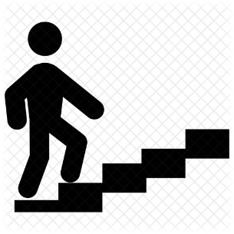
Career Pathway
Welding Technology
Over 30 Different Career Options
Average Salary - $32K
Welding Courses leading to:
Career/Technical Certificate
Associate in Applied Science
Internship
Apprenticeship
Job Placement
Welding Courses
HSE Prep
180 Skills/OWC
NCCER CORE
Forklift
Student Success Plan
Career Development
Transition
Intermediate Basic Skills Instruction
ACT WorkKeys
Smart Start
HSE Prep
NCRC
180 Skills/OWC
OSHA
CPR
Student Success Plan
Career Development
Transition
TABE Testing
Northstar Digital Literacy
Basic Skills Instruction
Literacy Instruction
Reading Horizons
Burlington English
Student Success Plan
Career Development
Transition
180 Skills/OWC
Foundation Bridge MIBEST/IET Credit/CTE

Slide 10
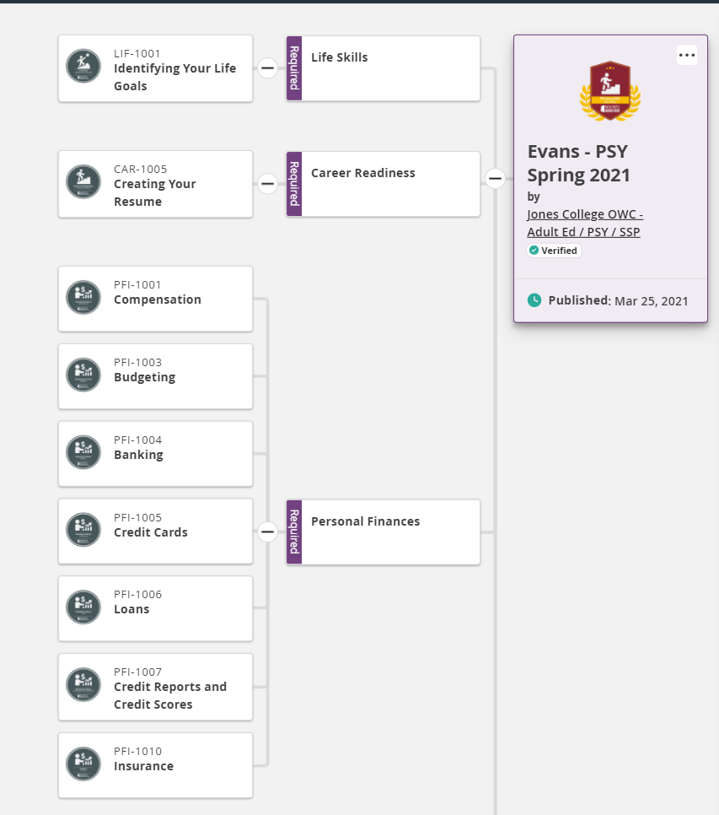
Custom Pathways
Example: Pathway being used in a Jones College Smart Start Class
Notes:
Content can be arranged to meet the needs of the organization into customizable pathways. These pathways can show the cohort and individual progress to completion. Will show the PSY / SSP pathway that is currently being used

Slide 11
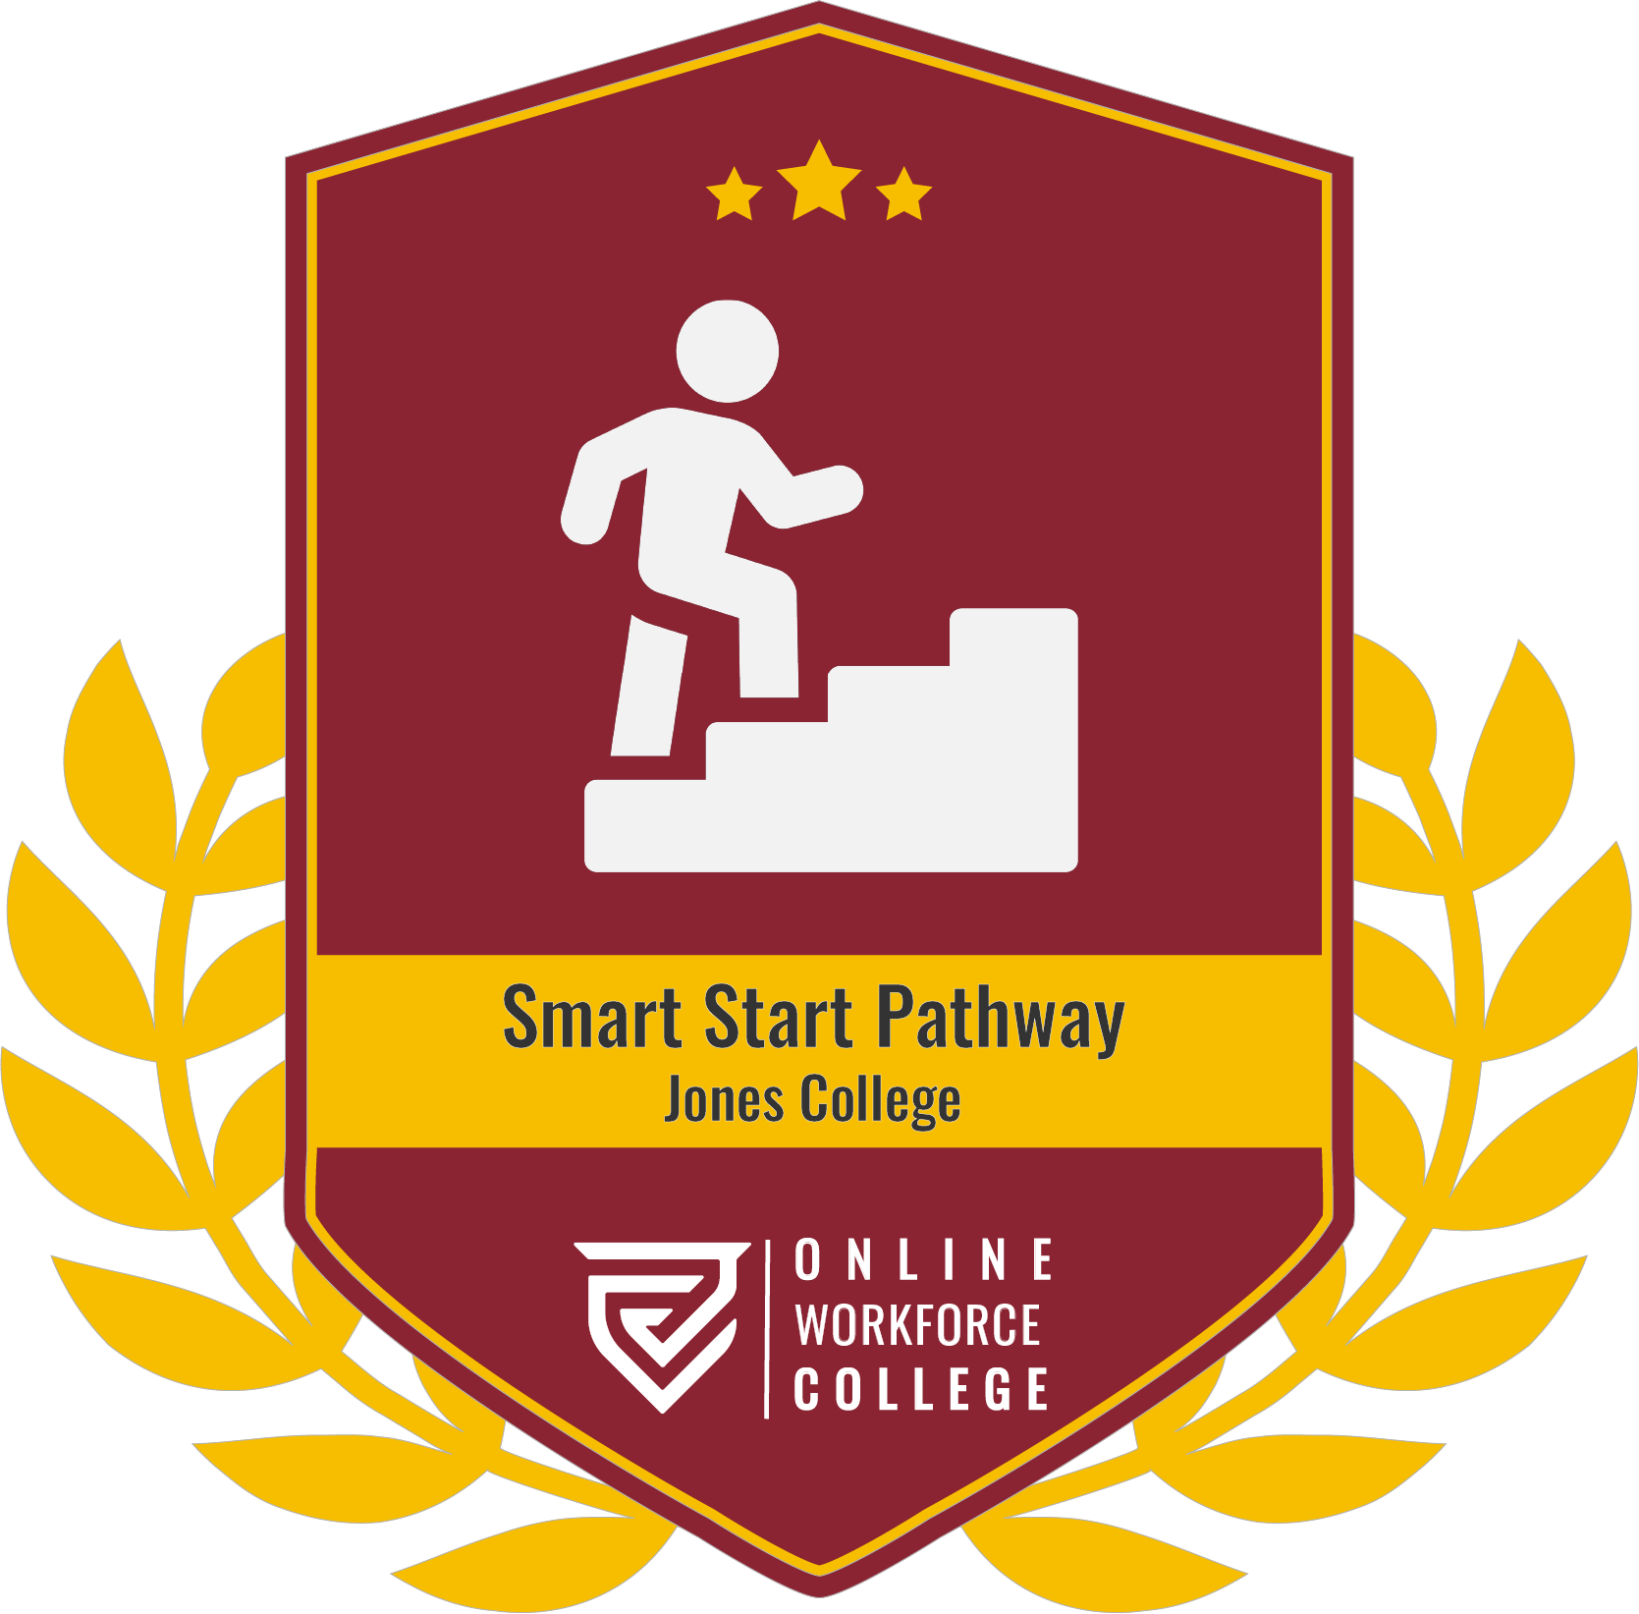
Custom
Badges
Example: Custom Milestone Badge for a Smart Start Pathway
Notes:
Once the learner has demonstrated mastery in this course. MSOWC uses Badger to issue, track, and share student progress. Each of these badges belong to the student to be shared with employers regardless of where they earn them. Employers can easily see that the learners have gained the knowledge they needs.
Custom badges can be developed to meet the need of the issuing entity. Badges are digital representations of an achievement and can be easily shared through a variety of ways. They are secure on the Badgr platform.

Slide 12
Northeast Mississippi Community College

Slide 13
Northeast Mississippi Community College
I attended an INTERESTING COMMITTEE MEETING!
(Somewhat uncommon.)
Advising committee.
They discussed a new term they are working with: CAREER PATHWAYS.
Challenge: Go with “pathways” or stick with more familiar “major”.
Not just schedule-making; also relationship-building.
Pathways: general to specific
Pathway: structure
Metaphor
Plan their lives
Build relationship

Slide 14
Career Pathway – Medical Pathway

Slide 15
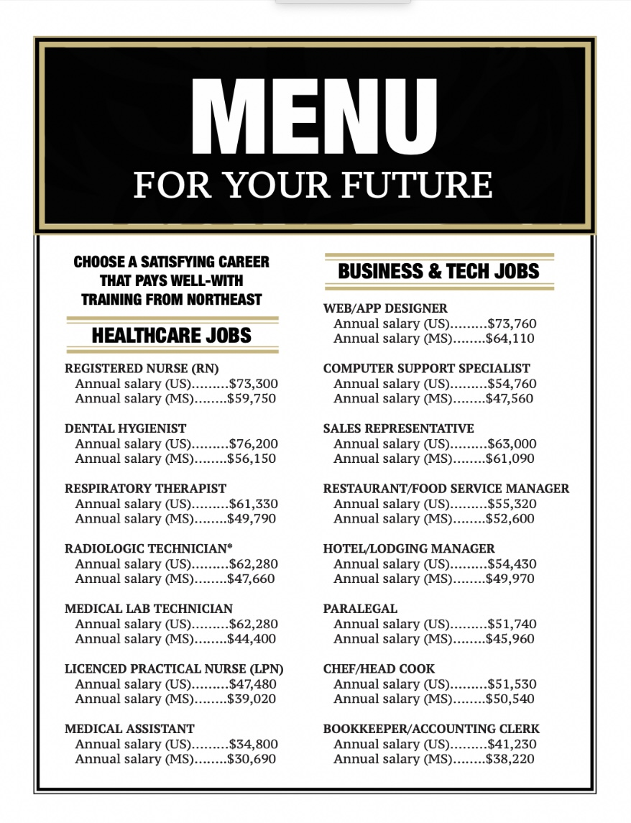
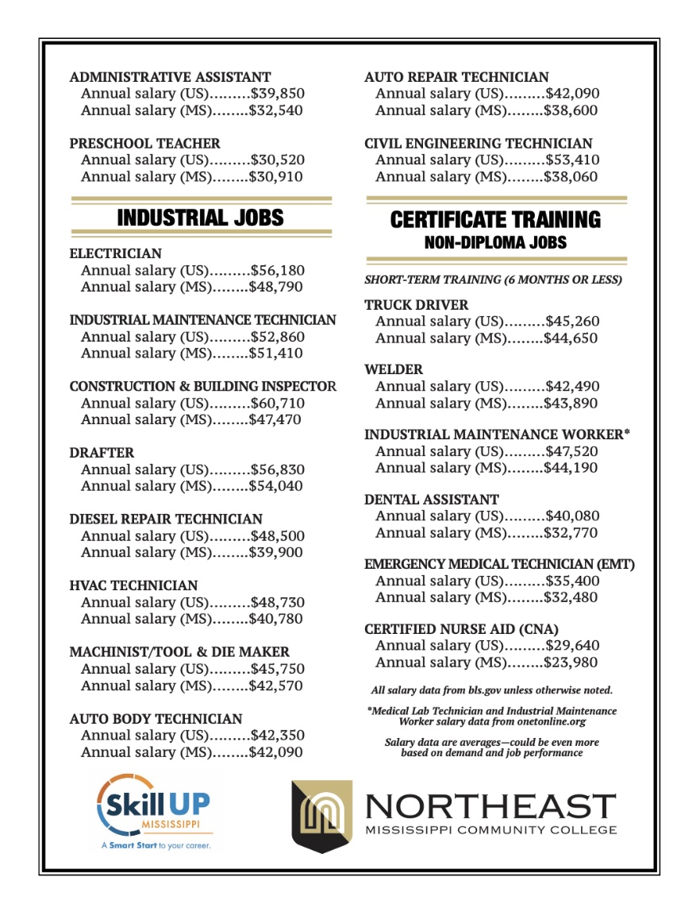
Northeast Mississippi Community College
What we do with the structure.
Smart Start class.
Teach career and goal-setting lesson.
One-on-one meetings.
Put in a pathway.
Discuss possibilities (menu).
Provide motivation (bookmark).
Learning lesson
MIBEST
Extra support
Specific pathways
Transitions
Work
Military
Training-EMPHASIS
https://medium.com/@CollegeAndCareerNavigatorSmart/i-cannot-give-up-8419786a0331

Slide 16
Outcomes

Slide 17
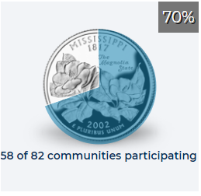
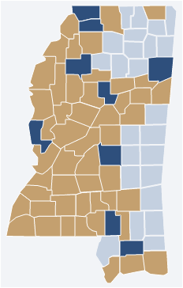
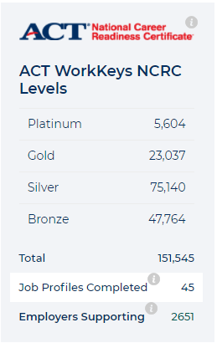
OUTCOMES
Since implementation of MS’ WIOA State Plan in 2015, adult education participants have:
9,208 – Earned High School Equivalency Diploma
3,283 – Entered Post-Secondary Institutions
9,042 – Earned Smart Start Credentials
12,177 – Earned National Career Readiness Certificates
MIBEST:
1,967 – Enrolled to date
55% -- Earned an HSE
53% -- Earned at least six (6) CTE college credits
59% -- Earned at least one occupational industry credential
FY 2020:
48% - Employed 2nd Quarter after Exit
47% - Employed 4th Quarter after Exit
43% - Attained Secondary School Diploma & Enrolled in PS Ed/Training within 1 year of exit
47% - Attained a Secondary School Diploma & Employed within 1 year of exit
44% - Attained any credential (unduplicated)
$2,948 - Median Earnings 2nd Quarter after Exit
Notes:
Students receiving these essential elements have shown tremendous results in their overall development:
Retention
Engaged/Increased interest
Self-confidence
Prepared/Equipped in pathway
Outcomes/Results higher

Slide 18
Bronwyn Robertson
Program Specialist-Workforce/Employer Engagement
MS Community College Board, Office of Adult Education
brobertson@mccb.edu
Laurie Kesler
AE Director
Northeast MS Community College, Adult Education
lgkesler@nemcc.edu
www.nemcc.edu
Charlie Smart
College & Career Navigator
Northeast MS Community College, Adult Education
cksmart@nemcc.edu
www.nemcc.edu
Wendy Evans
AE Director
Jones College, Adult Education
wendy.evans@jcjc.edu
www.jcjc.edu
www.skillupmississippi.com
www.mccb.edu

