Slide 1
Beyond Dual Credit Courses: Creating High School Academies that Offer Stackable Credentials
Gateway Technical College
Katie Graf, Director of High School Partnerships
Ray Koukari, Dean of Manufacturing, Engineering & IT
Jaime Spaciel, Director of Career Pathways & Program Effectiveness
August 19th, 2021 11am CDT
Notes:
Gateway Technical College created a High School Academy Model where high school students are dually enrolled in courses that lead to certifications and stackable credentials with the opportunity to graduate from Gateway Technical College before graduating from high school. Learn how the academy model was developed and has grown from 35 students in 2019 to over 120 students in 2021 to meet community needs and student interests.

Slide 2
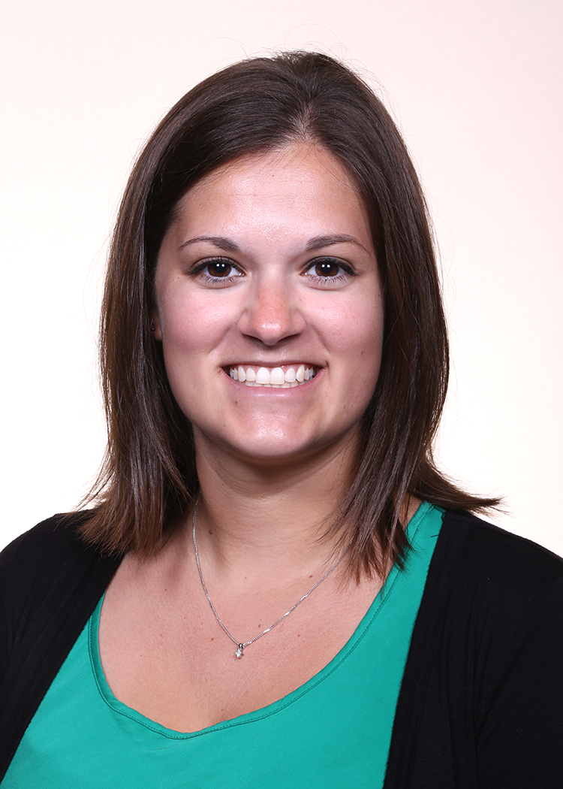
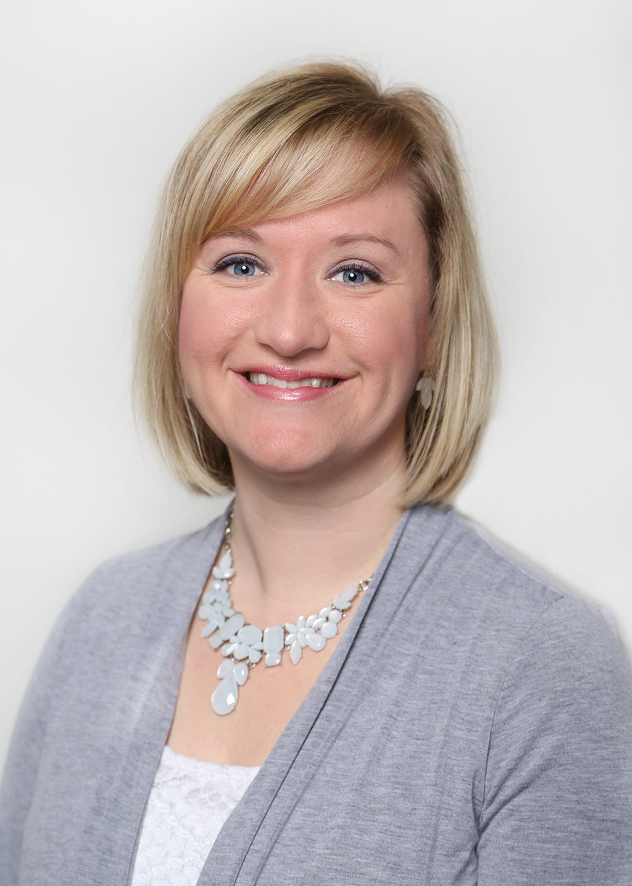
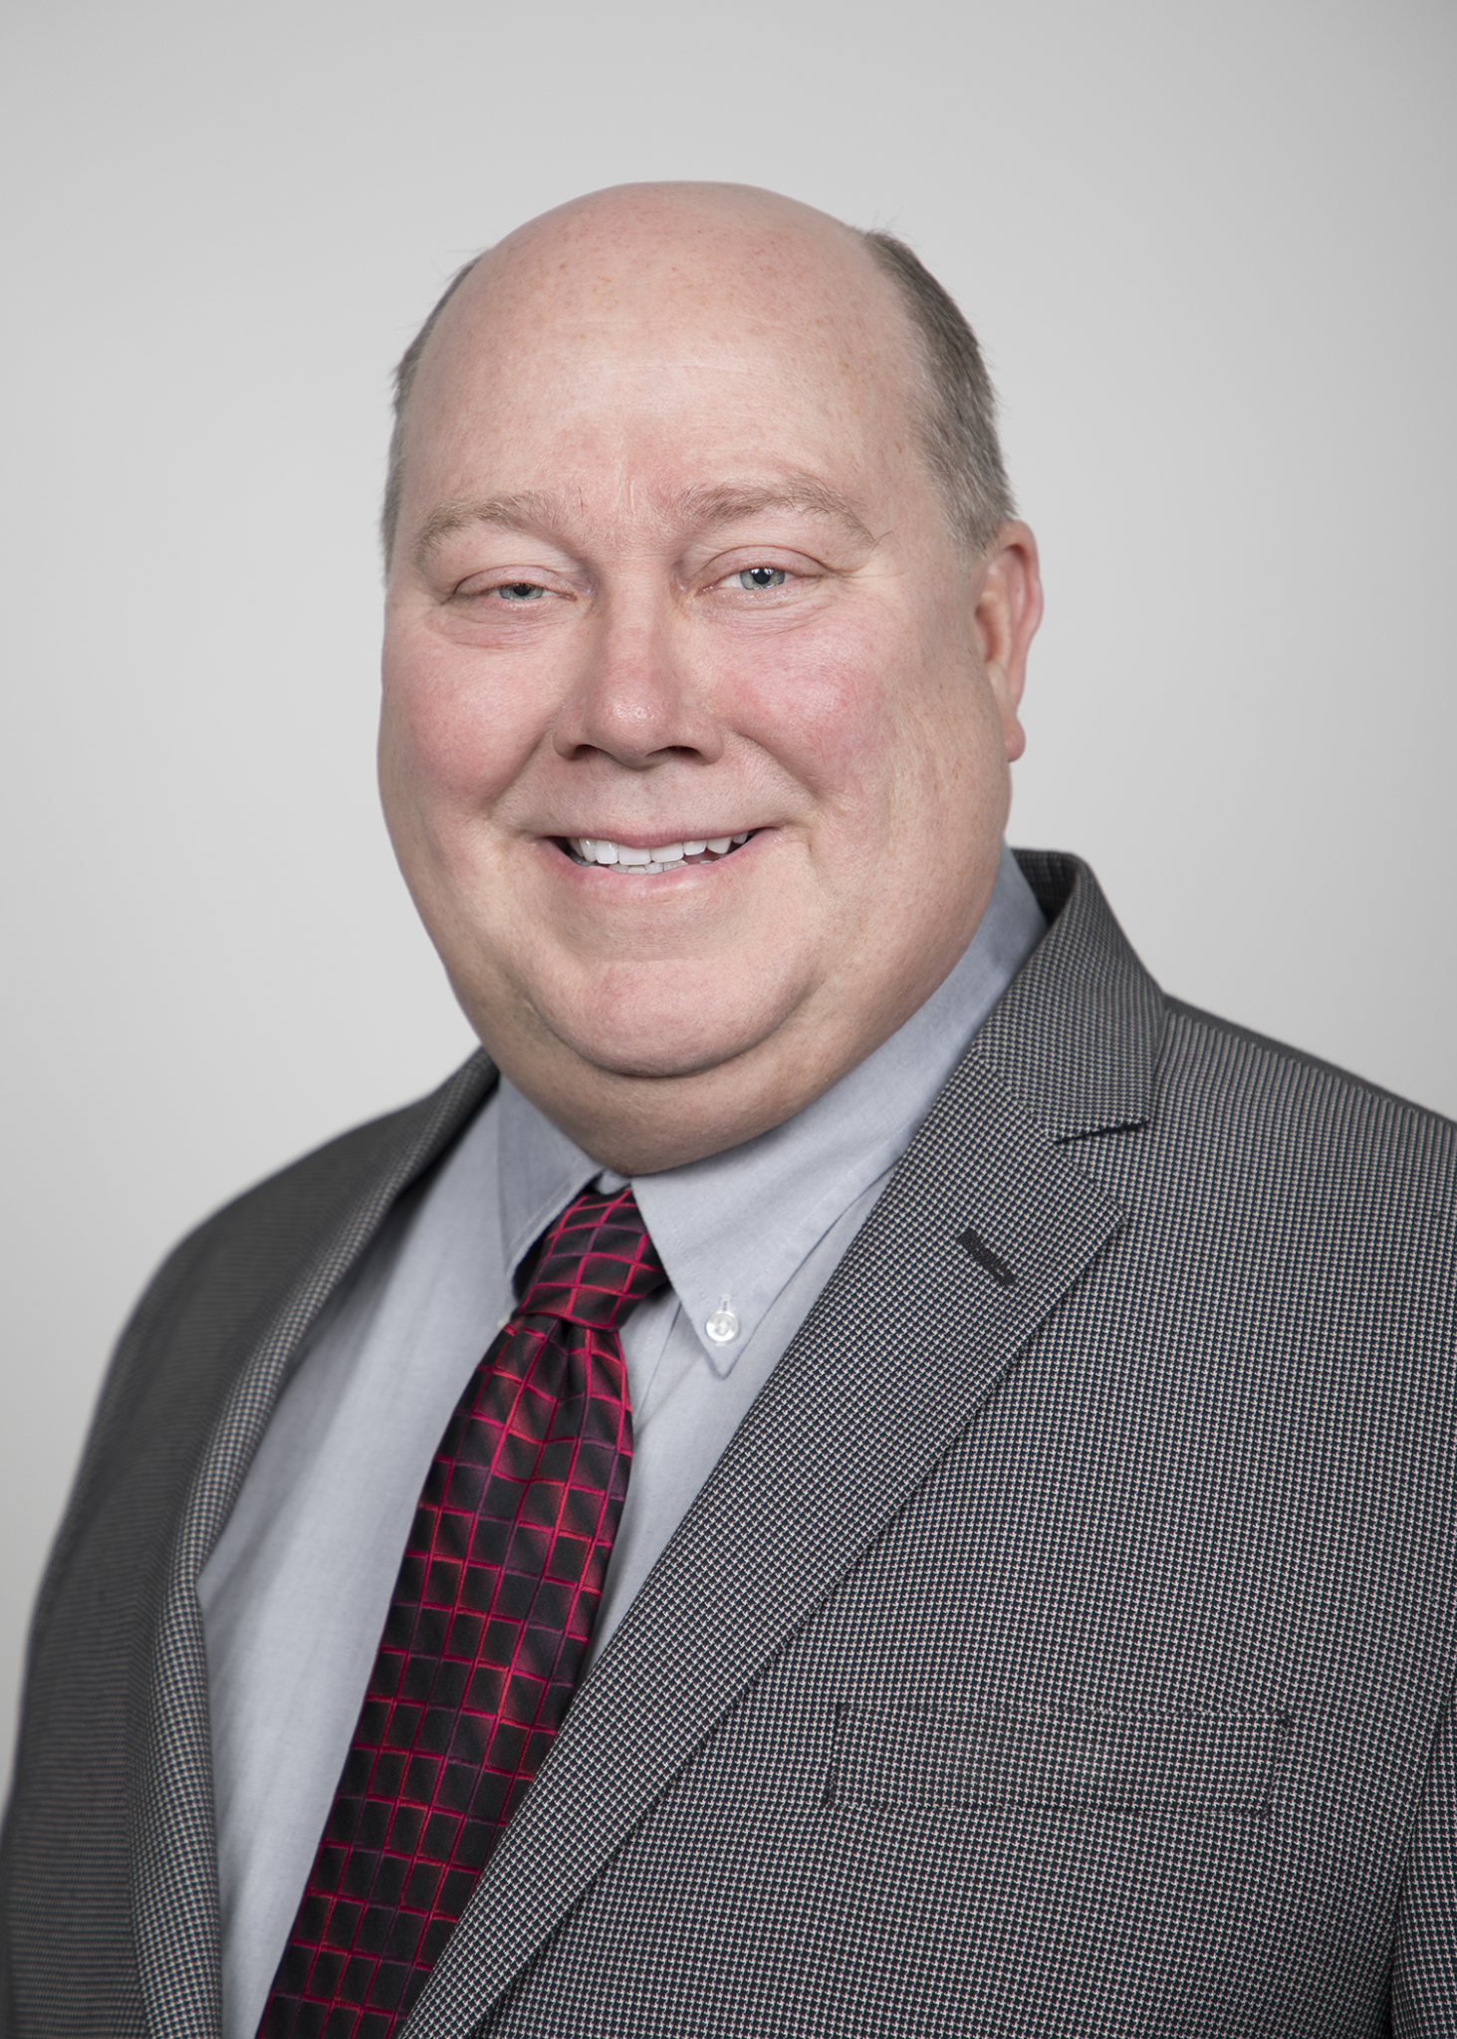
Gateway’s Team
Katie Graf
Director, High School Partnerships
Division: Student Services
Jaime Spaciel
Director, Career Pathways & Program Effectiveness
Division: Institutional Effectiveness
Ray Koukari
Dean, School of Manufacturing, Engineering & IT
Division: Academic Affairs
Notes:
Self Intro
Ray highlight: we are all in separate divisions, but we work so closely together

Slide 3
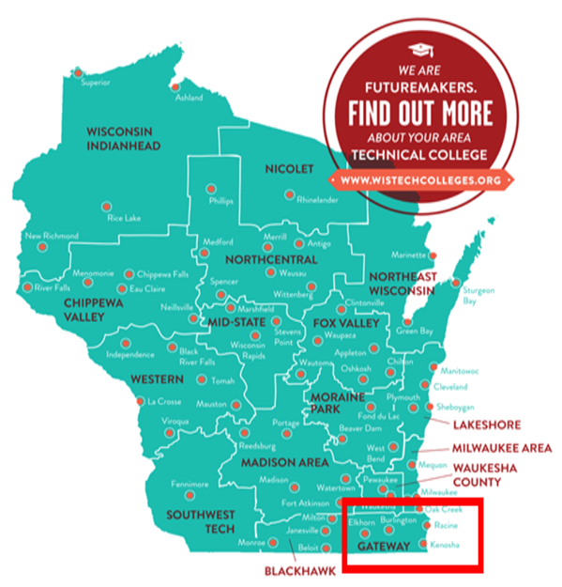
Gateway Facts
One of 16 colleges in the Wisconsin Technical College System
Founded in 1911
Serve approximately 20,000 students annually
Three main campuses split across a tri-county district
Five discipline-specific technology centers
Serve 35 public and private high schools; 14 public school districts
Including 3rd Largest District: Kenosha Unified & 5th Largest District: Racine Unified
Guided Pathways School
Notes:
Ray

Slide 4
Career Pathways
Intentional focus on designing systems in 2015
Use WTCS-approved pathway credentials (certificates and diplomas) to build entry and exit points
20 certificates - 2-18 credits, first year of program
15 diplomas - 2-54 credits, more flexibility
Developed with employers, lead to in-demand jobs in our district
Require no or very little prior experience
Most courses were already being offered for transcripted credit in the high schools
Notes:
Jaime

Slide 5
Career Pathway Maps
Launched in 2016 to highlight all pathway-related options for each program
Expanded to all programs, including apprenticeship
64 total maps; new maps are added as programs are developed
Updated annually to reflect changes in options, salary information, etc.
High school partners are provided with a bound, color copy as well as access to electronic versions
Notes:
Jaime

Slide 6
Notes:
Jaime

Slide 7
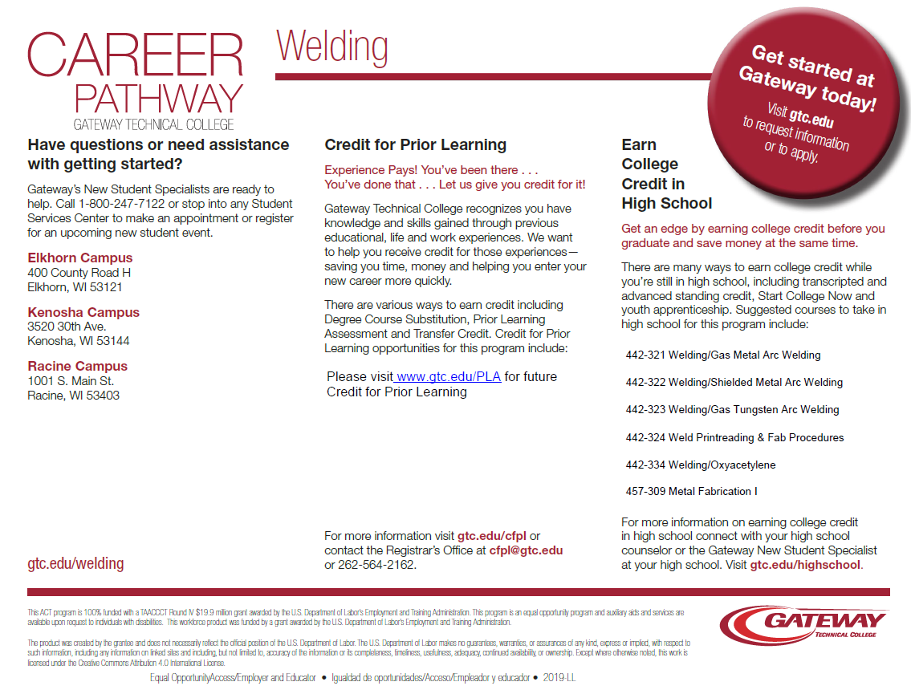
Notes:
Jaime

Slide 8
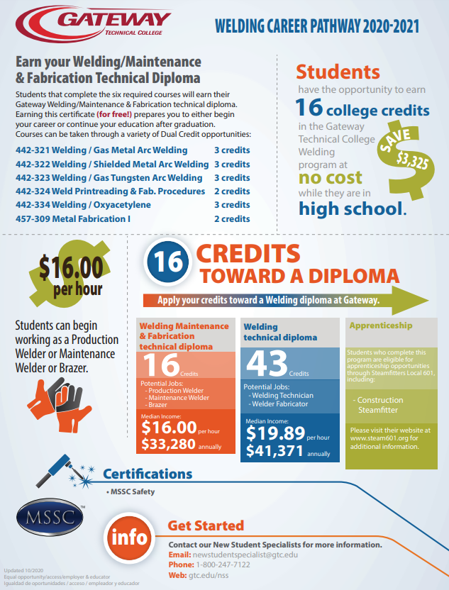
High School Infographics
Designed for specific event, but high school partners requested for all pathways
Print in various sizes
Displayed in high school hallways and classrooms
Updated annually to match pathway maps
Notes:
Jaime

Slide 9
A Strong Partnership Between
Pathways and Dual Credit
Partner together on pathway-specific recruitment events
Target courses that are part of pathway credentials to offer to the high schools
Collaborate on infographics and other pathways/high school materials
Present on pathways to the career prep consortium and high school administrators
Leverage pathway systems to target grants
Notes:
Jaime

Slide 10
Gateway Supporting High Schools through Dual Credit
Gateway’s Dual Credit Opportunities:
Transcripted Credit
Career Pathway Grants
Advanced Standing
Start College Now
Contract For Service (38.14)
High School Academies
Youth Apprenticeship
VANguard (Distance Learning)
Notes:
Katie

Slide 11
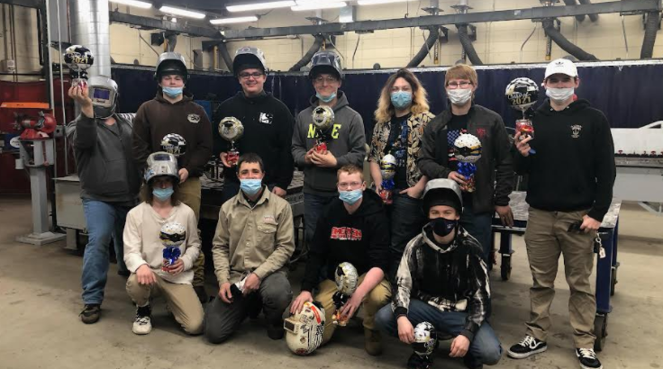
High School Academies
High school students are dually enrolled in courses that lead to certifications and stackable credentials with the opportunity to graduate from Gateway Technical College before graduating from high school. Available programs in 2021-2022:
CNC
Criminal Justice
General Studies
IT-Data Analytics
Nursing
SMART Manufacturing
Welding
Gateway Technical College- High School Academies
Notes:
Ray
Ray introduces video (hearing from two of our students)

Slide 12
High School Academies
High School Academies include:
Sequence of courses leading to a stackable credential (ACT 59/CTE Incentive Eligible)
Students can continue on at Gateway furthering their career path
Courses taught at Gateway’s campuses & centers by Gateway faculty
At high school with appropriate equipment/lab space
Courses are scheduled with a high school students’ schedule in mind (start or end their day at Gateway)
Students are considered dual credit students, earning both high school & college credit
Students have access to same services as Gateway’s students including tutoring, disability support, etc.
Transportation not included
Notes:
Katie

Slide 13
Funding
Grant funded
2018-2019 piloted with a Department of Workforce Development Grant
Private donor funded
2020-2021 partnered with Gateway’s Foundation to have a private donor fund an Academy
High school pays tuition/fees and textbook costs
Once high schools see the success & difference it’s having they are willing to fund it!
Work with districts & high schools to budget for it
High schools sending average 4 students each year
2020-2021: Private high school is funding 40 students through their own fundraising efforts
“Three years ago, we had one student attend the Welding Academy. His welding helmet was the best advertisement for the program because he carried it with him always. Kids noticed it and asked about it. Sure enough, the following year we had a lot more students sign up for the program and they all carried their welding helmets attached to their backpacks. They were so proud of them and they carried them like varsity jackets. They knew they were learning important skills and they loved their instructor. They wanted everyone in the building to know they were part of something special.” -Maria Kotz, Principal
Notes:
Katie

Slide 14
Pilot: 2018-2020 HS Welding Academy
Six Gateway courses offered over three semesters: 16 credits & an additional MSSC Safety class
Books, Welding Kit & Supplies funded through DWD Fast Forward High School Student Certification Grant
Certifications Earned:
30 High School Gateway Welding Maintenance & Fabrication Technical Diploma Graduates
80% Success Rate
11 Students were juniors when they graduated from Gateway
Students have opportunity to continue their education at Gateway
Additional Options Certifications: MSSC Safety Certification & Youth Apprenticeship
Continuing Welding Post Pilot Year:
Waterford Union HS offering classes at their high school
New Cohort Started at Racine & Elkhorn Campuses
Condensed the program to two semesters
Courses only three days a week for five hours
High schools paying tuition/fees/book costs
Notes:
Ray

Slide 15
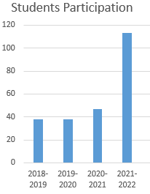
Positive Impact
High school students are graduating with credentials from Gateway prior to graduating from high school
Students are employable and are able to enter the workforce
Students are continuing on at Gateway immediately after graduation
81% of 2021 High School Academy graduates are accepted to Gateway for Fall 2021
Increase direct enrollments at Gateway Technical College
42% of 2021 High School Academy Graduates are
direct enrolled in at least one course this academic year
Interest is increasing in High School Academies!
Estimated Tuition & Fees from HS Academies
(2018-2022): $520,000
Student participation increased by 197% since first year!
Notes:
Katie

Slide 16
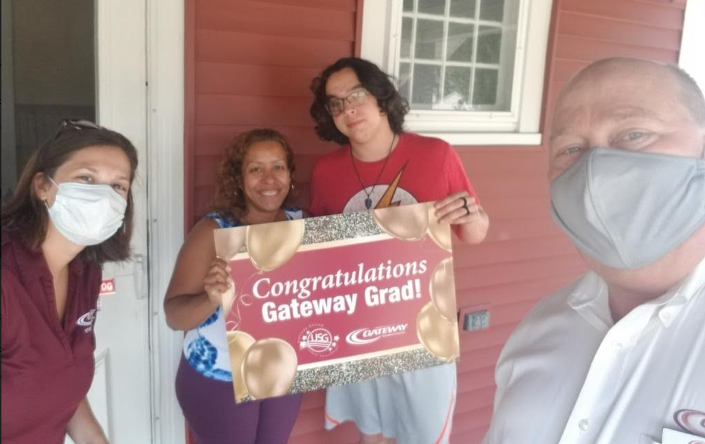
Positive Impact: Parents, Students & Community
“For Jacob, this was a game changer. He didn’t know anything about welding, but he connected with his instructors right away, he knew some of the students who were from his high school and we was able to do his work on a technical college campus. I can’t say enough on how well he has done with this.” -Michelle Allender, parent
“Sparking Success Early” STUFF Magazine: Ethan Schaefer
“The Double-Double Graduate” CTE Newsroom: Jacob Allender
“Badger Student Graduates College, High School” Lake Geneva News: Trevor Statdfield
Notes:
Ray: Jessica & her son Aiden

Slide 17
Best Practices & Resources
Gateway Technical College Resources:
Welding Career Pathway Map
Welding Infographic
HS Academy Flyer: Welding
HS Academy Application
HS Academy Information Night Presentation
Gateway Technical College HS Annual Report 2019-2020
gtc.edu/earn-credit
Gateway Technical College Contacts:
Katie Graf grafk@gtc.edu
Director, High School Partnerships
Ray Koukari koukarir@gtc.edu
Dean, School of Manufacturing, Engineering & IT
Jaime Spaciel spacielj@gtc.edu
Director, Career Pathways & Program Effectiveness
Notes:
Jaime

Slide 18
What additional information
can we share?
QUESTIONS?

